Slide 1
THE
PRICE
of
research
Cancer Checkout
Notes:
Adapted from the CURES project created by Sami Alrashed & Carlos Eid, 2020
Adapted further to PowerPoint format by Krista Lucier

Slide 2
Why Do We Need Research?
Innovation
New treatments and therapies are able to be brought to our communities
Improvement
Diagnostic advances are made to improve cancer detection and prevention
Impact
Research trains future students and helps to retain a community of bright professionals

Slide 3
Research Works!
Effective
63% of those diagnosed with cancer today will survive beyond 5 years, compared to 30% in the 1960s
Enhances
Patients treated at health institutions that are engaged in active research live better and longer

Slide 4
Realities of Research
Time Consuming
There are many components to research, and each requires lots of time, training, and
funding
Costly
Equipment requires maintenance, software updates, and skilled operators, which can get expensive!

Slide 5
How Much Does Research Cost?
Conducting cancer research is a long and expensive process. Even the smaller items needed in the lab are often taken for granted.
The following slides feature common pieces of equipment found in cancer research labs. It is your job to figure out how much they cost.
Click the amount you think is correct and see the PRICE OF RESEARCH!
Let’s get started! Good luck! →

Slide 6
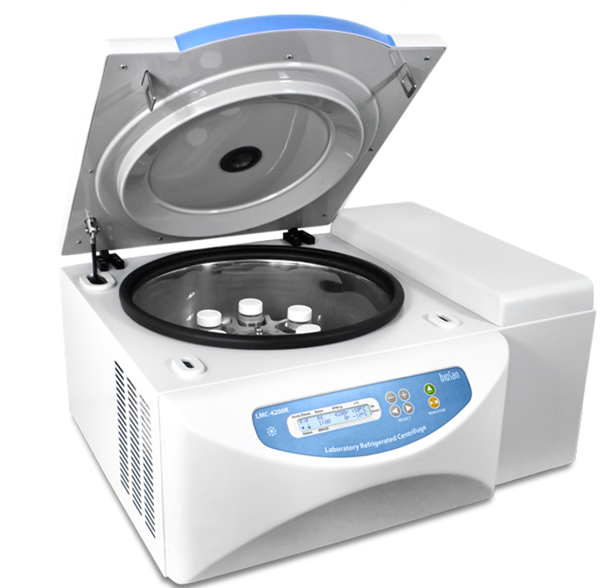
Centrifuge
A centrifuge spins samples or solutions using a force that separates components based on density. Centrifuges vary in size, power, and price, and each version is used for specific samples or types of research.
$100
$500
$1,000
$5,000
$10,000
$15,000

Slide 7
Sorry!
That’s Incorrect
← Try again!

Slide 8
That’s correct!
Well Done!
Continue →

Slide 9
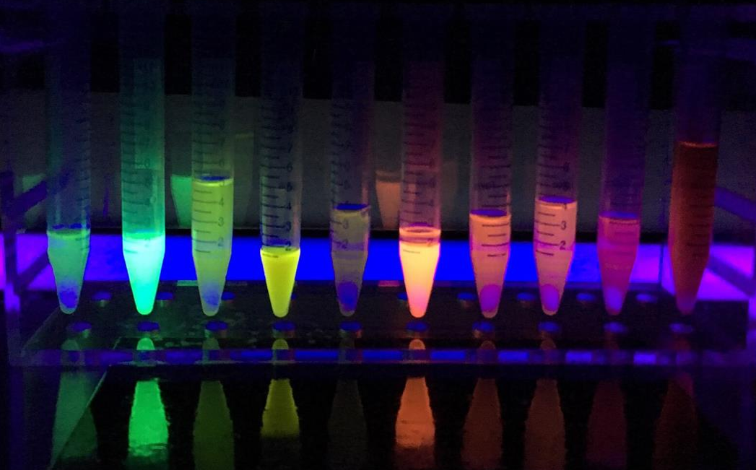
Reagents and Enzymes
A reagent is a substance added to a system to initiate a chemical reaction, or added to test to determine if a reaction has occurred.
Enzymes are proteins that act as biological catalysts. Catalysts accelerate chemical reactions.
$50
$200
$400
$1,000

Slide 10
Sorry!
That’s Incorrect
← Try again!

Slide 11
That’s correct!
Well Done!
Continue →

Slide 12
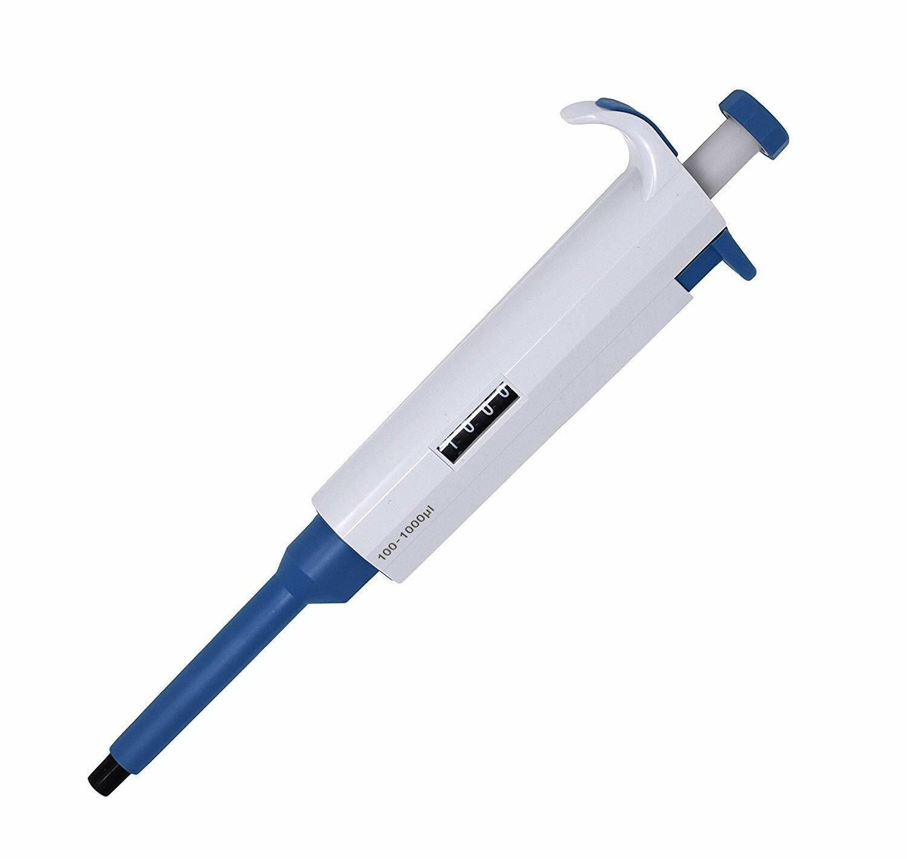
Micropipette
A micropipette is a laboratory tool commonly used in chemistry, biology, and medicine to transport a measured volume of liquid, often as a media dispenser.
$100
$200
$350
$400
$500
$550

Slide 13
Sorry!
That’s Incorrect
← Try again!

Slide 14
That’s correct!
Well Done!
Continue →

Slide 15
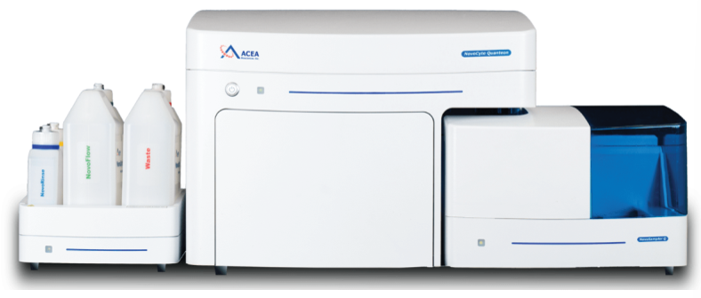
Flow cytometer
A flow cytometer is an automated instrument that can quantitate properties of single cells. Flow cytometers take in a suspension of cells and run them past a laser beam, one cell at a time. Then cell size, cell granularity, and amounts of cell components can be measured.
$25,000
$100,000
$250,000
$400,000

Slide 16
Sorry!
That’s Incorrect
← Try again!

Slide 17
That’s correct!
Well Done!
Continue →

Slide 18
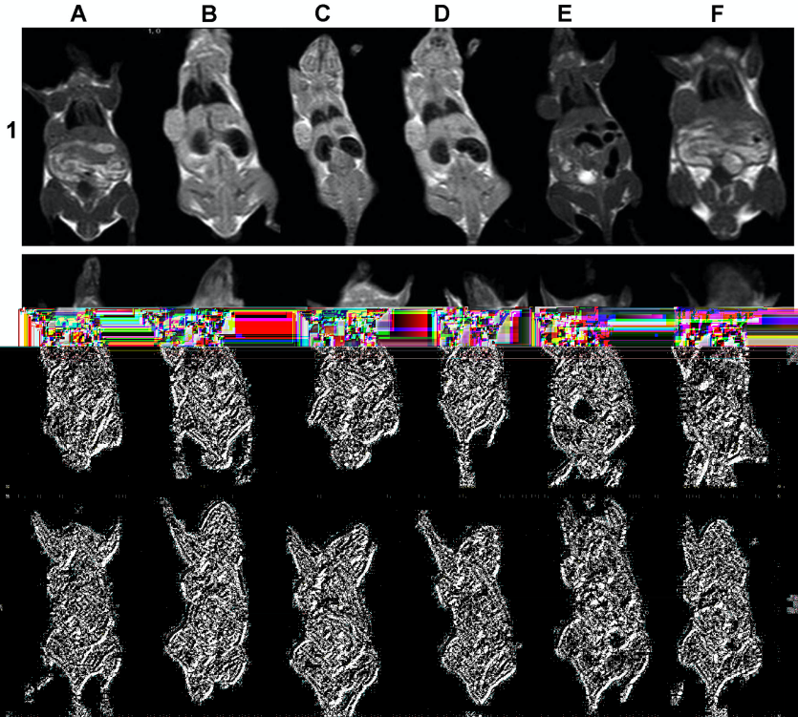
Compact MRI
Magnetic resonance imaging is a medical imaging technique used in radiology to form pictures of the anatomy and physiological processes of the body. MRI scanners use strong magnetic fields to generate images of the organs in the body.
$100,000
$350,000
$500,000
$1,000,000

Slide 19
Sorry!
That’s Incorrect
← Try again!

Slide 20
That’s correct!
Well Done!
Continue →

Slide 21
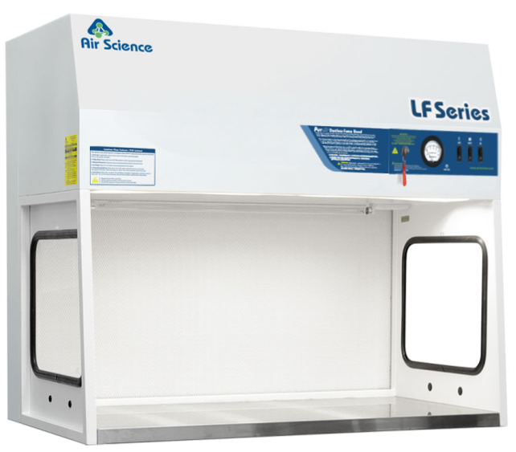
Fume Hood
A fume hood is a type of local ventilation device that is designed to limit exposure to hazardous or toxic fumes, vapours, or dusts.
$1,000
$5,000
$7,500
$10,000
$25,000
$40,000

Slide 22
Sorry!
That’s Incorrect
← Try again!

Slide 23
That’s correct!
Well Done!
Continue →

Slide 24
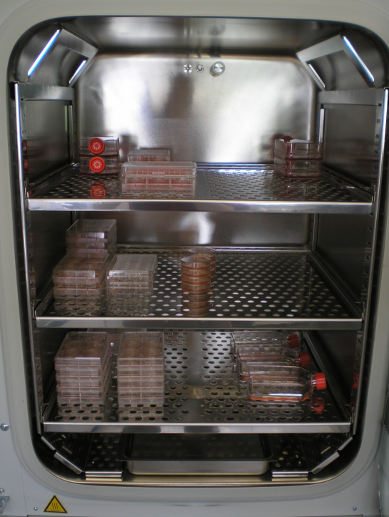
Cardon Dioxide (CO2) Incubator
CO2 Incubators mimic a cell’s natural environment, where the CO2 concentration is about 5%. It is controlled to match physiologic conditions including cellular pH. Incubators are used to maintain and grow cell cultures over time.
$2,000
$4,000
$5,000
$7,000

Slide 25
Sorry!
That’s Incorrect
← Try again!

Slide 26
That’s correct!
Well Done!
Finish →

Slide 27
Like what you see? Scan this QR code to give us feedback!
Without research, hope is just a word. Research allows us to continue to improve outcomes for patients and our community. Thank you for your support!
Thanks
for
playing
Notes:
Adapted from the CURES project created by Sami Alrashed & Carlos Eid, 2020
Adapted further to PowerPoint format by Krista Lucier

