Slide 1
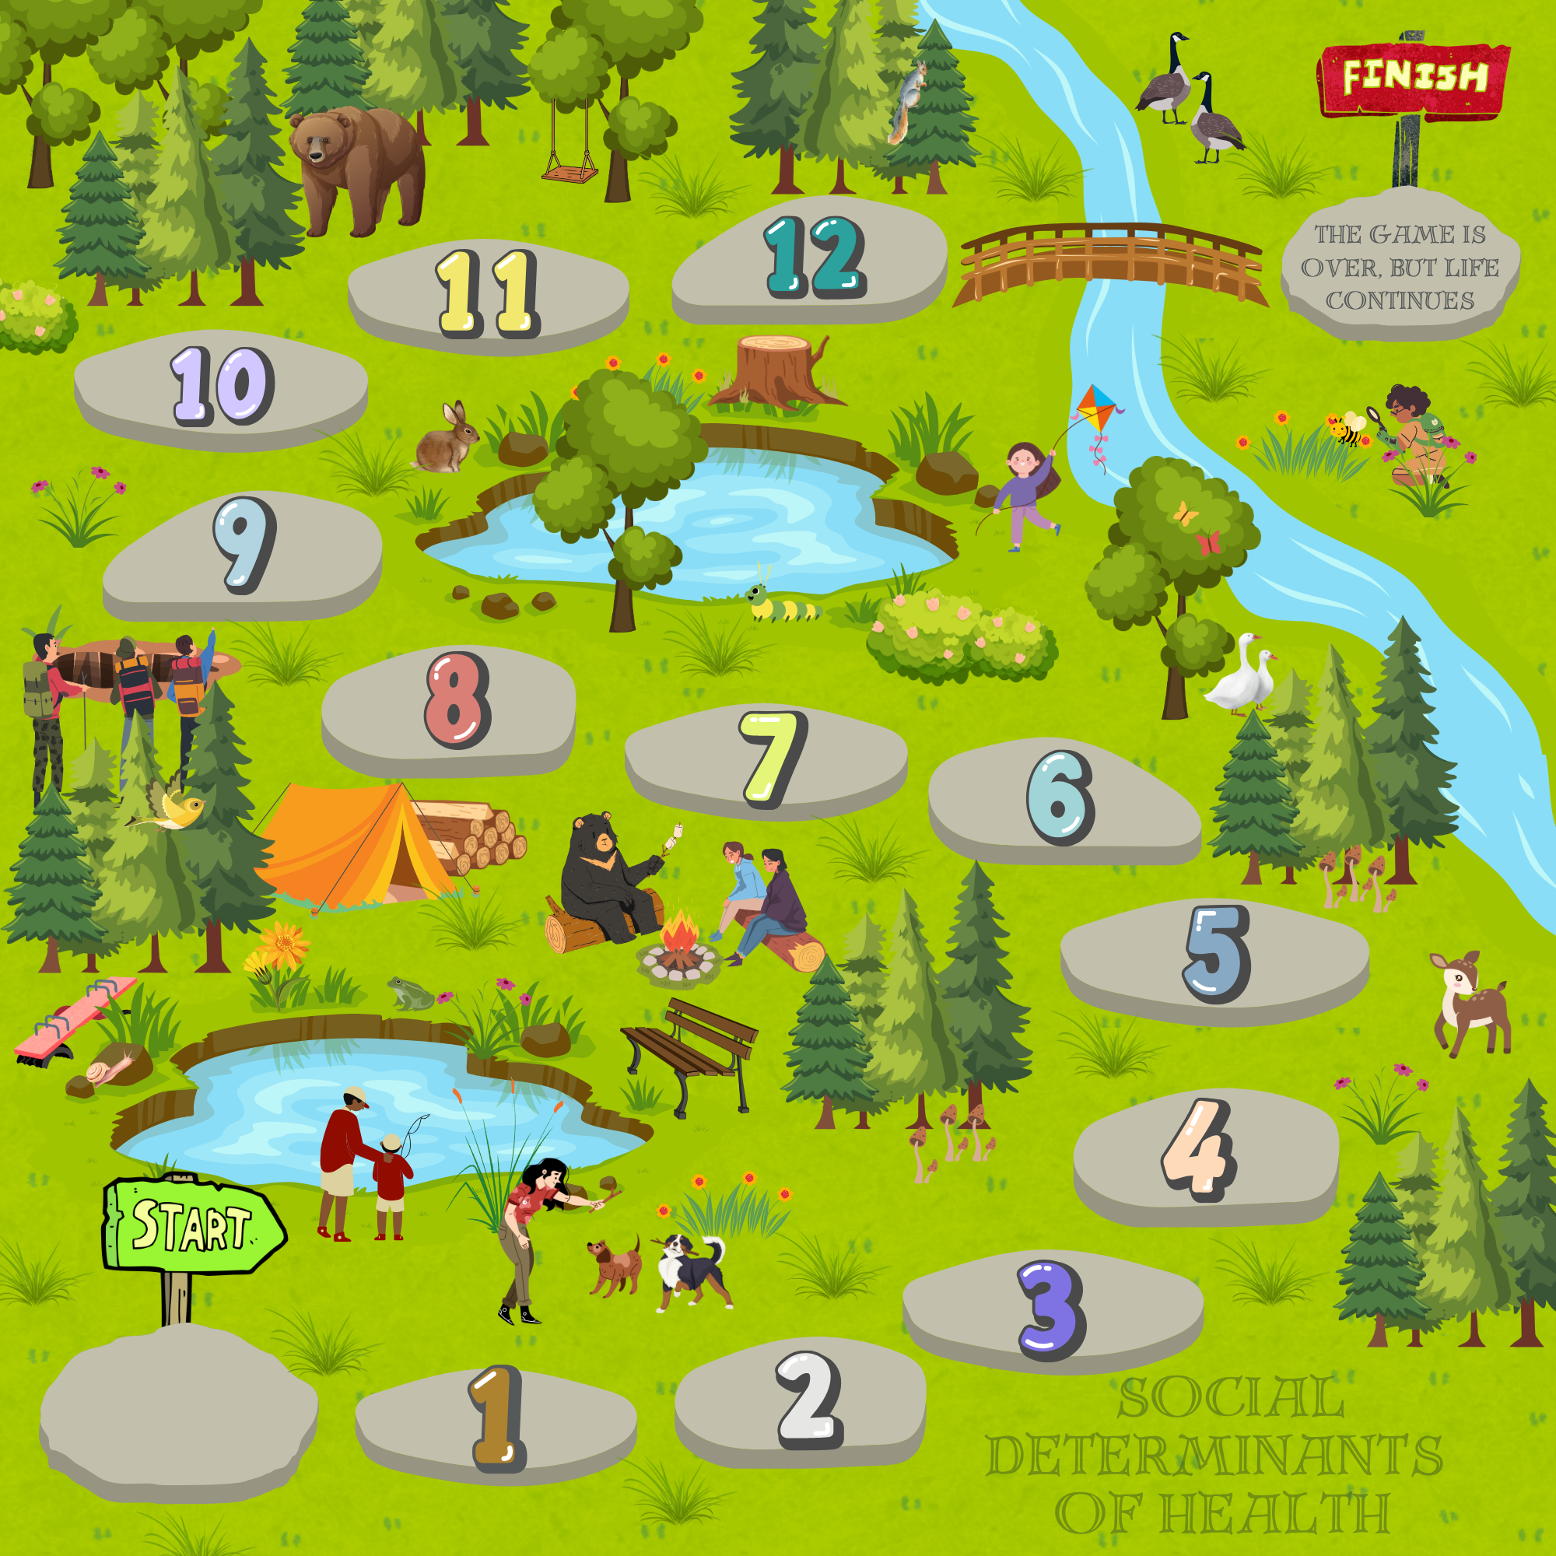


A game
“like”
Social determinants of health
Play →
Notes:
Created by: Amal Sleiman
Adapted by: Krista Lucier

Slide 2
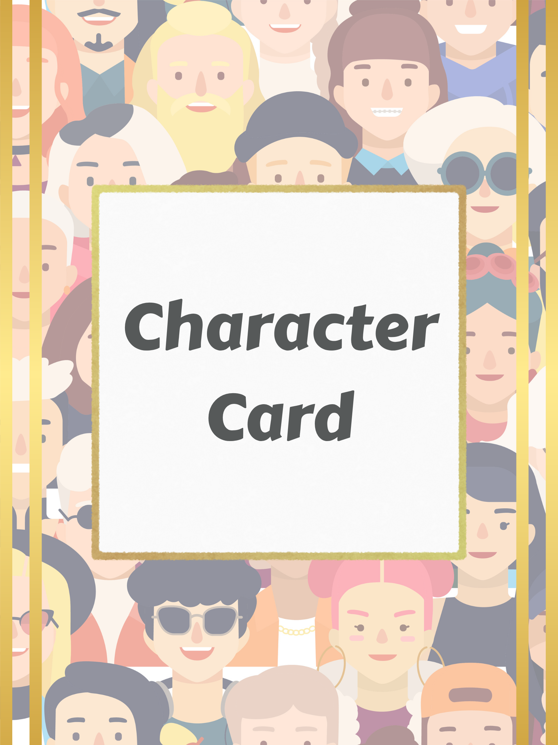
Choose your player!
1 2 3 4 5
6 7 8 9 10

Slide 3

What round are you on?

Slide 4
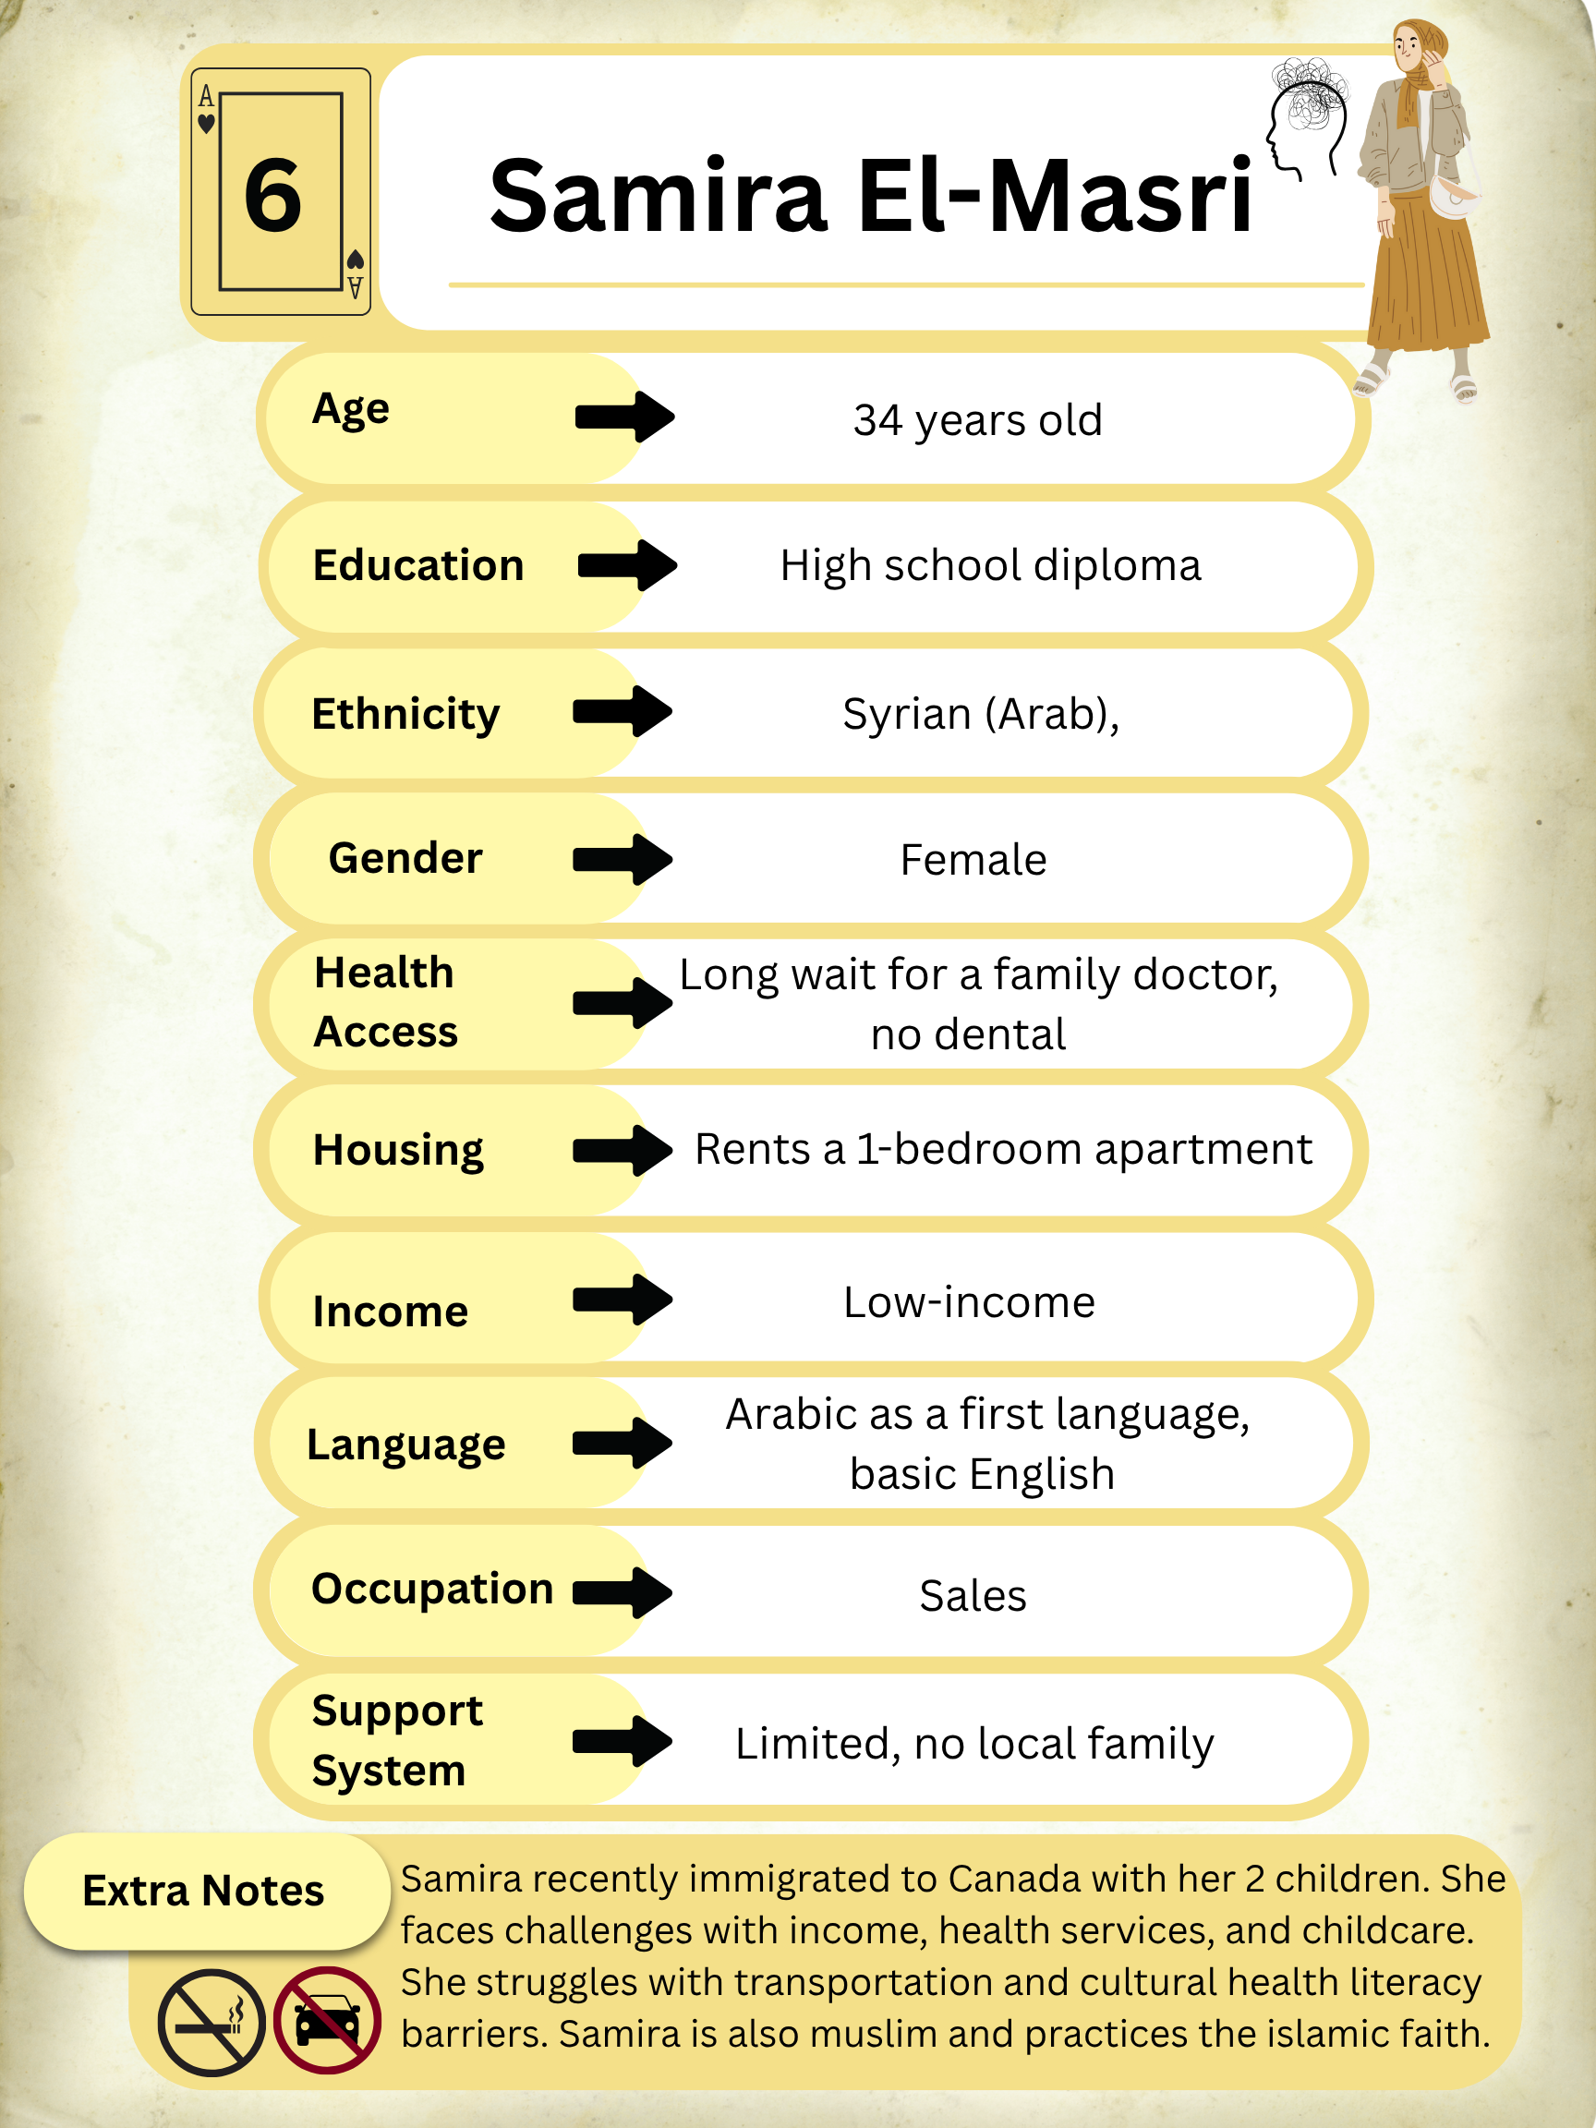
You Chose: Player 1
Samira is female, 34-years old, and Syrian
Samira does NOT smoke
Samira does NOT drive
Samira’s adverse childhood experience (ACE) score is 6
Take a photo of your character card to
remember your stats!
Add Player
←
Start game →

Slide 5
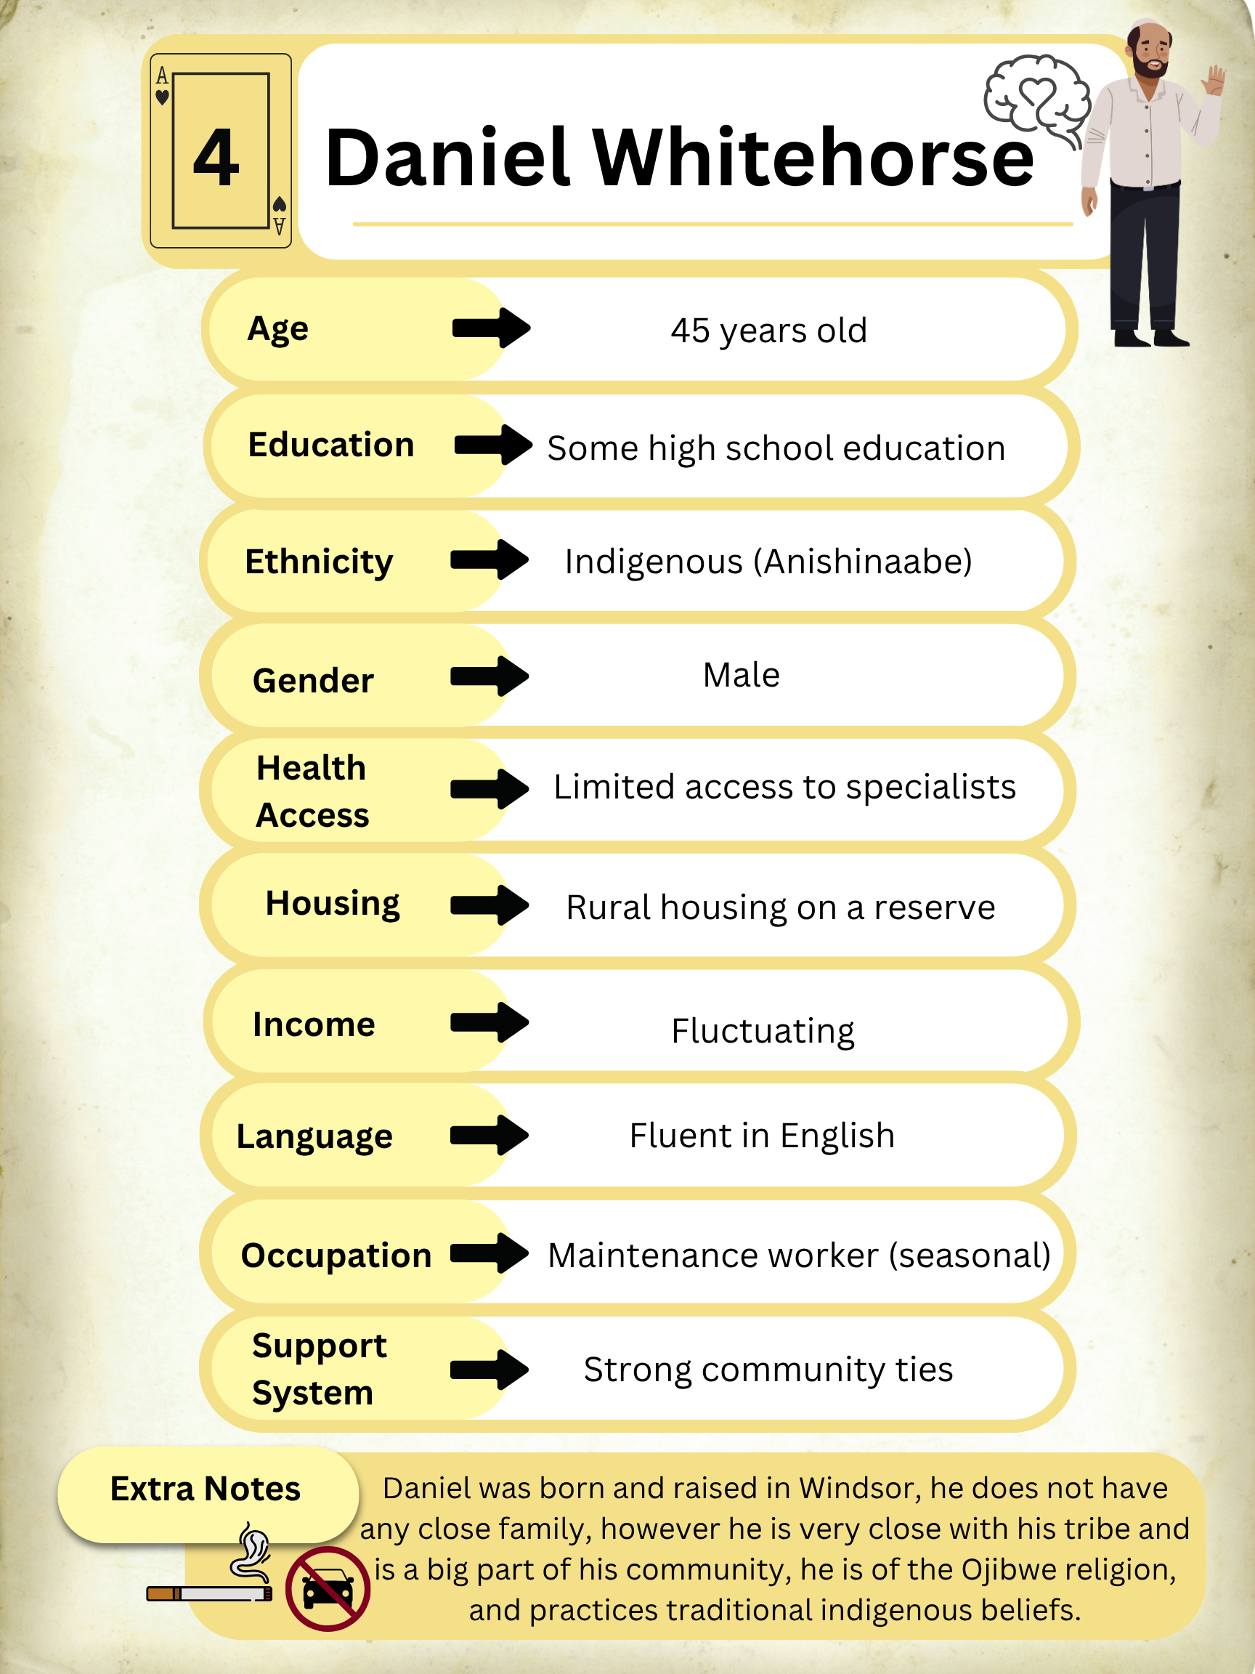
You Chose: Player 2
Daniel is male, 45-years old, and Indigenous
Daniel DOES smoke
Daniel does NOT drive
Daniel’s adverse childhood experience (ACE) score is 4
Take a photo of your character card to
remember your stats!
Add Player
←
Start game →

Slide 6
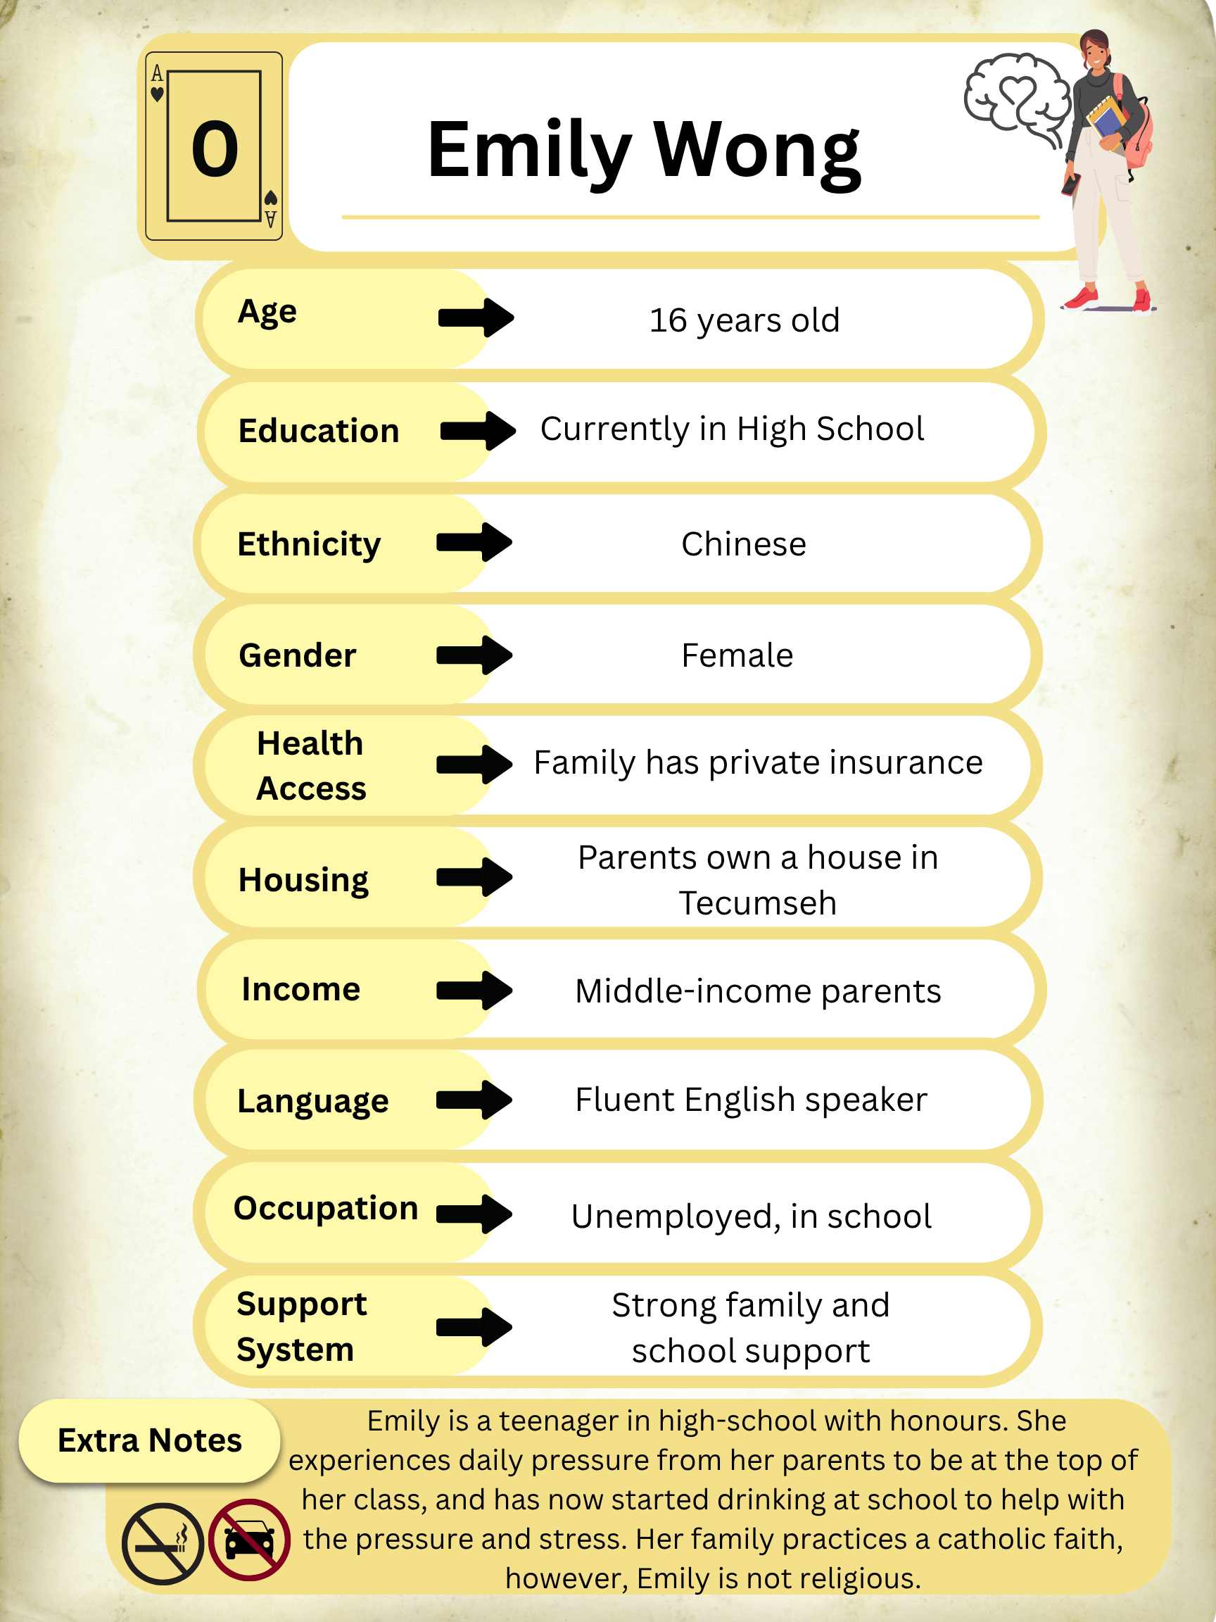
You Chose: Player 3
Emily is female, 16-years old, and Chinese
Emily does NOT smoke
Emily does NOT drive
Emily’s adverse childhood experience (ACE) score is 0
Take a photo of your character card to
remember your stats!
Add Player
←
Start game →

Slide 7
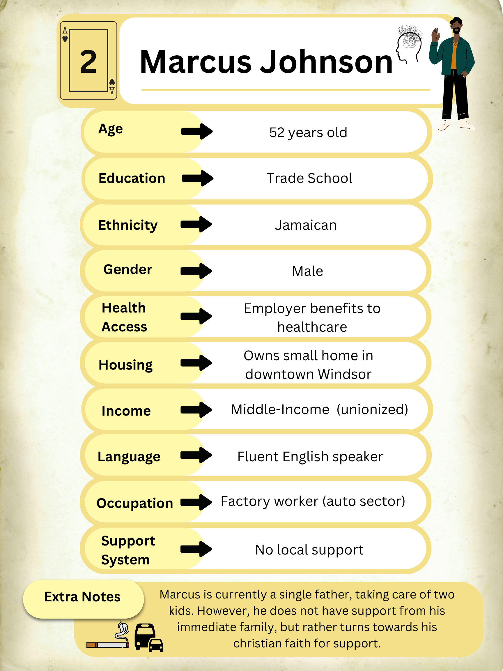
You Chose: Player 4
Marcus is male, 52-years old, and Jamaican
Marcus DOES smoke
Marcus has access to public transportation
Marcus’s adverse childhood experience (ACE) score is 2
Take a photo of your character card to
remember your stats!
Add Player
←
Start game →

Slide 8
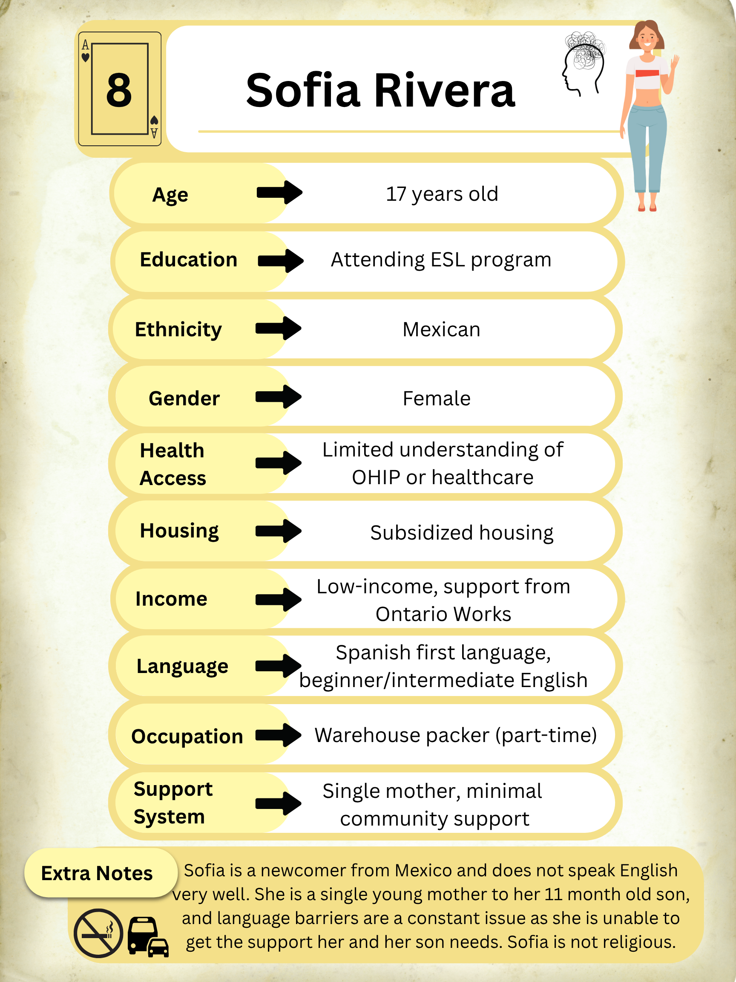
You Chose: Player 5
Sofia is female, 17-years old, and Mexican
Sofia does NOT smoke
Sofia has access to public transportation
Sofia’s adverse childhood experience (ACE) score is 8
Take a photo of your character card to
remember your stats!
Add Player
←
Start game →

Slide 9
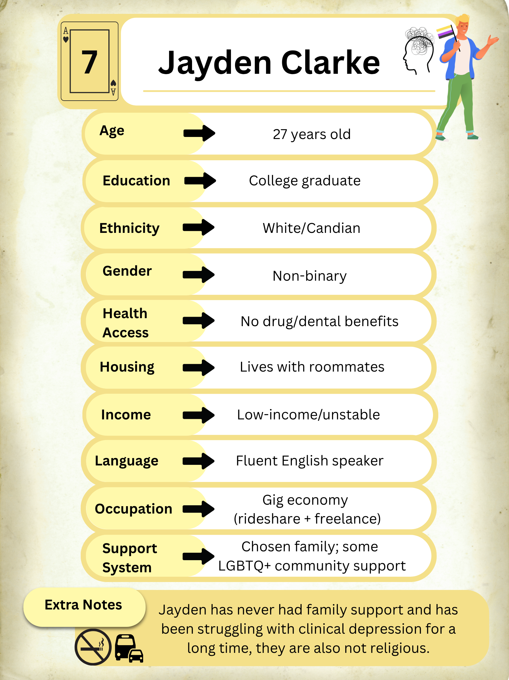
You Chose: Player 6
Jayden is non-binary, 27-years old, and White
Jayden does NOT smoke
Jayden has access to public transportation
Jayden’s adverse childhood experience (ACE) score is 7
Take a photo of your character card to
remember your stats!
Add Player
←
Start game →

Slide 10
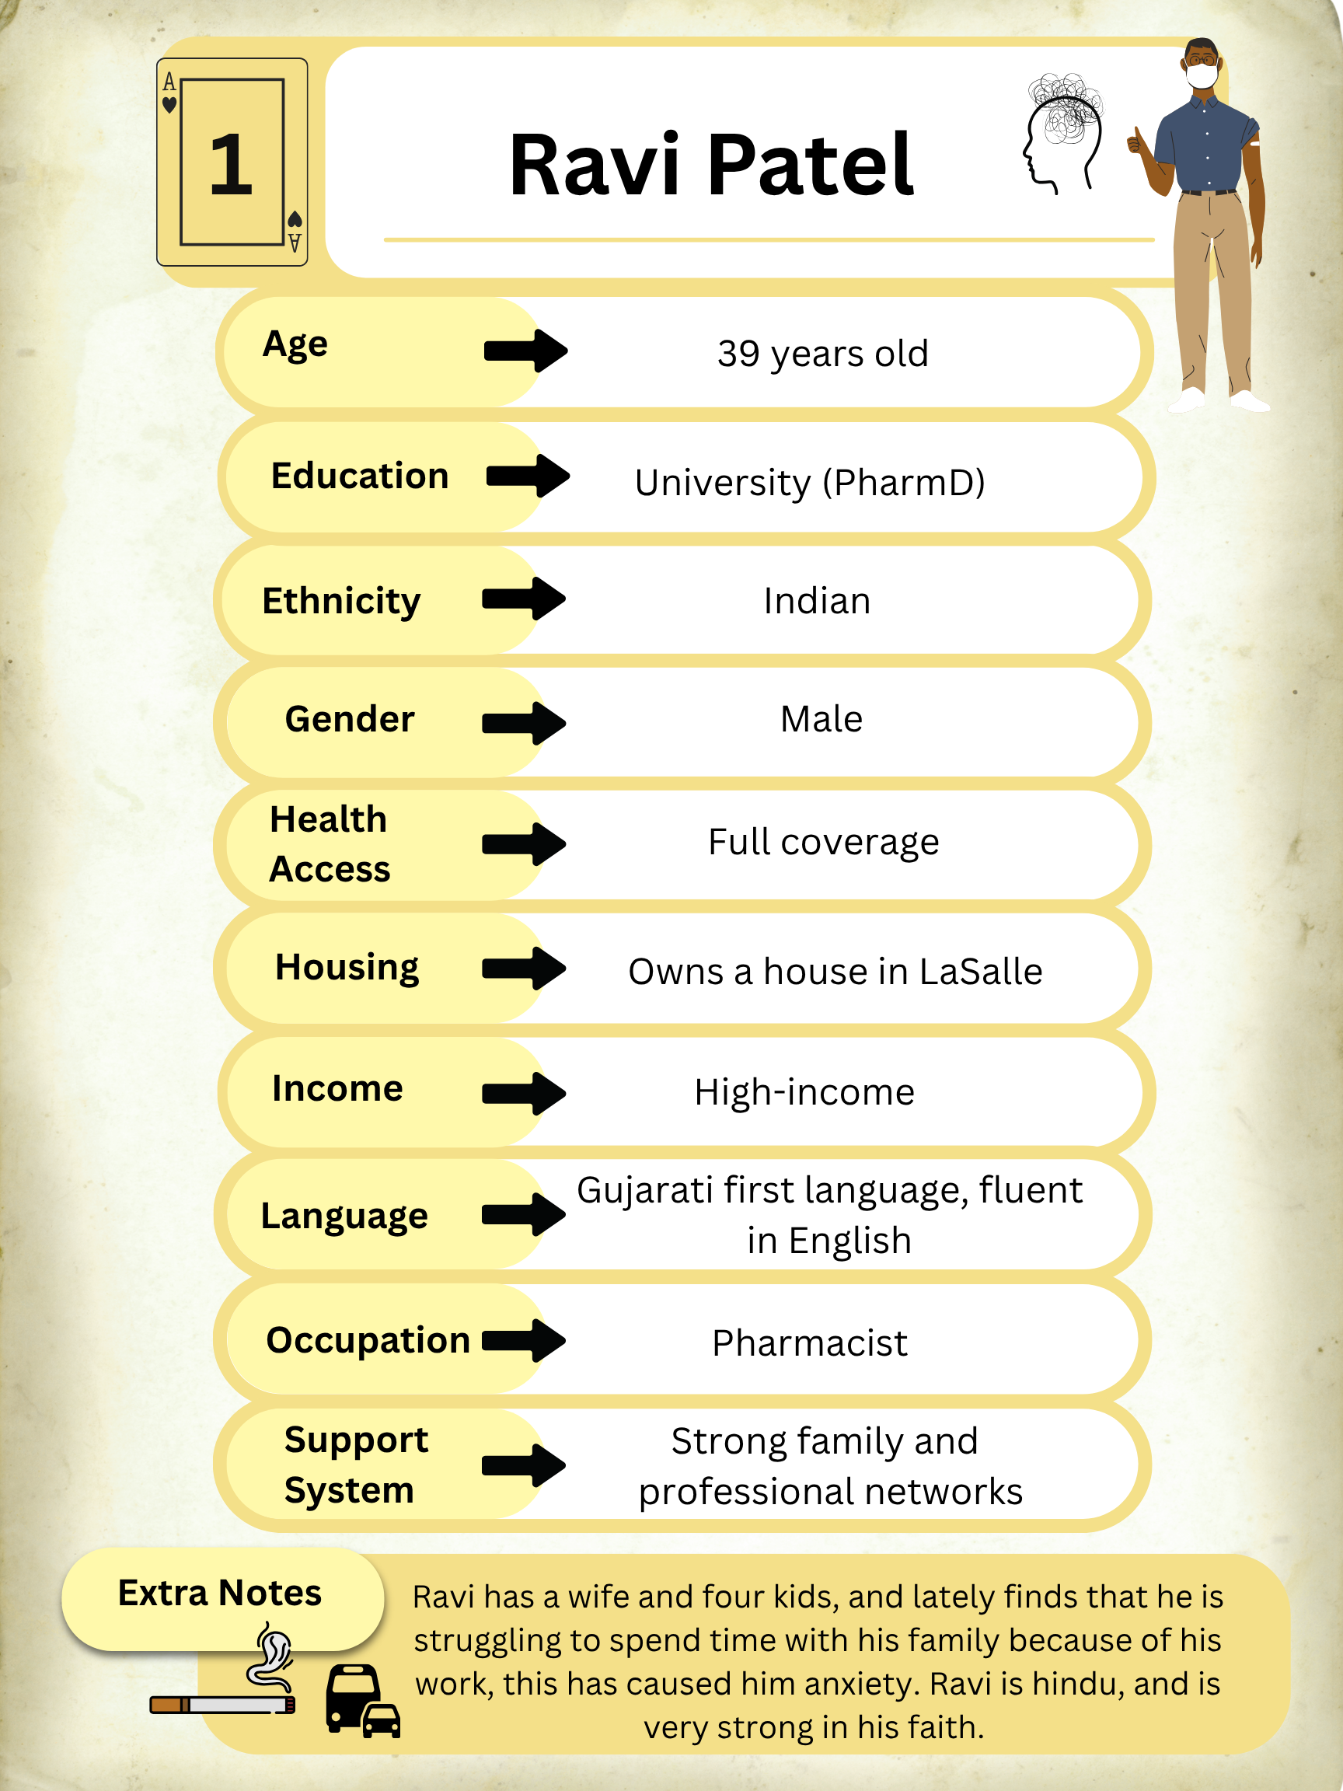
You Chose: Player 7
Ravi is male, 39-years old, and Indian
Ravi DOES smoke
Ravi has access to public transportation
Ravi’s adverse childhood experience (ACE) score is 1
Take a photo of your character card to
remember your stats!
Add Player
←
Start game →

Slide 11
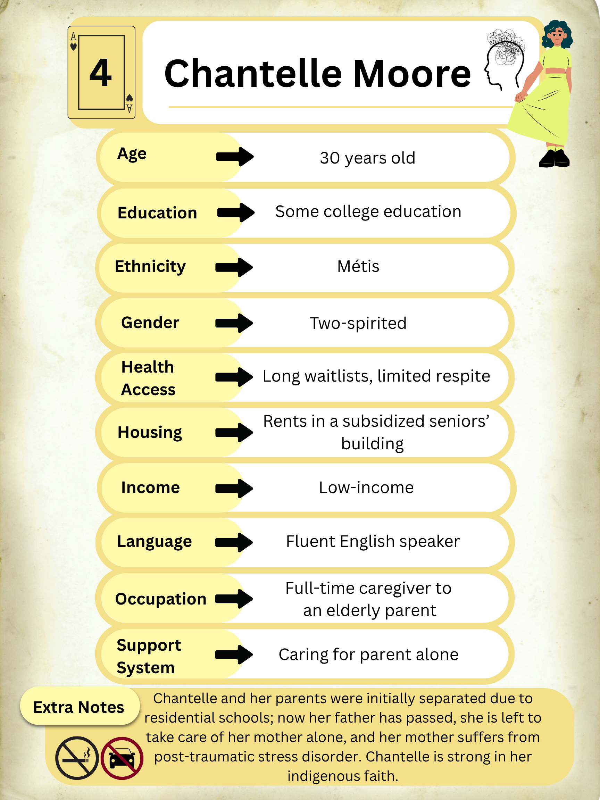
You Chose: Player 8
Chantelle is two-spirited, 30-years old, and Métis
Chantelle does NOT smoke
Chantelle does NOT drive
Chantelle’s adverse childhood experience (ACE) score is 4
Take a photo of your character card to
remember your stats!
Add Player
←
Start game →

Slide 12
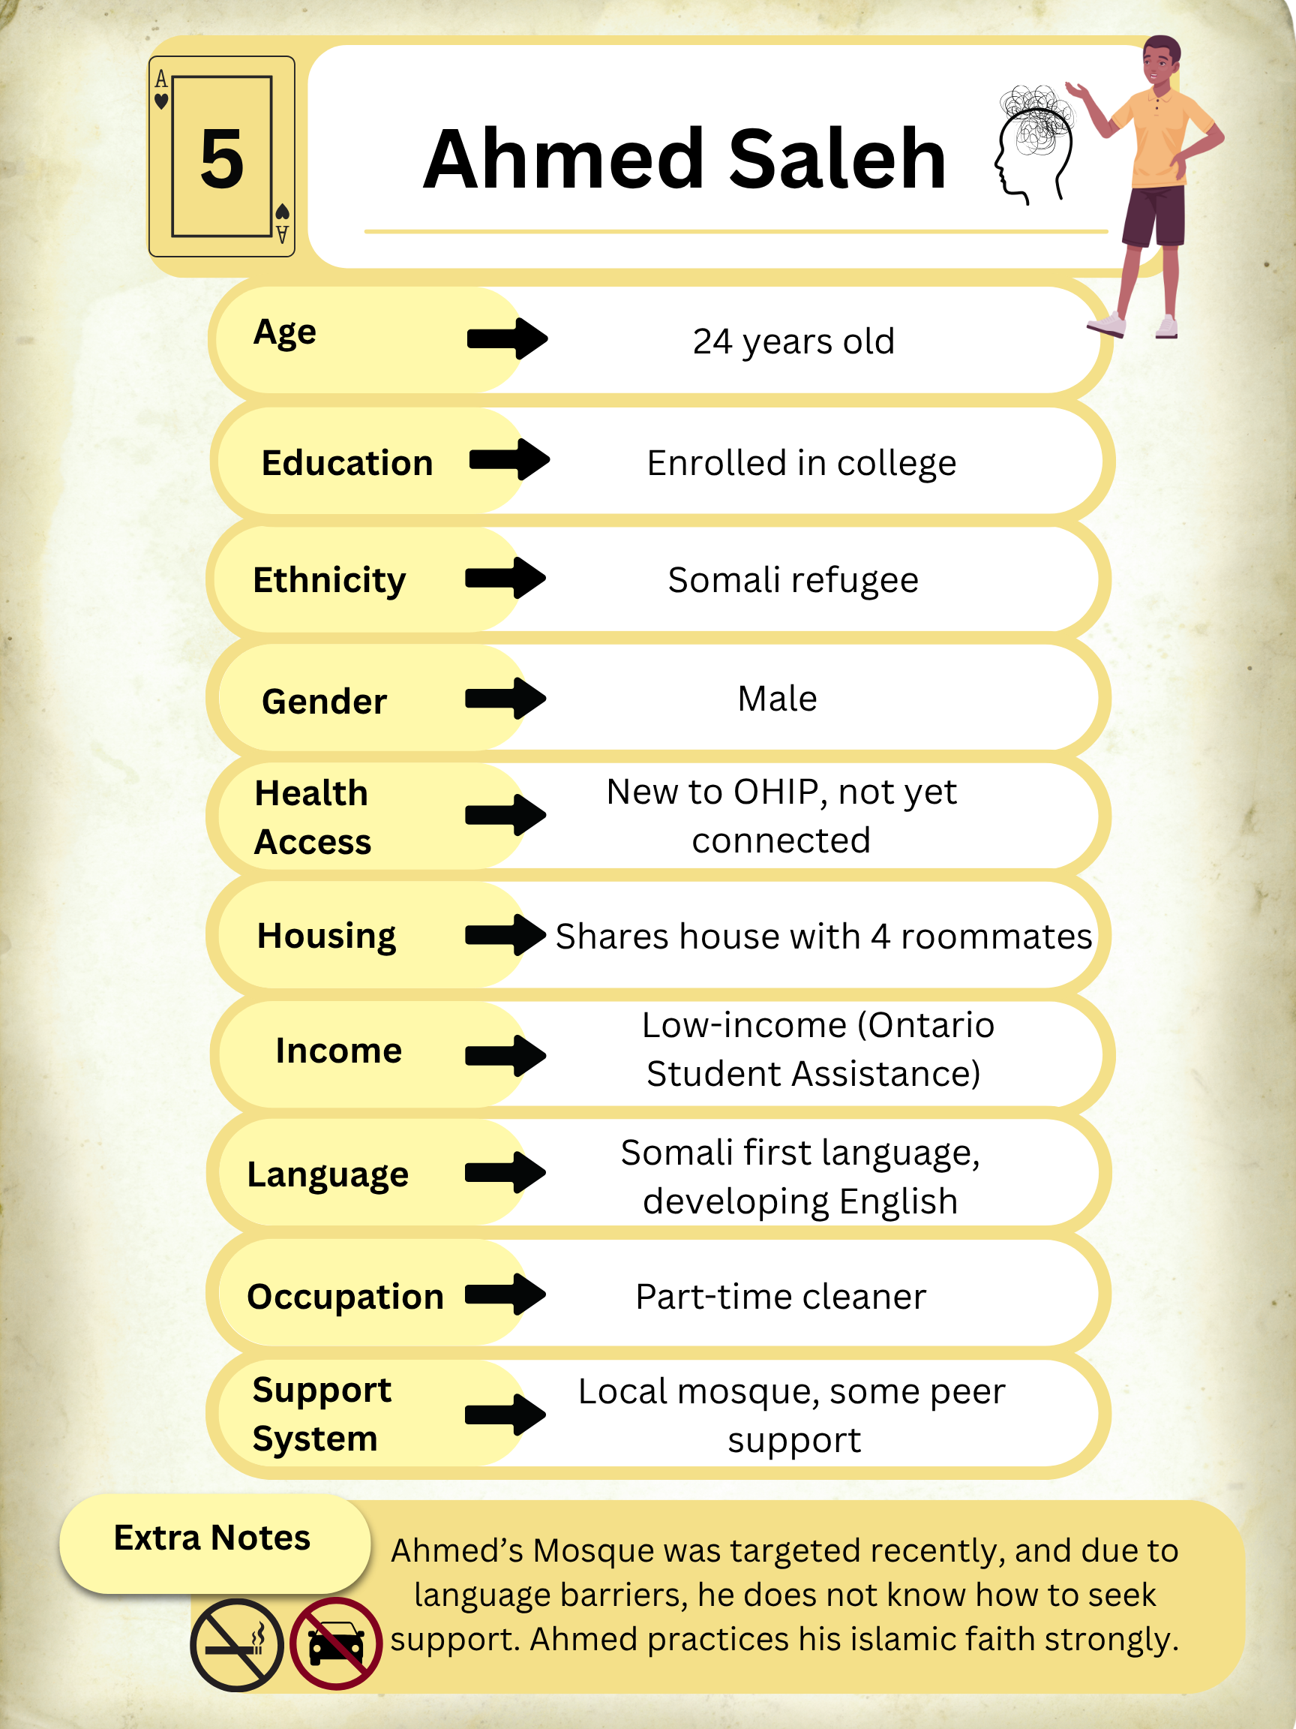
You Chose: Player 9
Ahmed is male, 24-years old, and Somalian
Ahmed does NOT smoke
Ahmed does NOT drive
Ahmed’s adverse childhood experience (ACE) score is 5
Take a photo of your character card to
remember your stats!
Add Player
←
Start game →

Slide 13
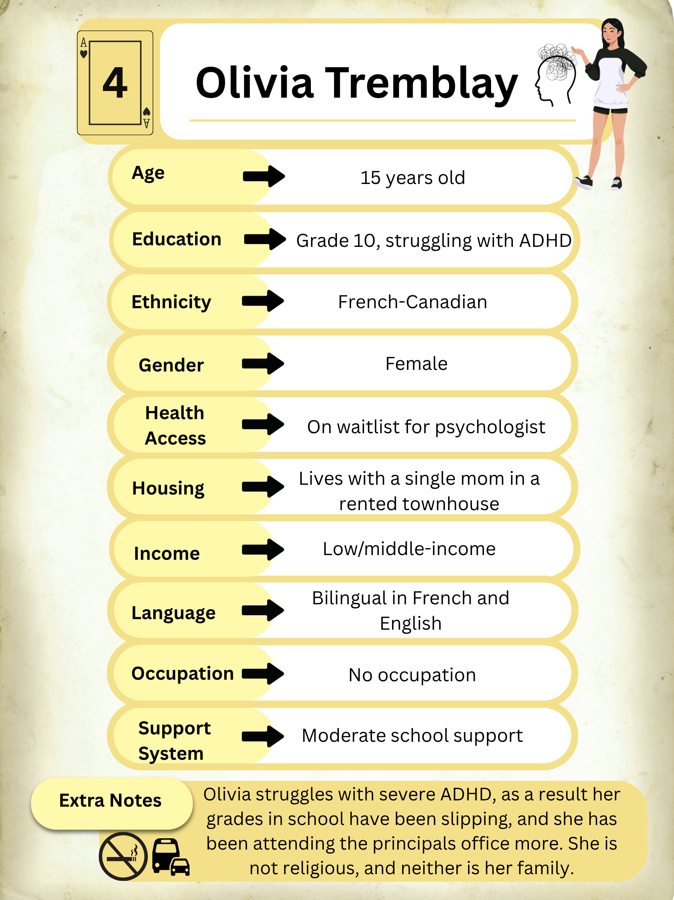
You Chose: Player 10
Olivia is female, 15-years old, and French-Canadian
Olivia does NOT smoke
Olivia has access to public transportation
Olivia’s adverse childhood experience (ACE) score is 4
Take a photo of your character card to
remember your stats!
Add Player
←
Start game →

Slide 14

Round 1
Go!

Slide 15
Round 1: Choose your Card!
1 2 3 4
5 6 7 8

Slide 16
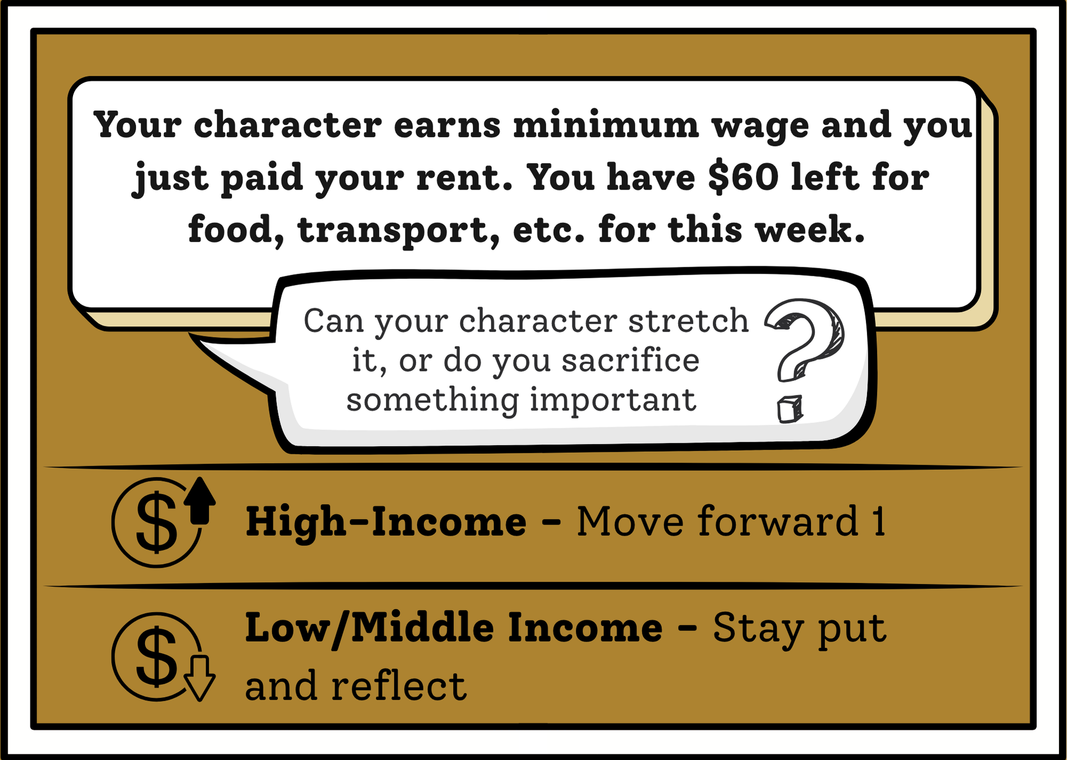
You Chose: card 1
Choose round

Slide 17
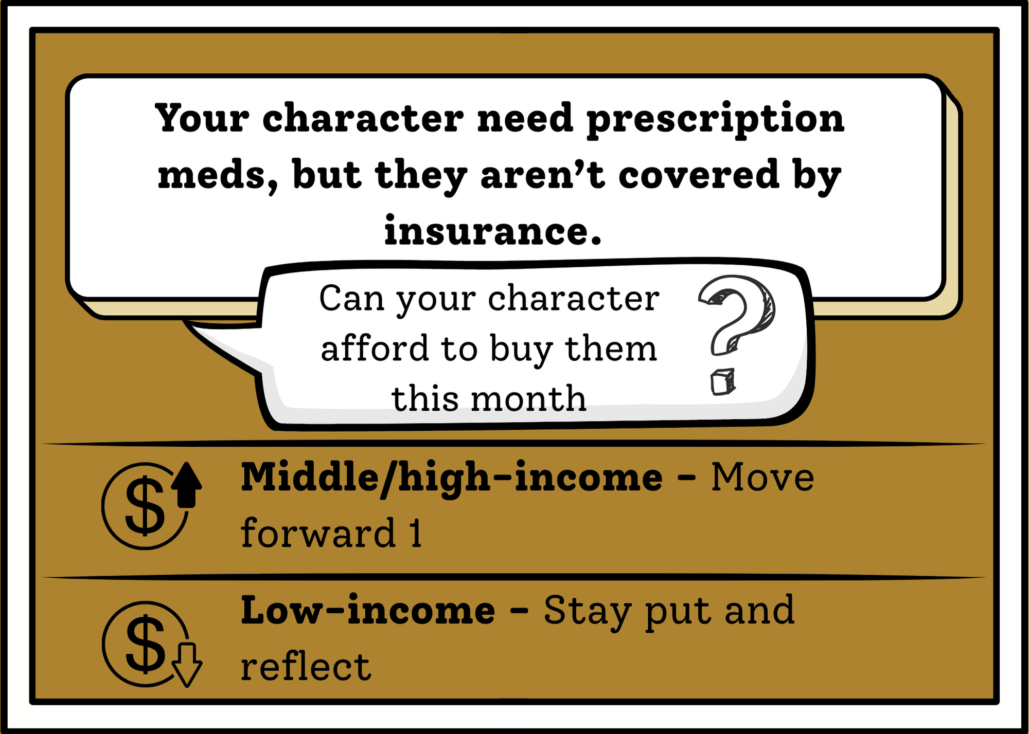
You Chose: card 2
Choose round

Slide 18
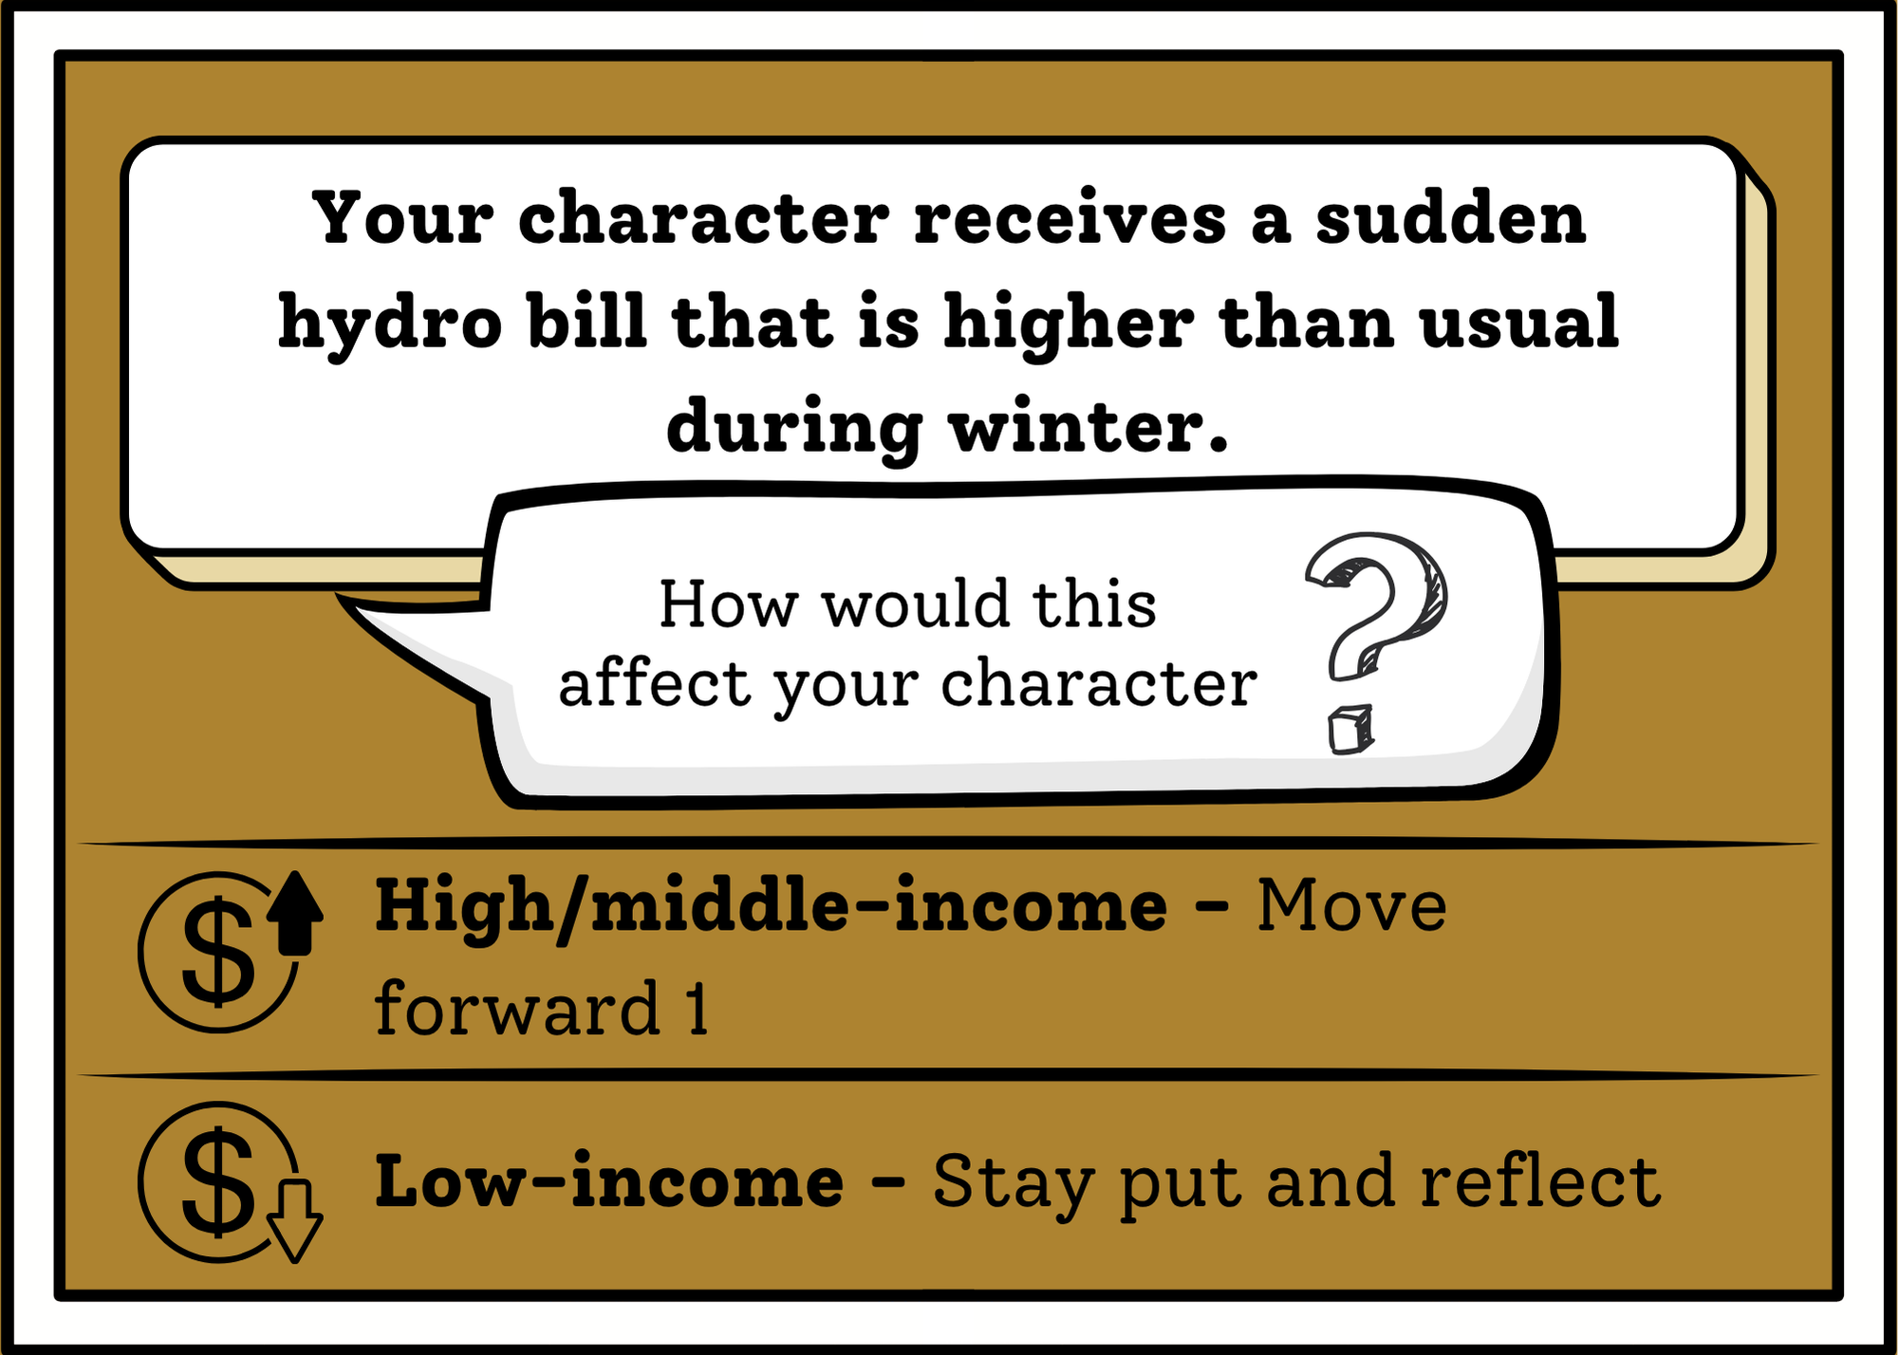
You Chose: card 3
Choose round

Slide 19
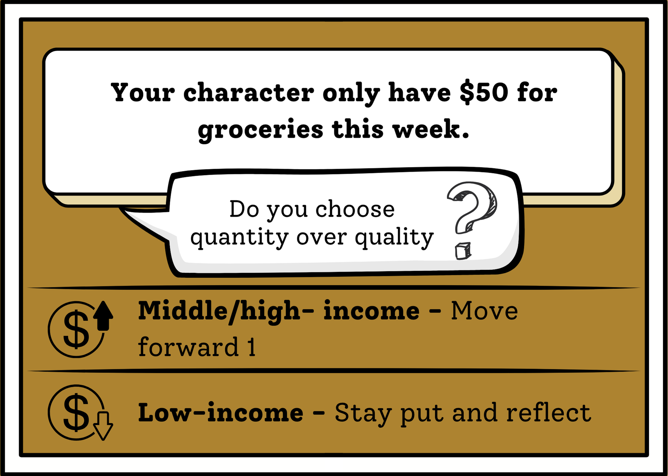
You Chose: card 4
Choose round

Slide 20
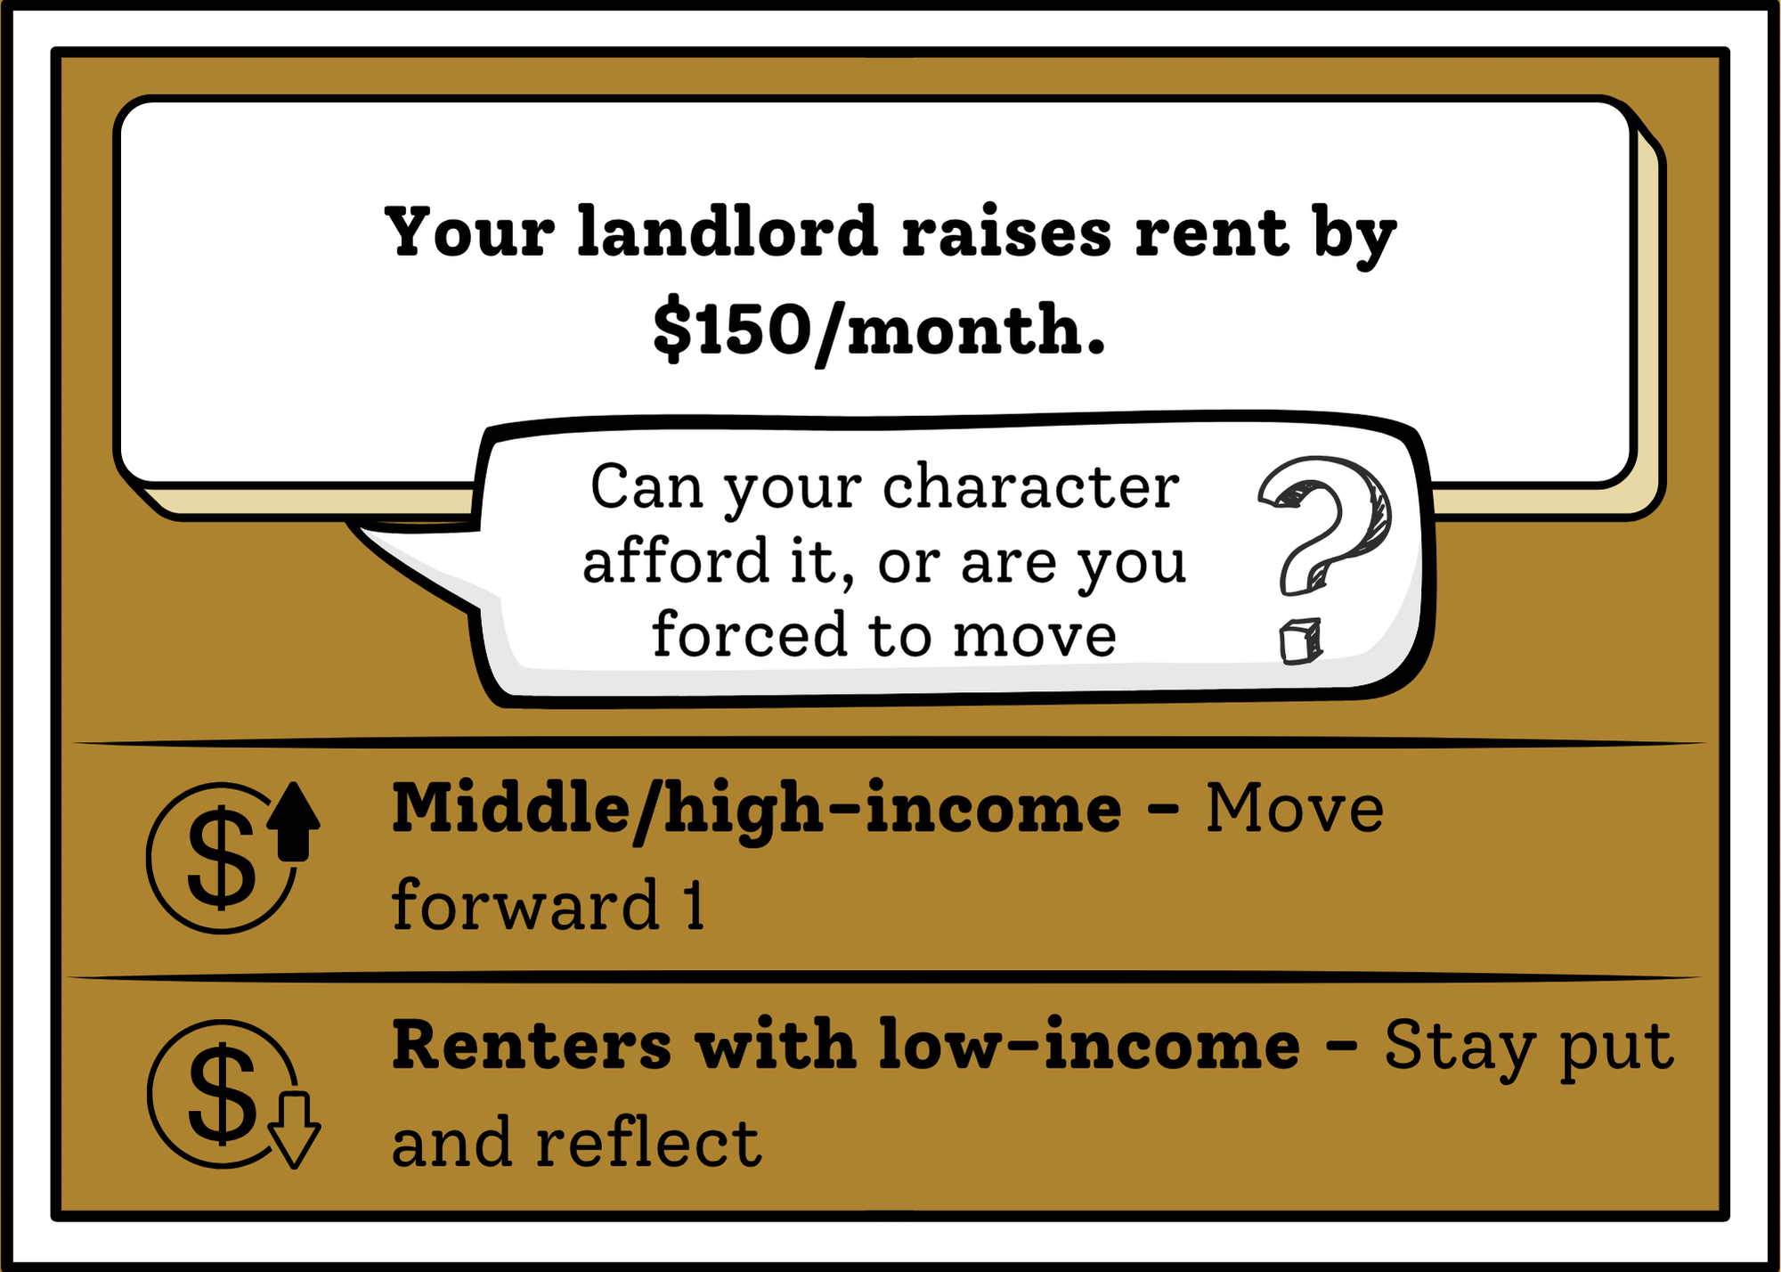
You Chose: card 5
Choose round

Slide 21
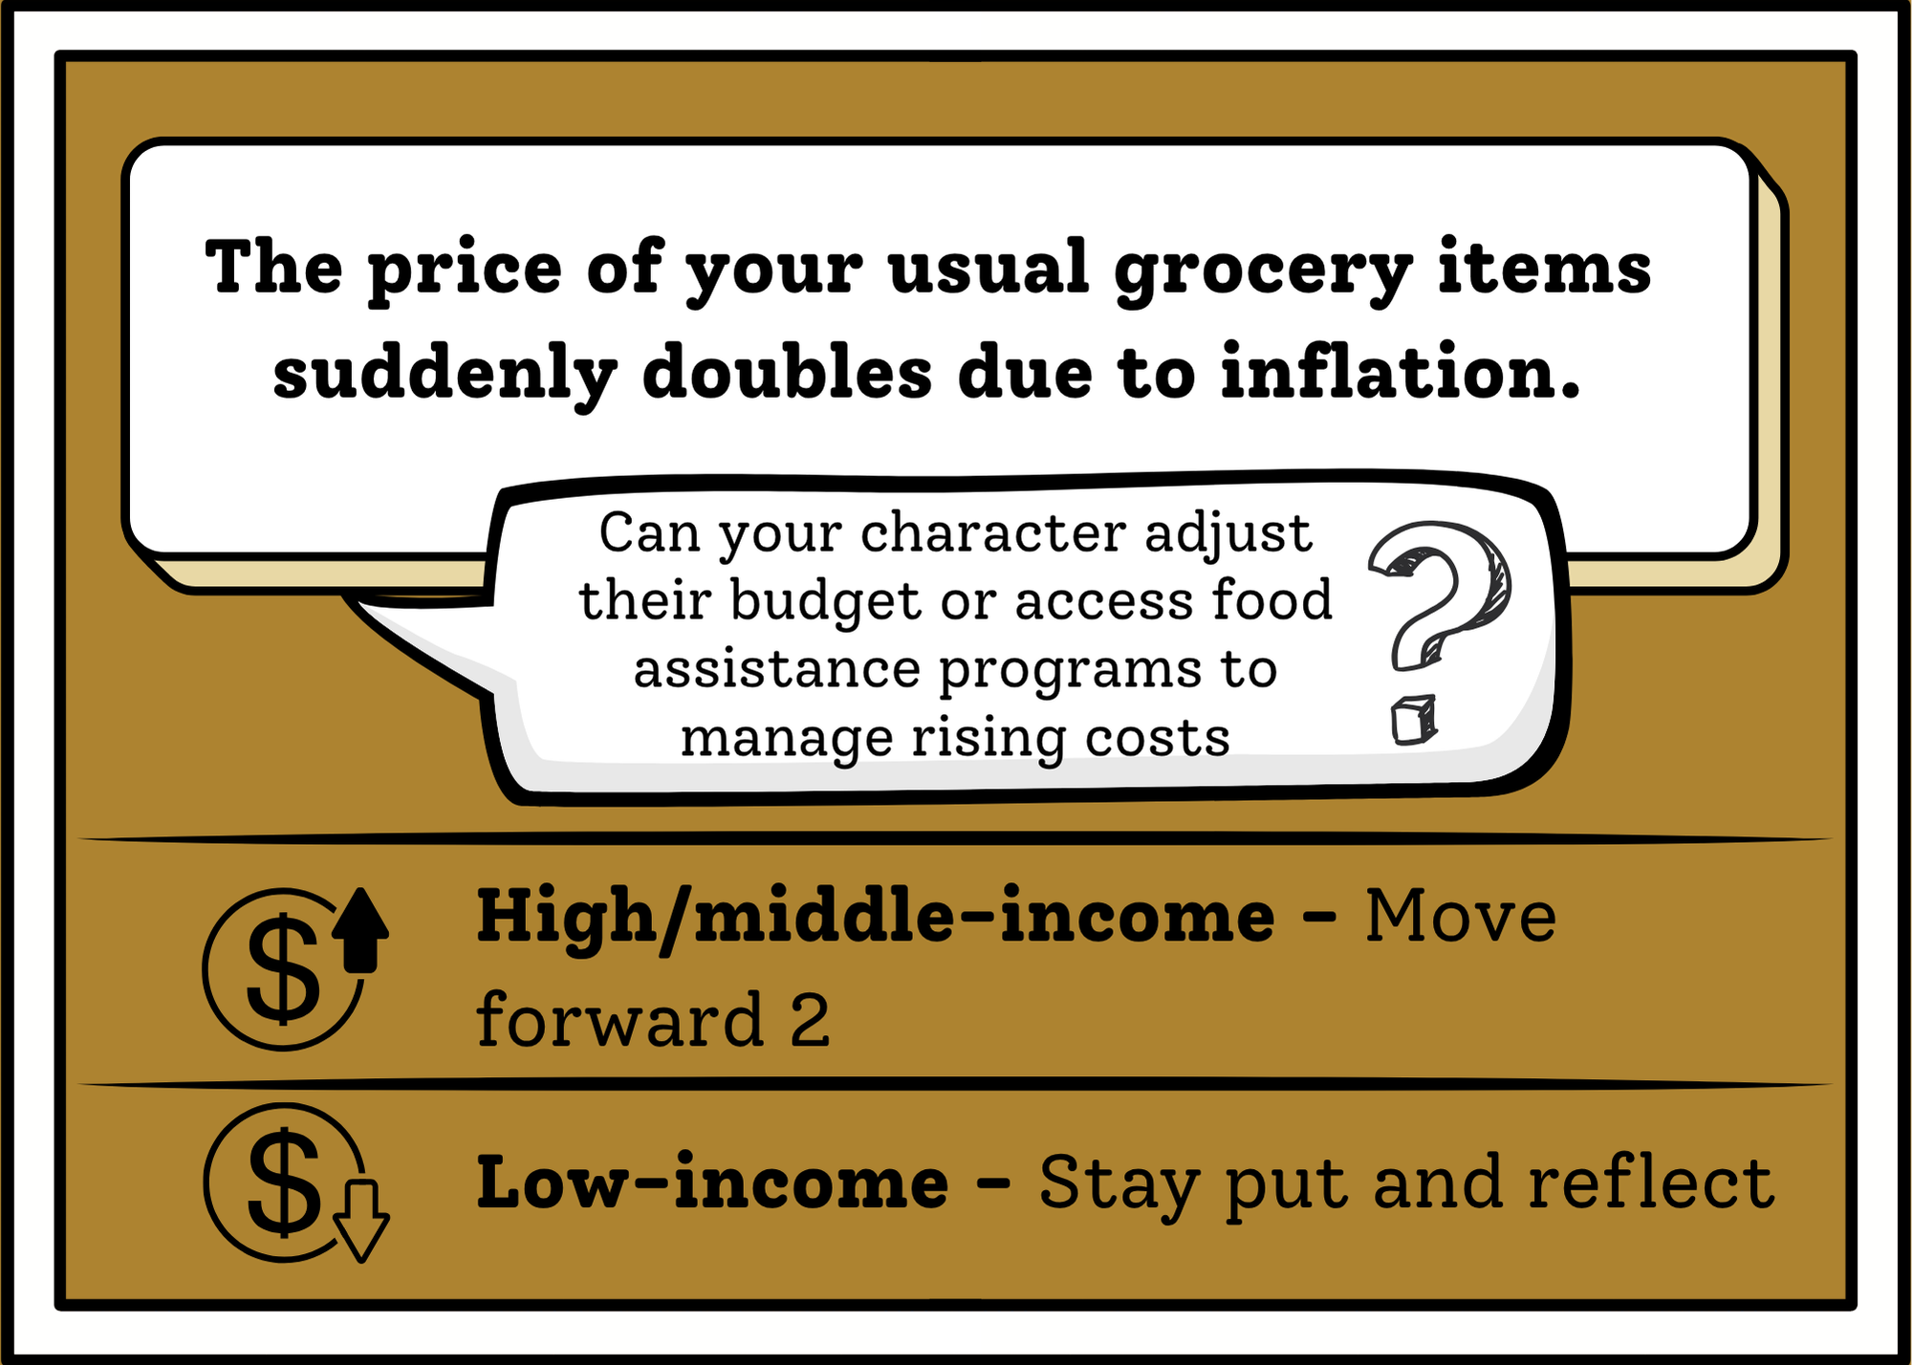
You Chose: card 6
Choose round

Slide 22
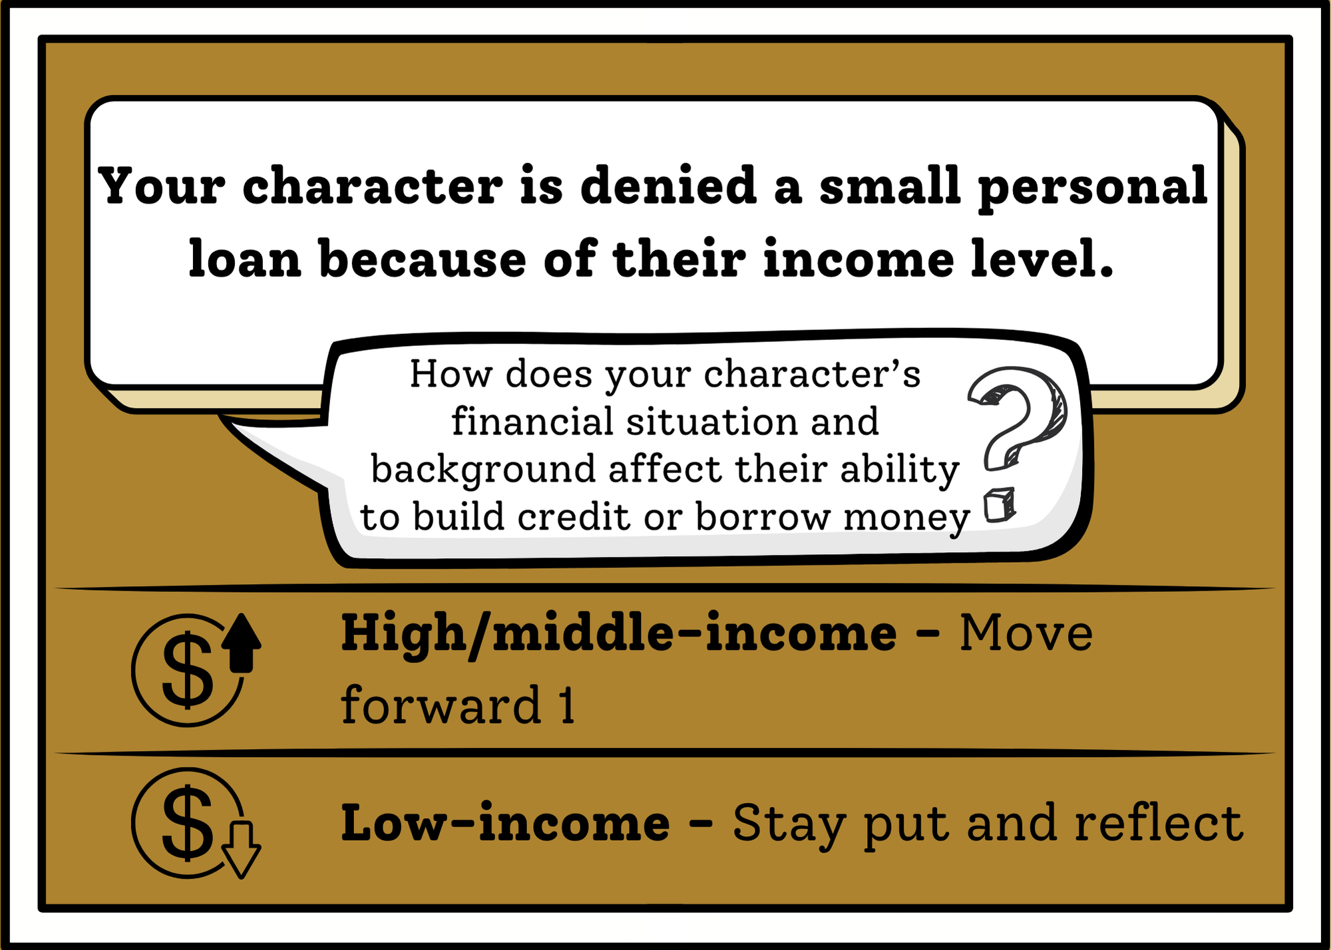
You Chose: card 7
Choose round

Slide 23
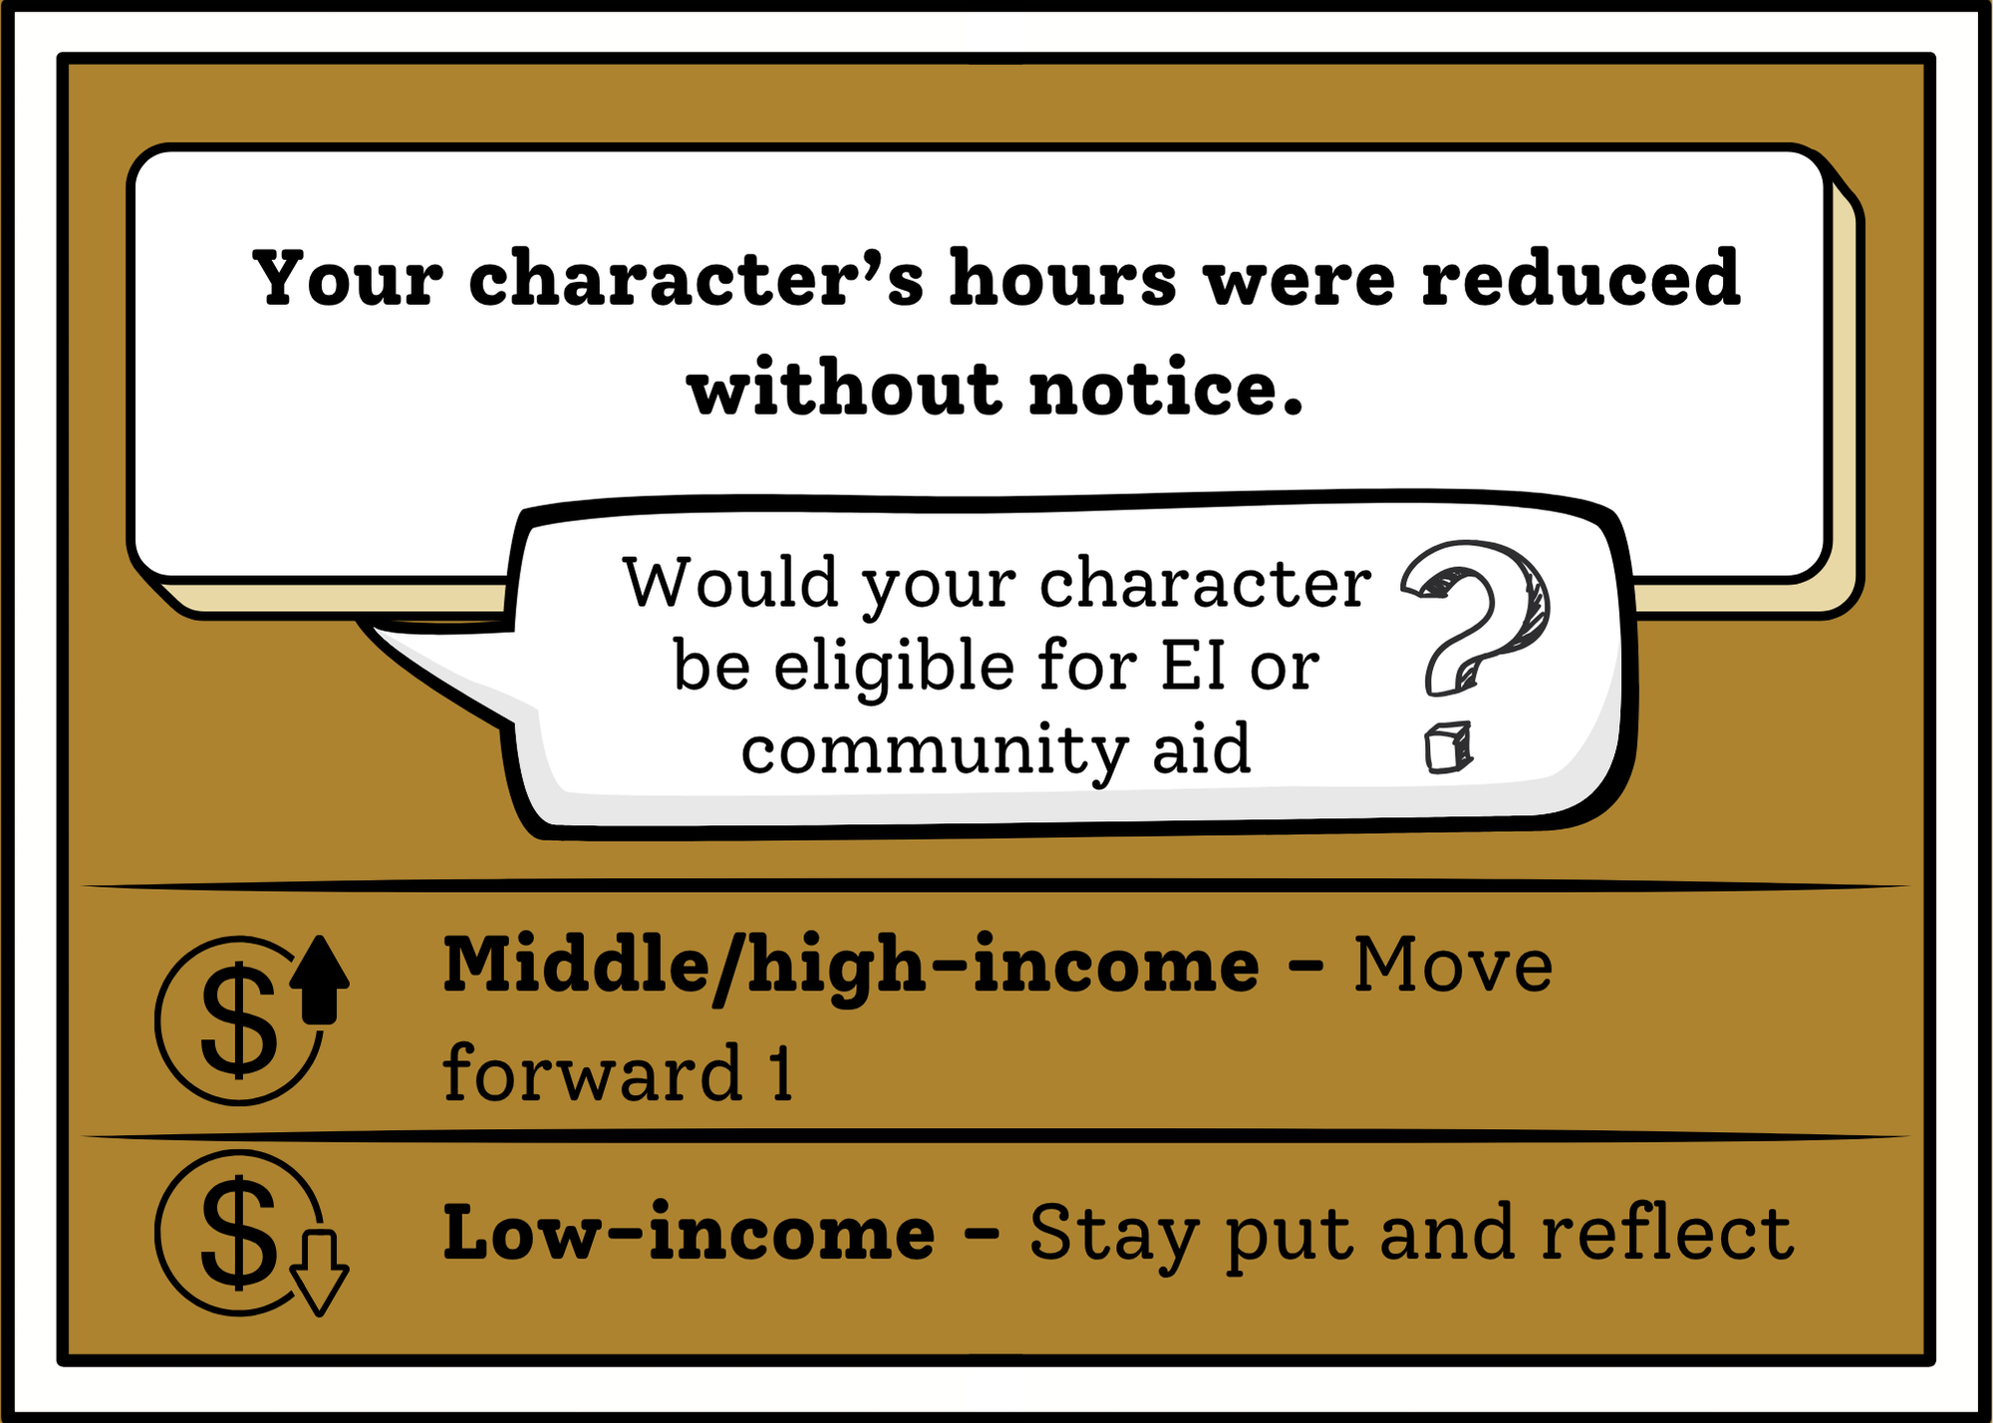
You Chose: card 8
Choose round

Slide 24

Round 2
Go!

Slide 25
Round 2: Choose your Card!
1 2 3 4
5 6 7 8

Slide 26
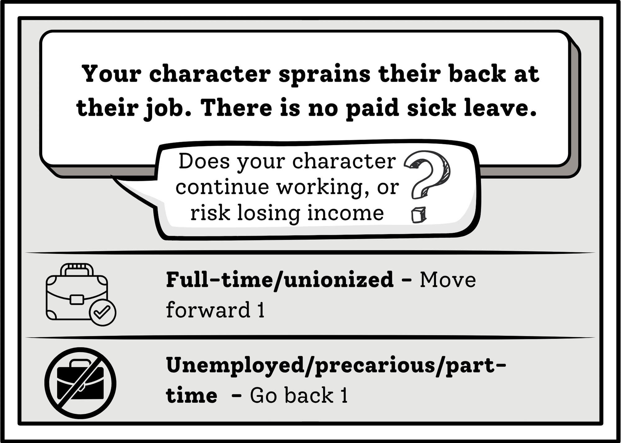
You Chose: card 1
Choose round

Slide 27
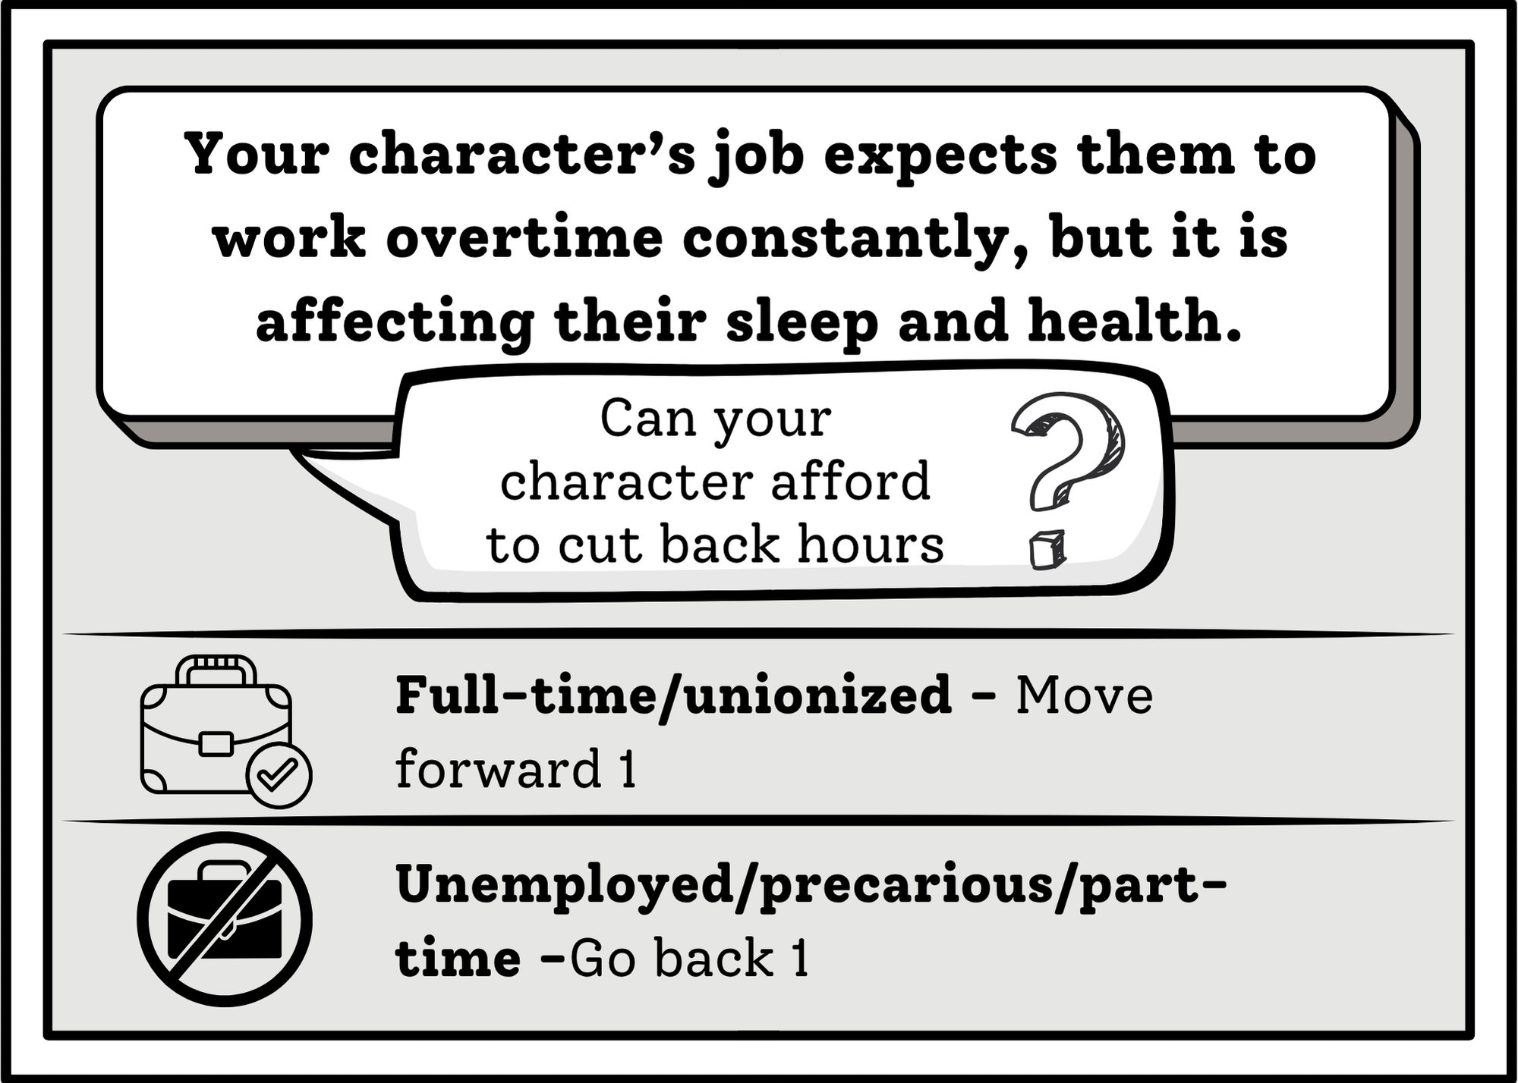
You Chose: card 2
Choose round

Slide 28
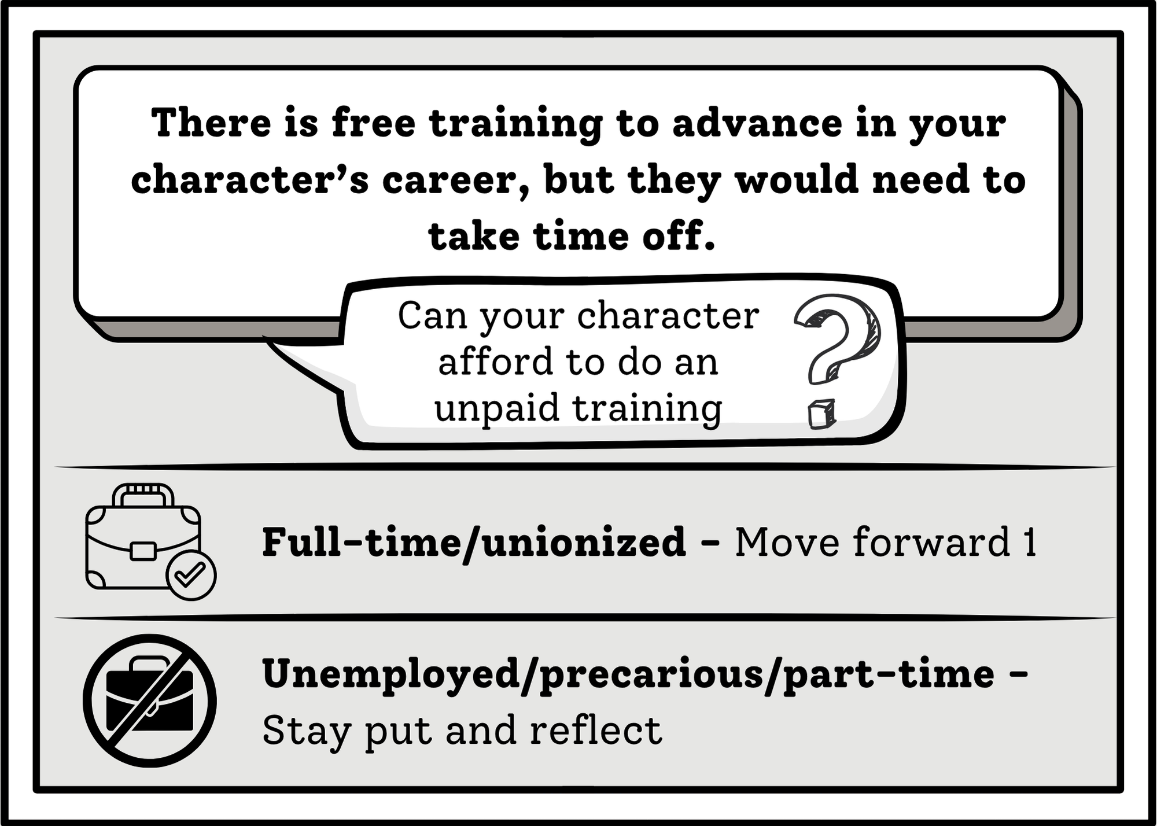
You Chose: card 3
Choose round

Slide 29
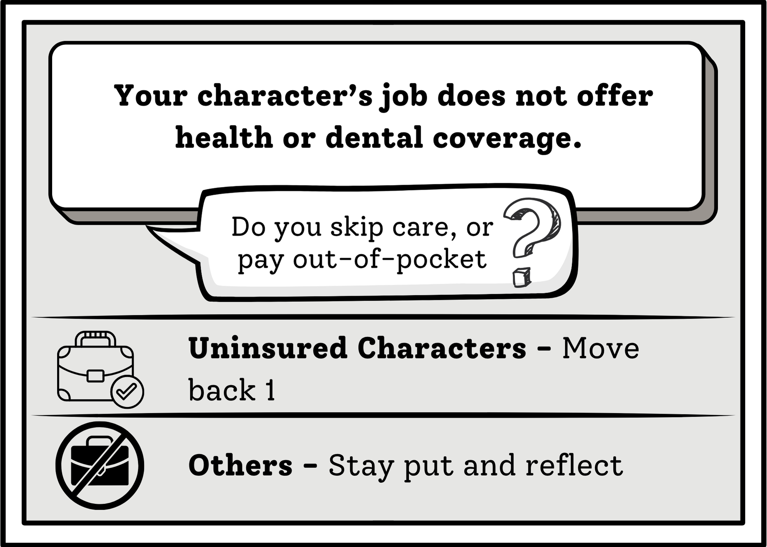
You Chose: card 4
Choose round

Slide 30
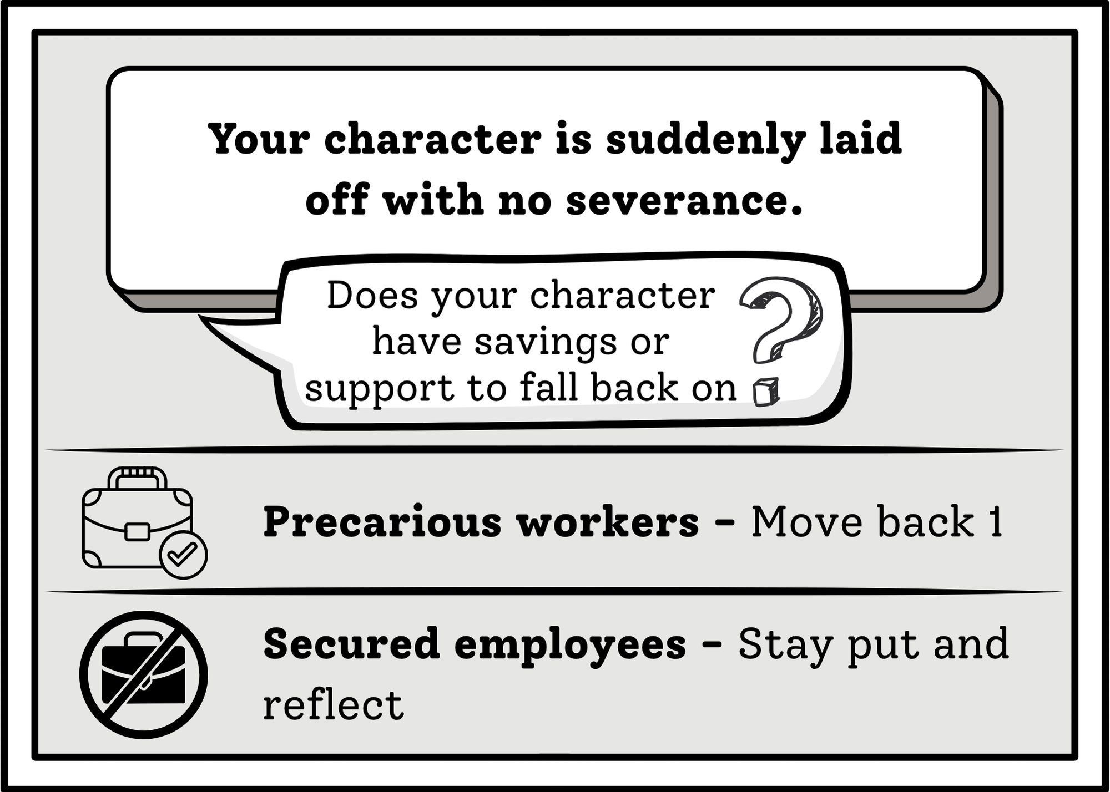
You Chose: card 5
Choose round

Slide 31
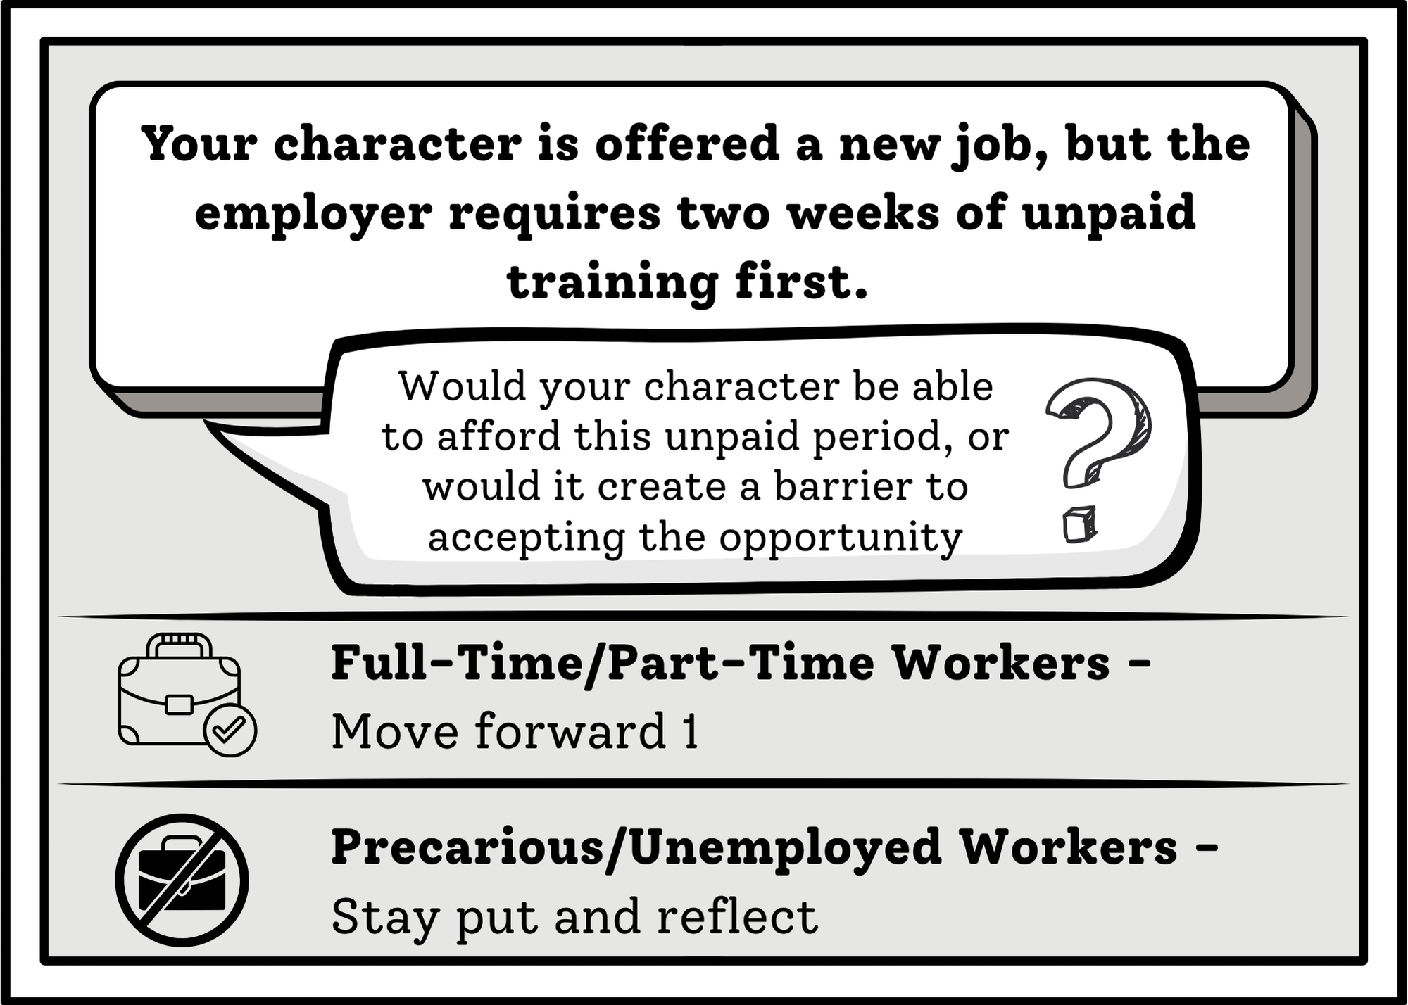
You Chose: card 6
Choose round

Slide 32
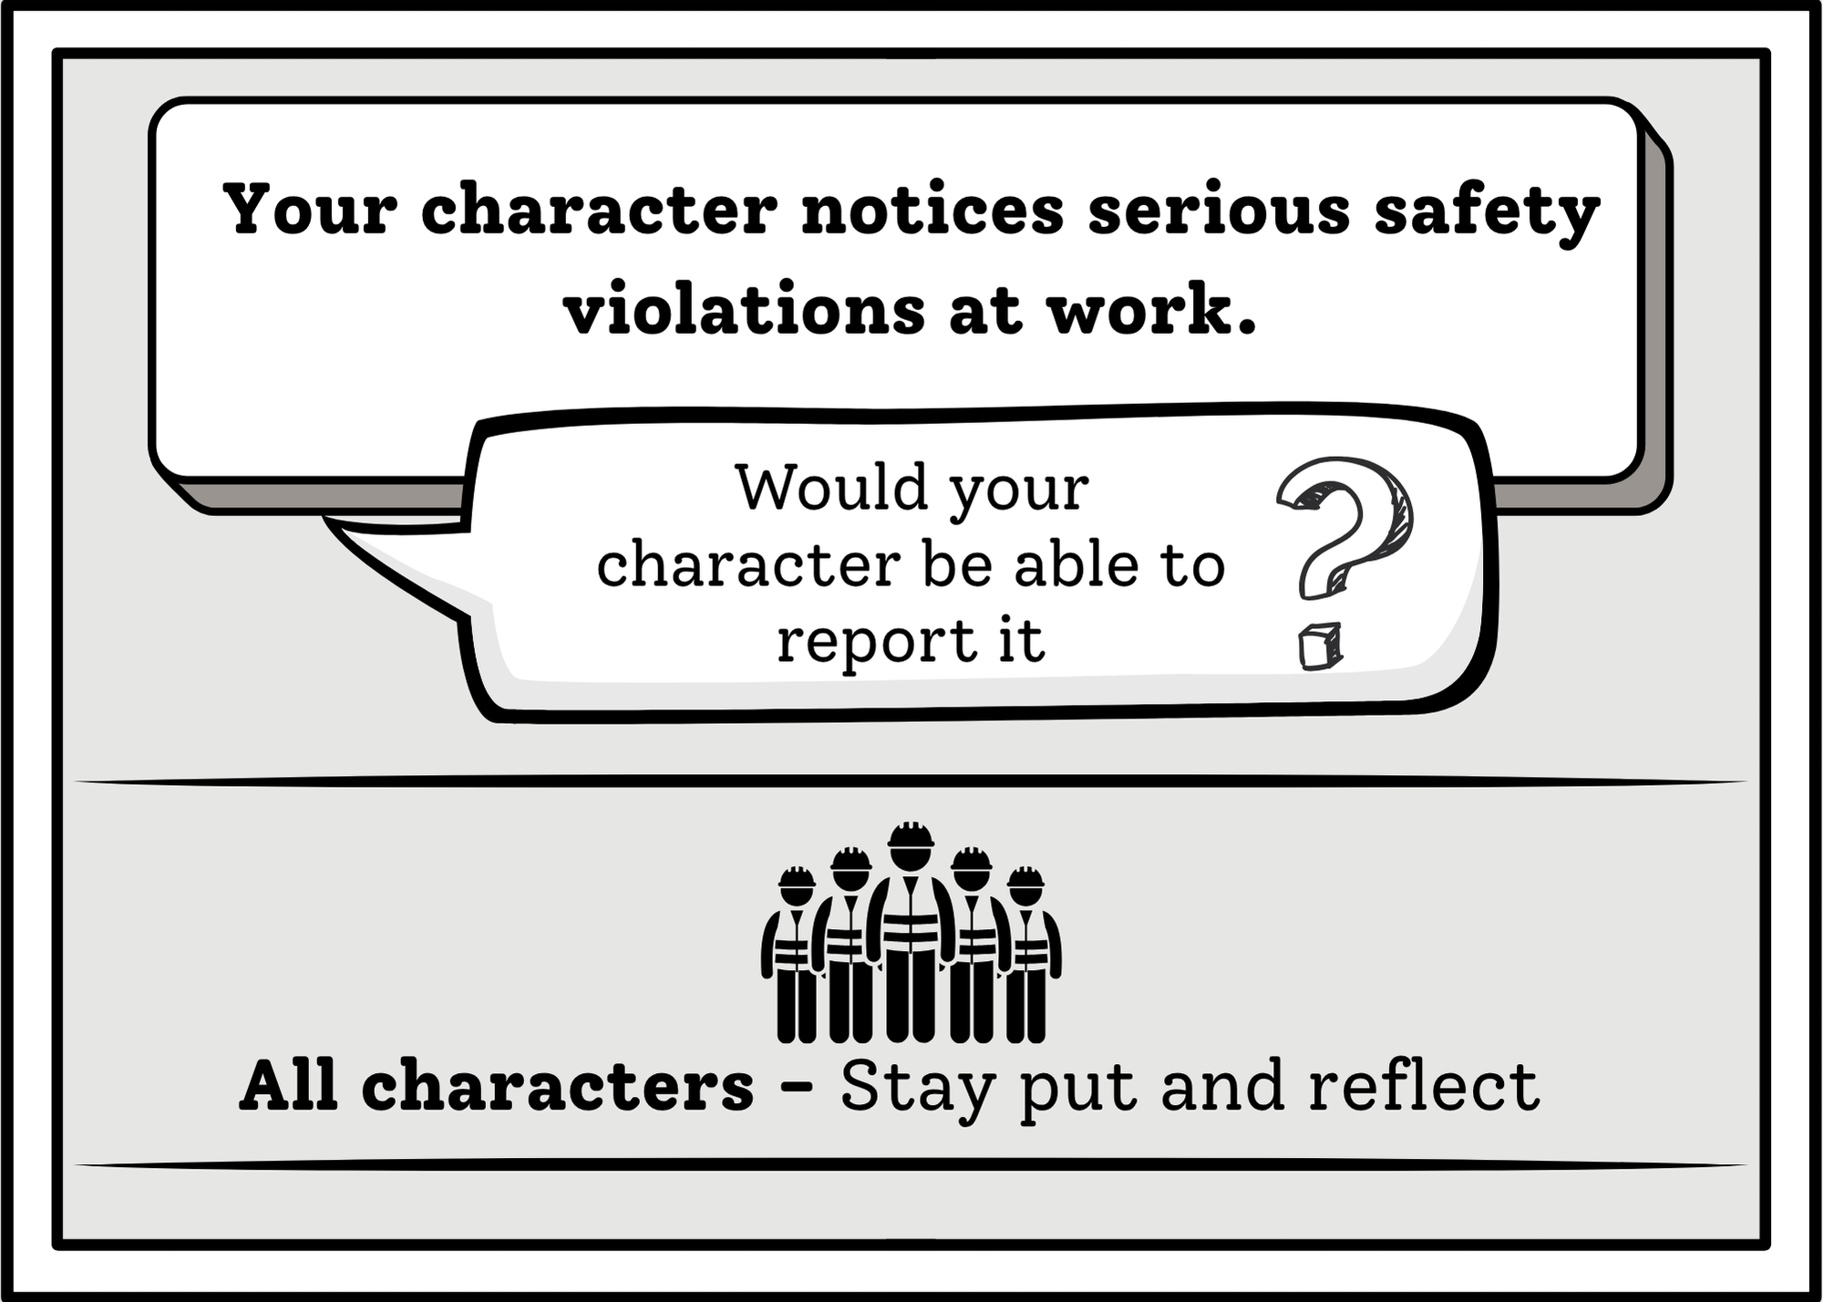
You Chose: card 7
Choose round

Slide 33
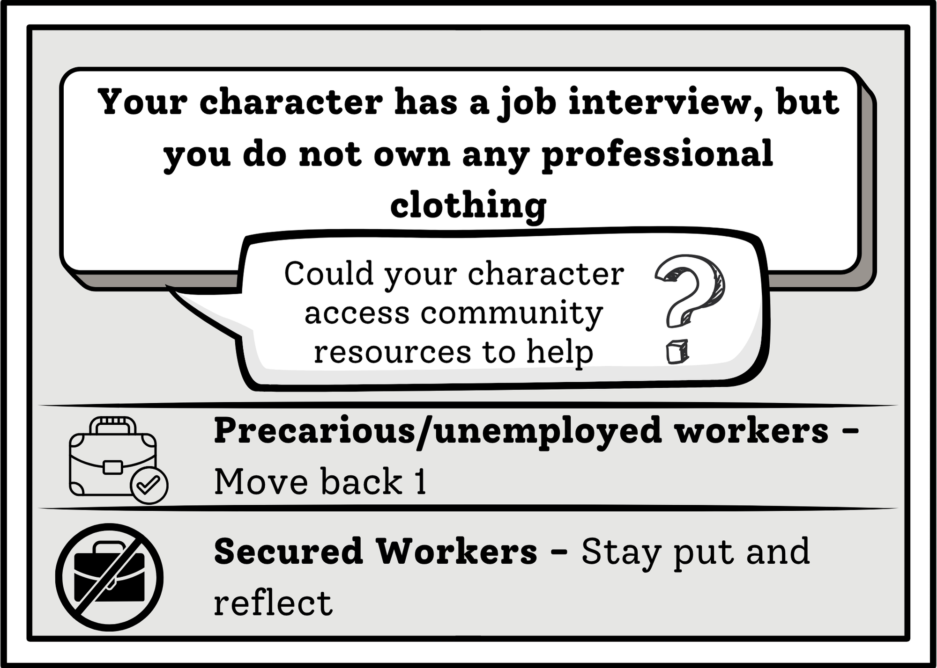
You Chose: card 8
Choose round

Slide 34

Round 3
Go!

Slide 35
Round 3: Choose your Card!
1 2 3 4
5 6 7 8

Slide 36
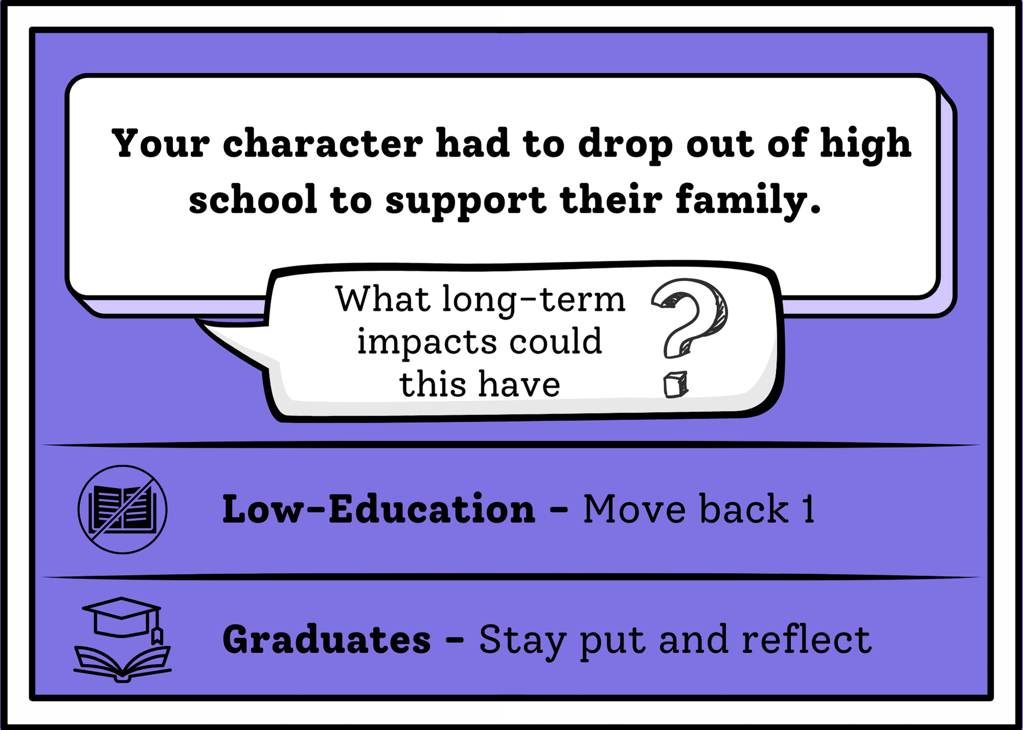
You Chose: card 1
Choose round

Slide 37
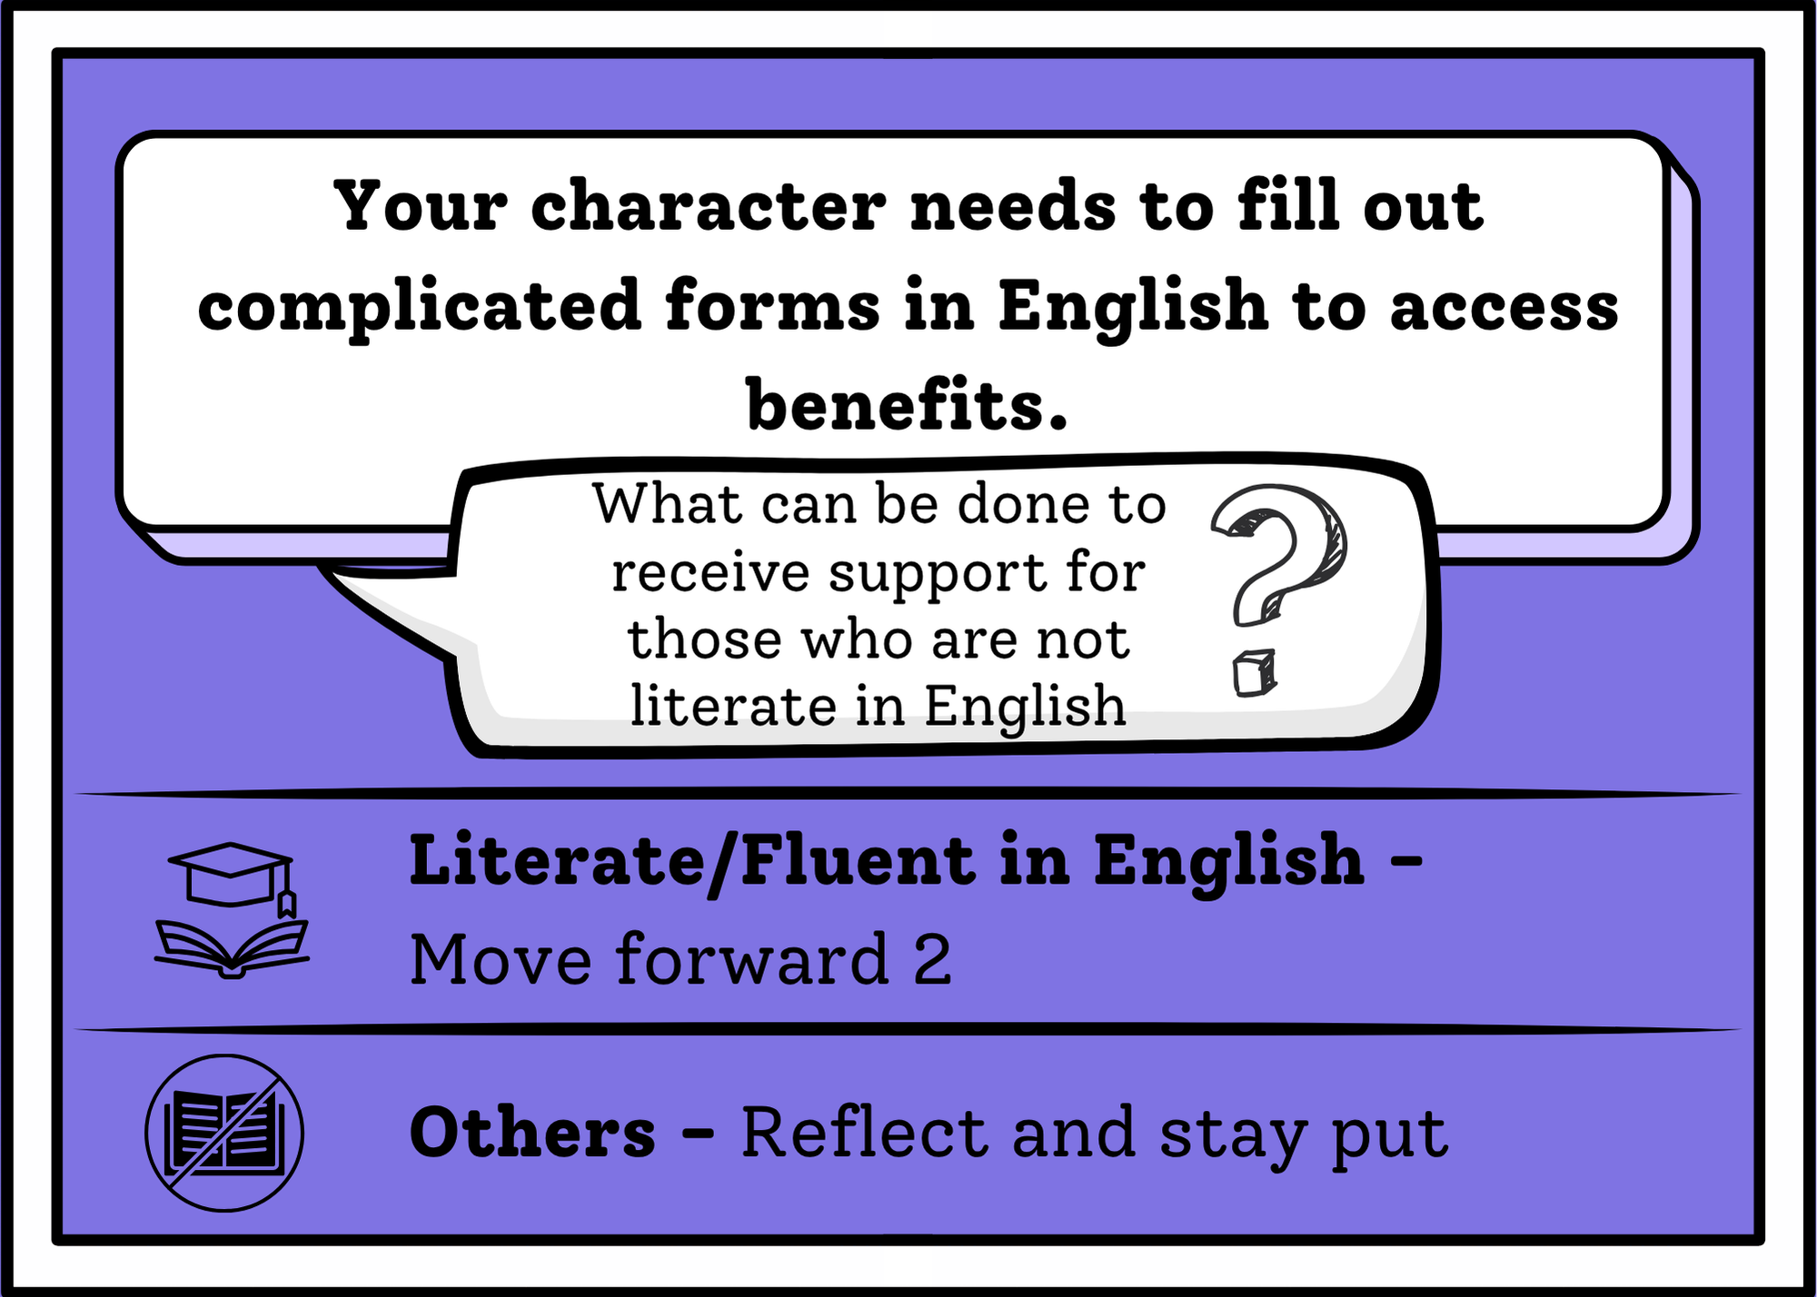
You Chose: card 2
Choose round

Slide 38
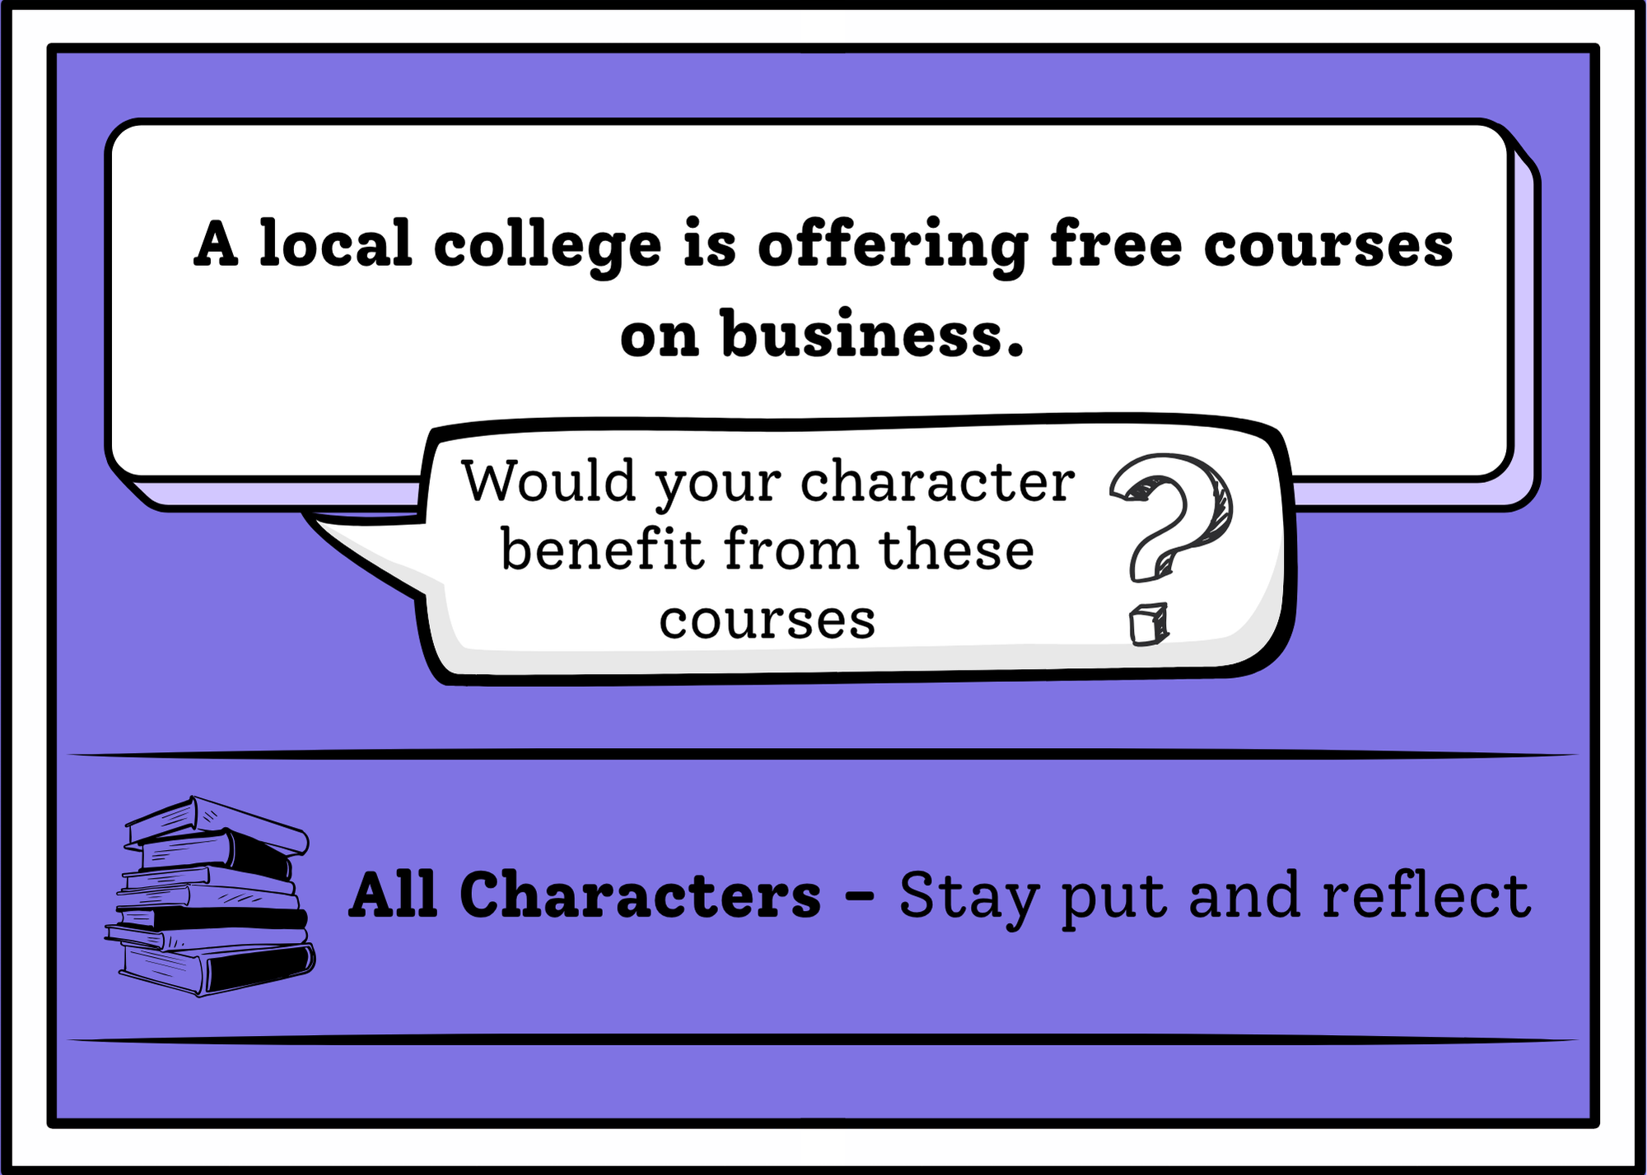
You Chose: card 3
Choose round

Slide 39
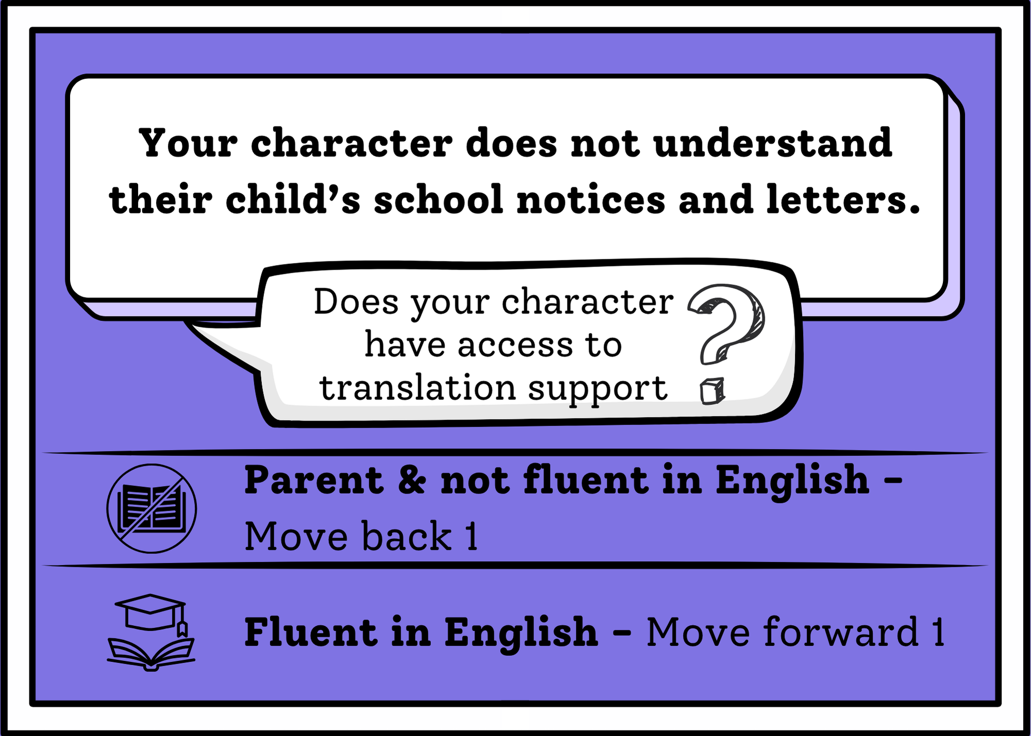
You Chose: card 4
Choose round

Slide 40
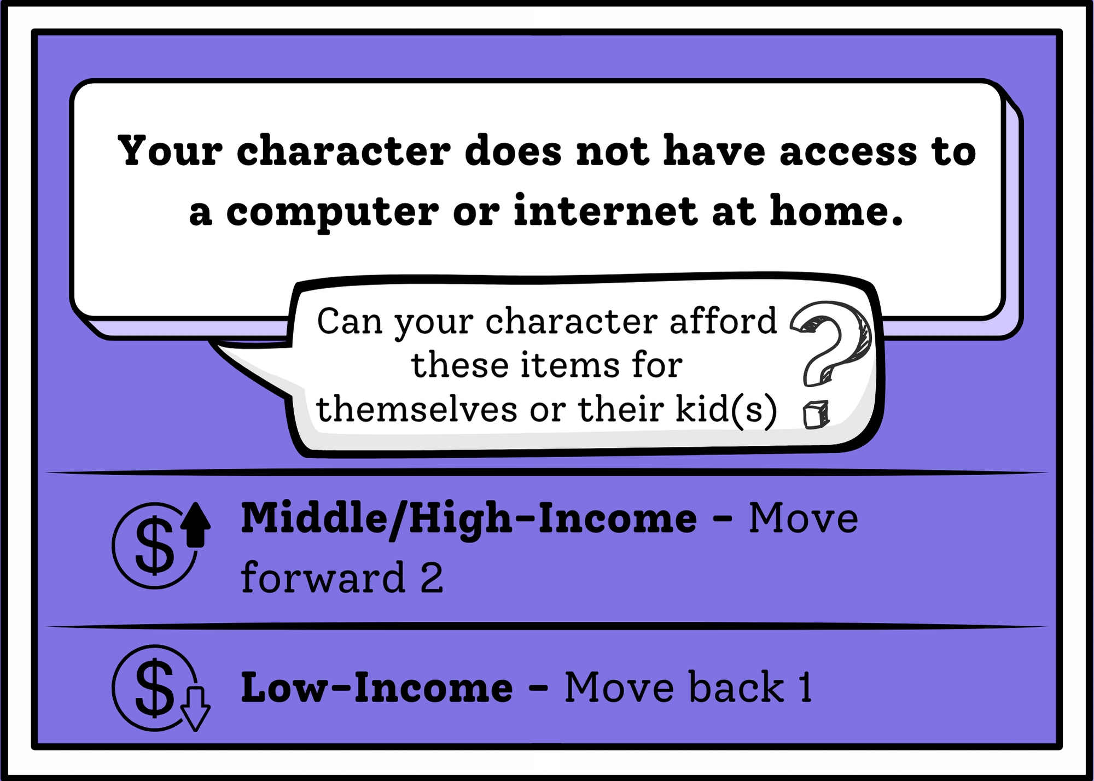
You Chose: card 5
Choose round

Slide 41
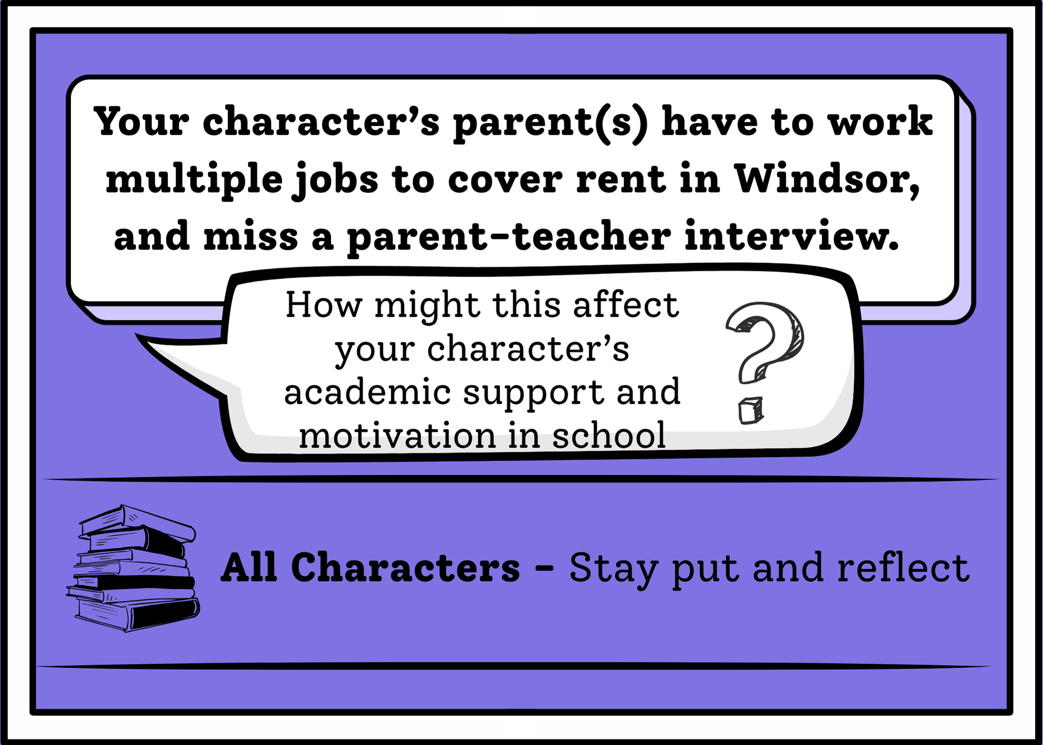
You Chose: card 6
Choose round

Slide 42
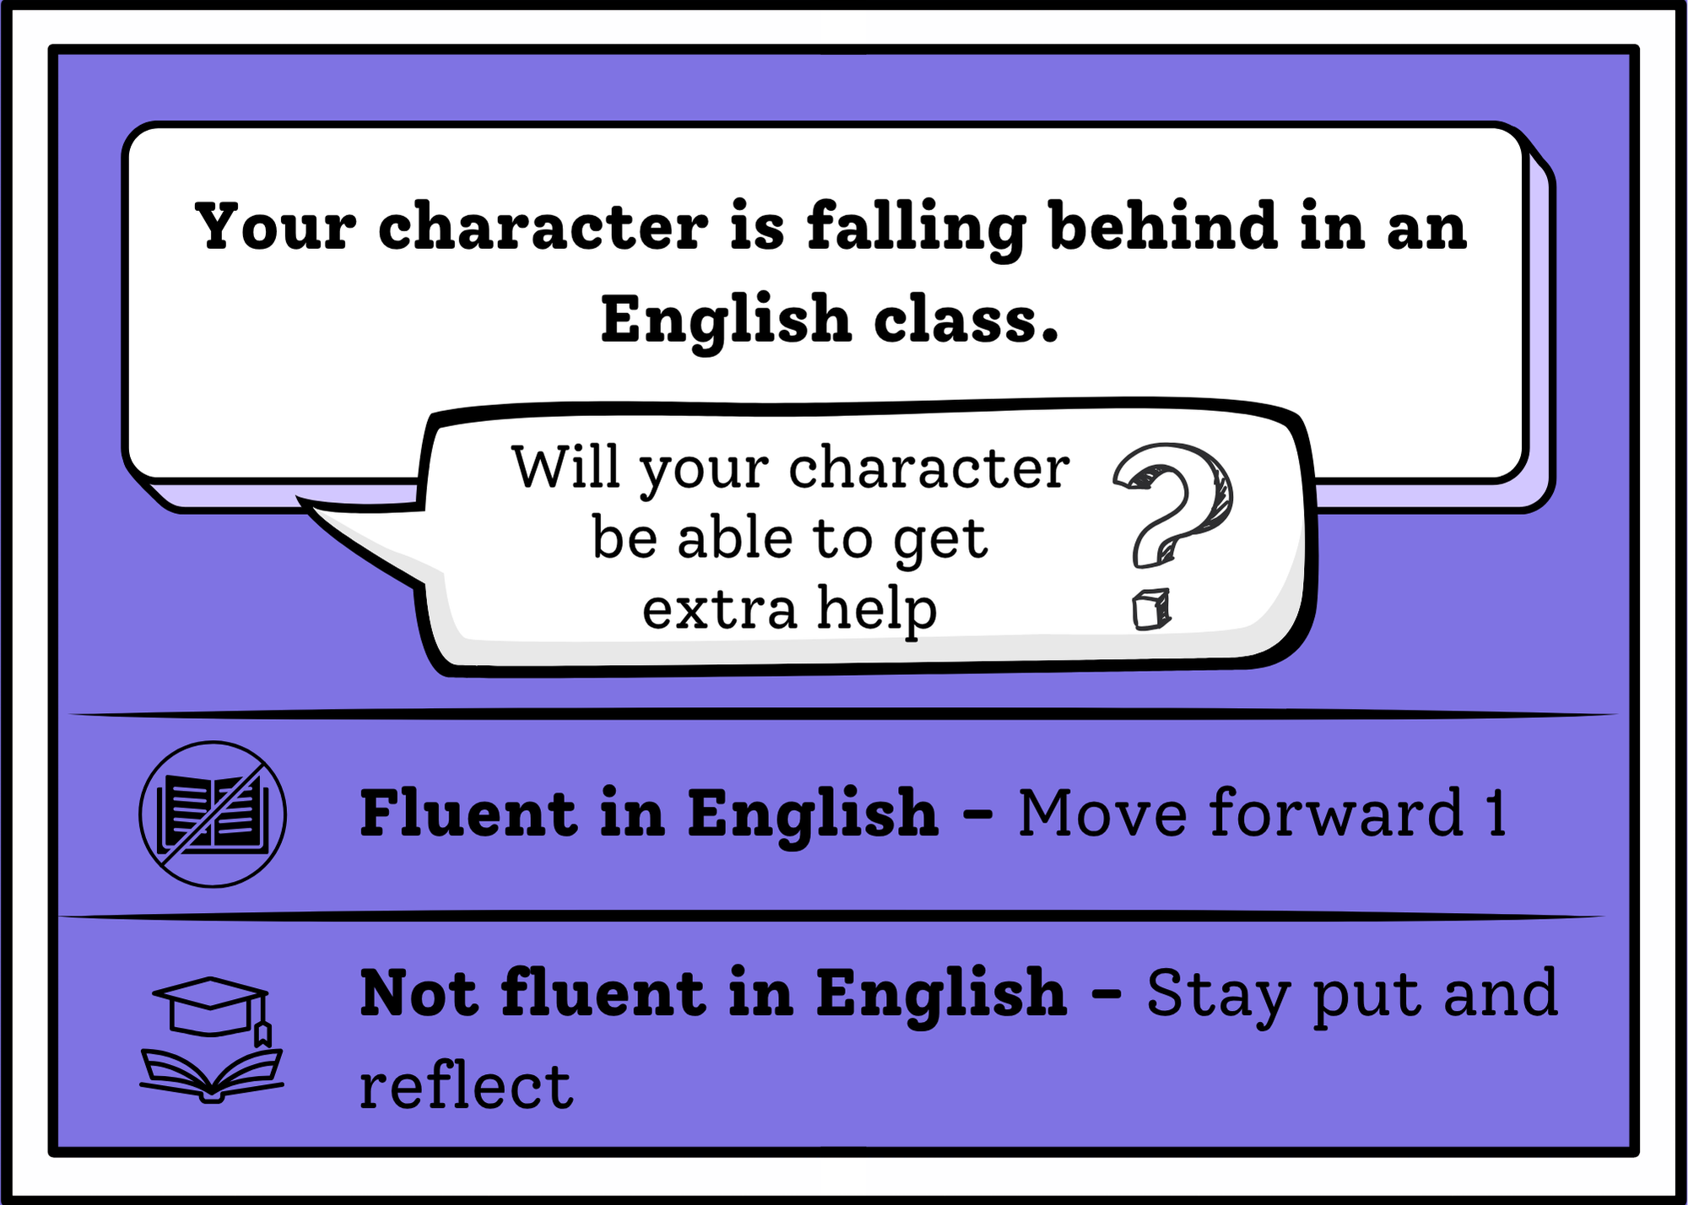
You Chose: card 7
Choose round

Slide 43
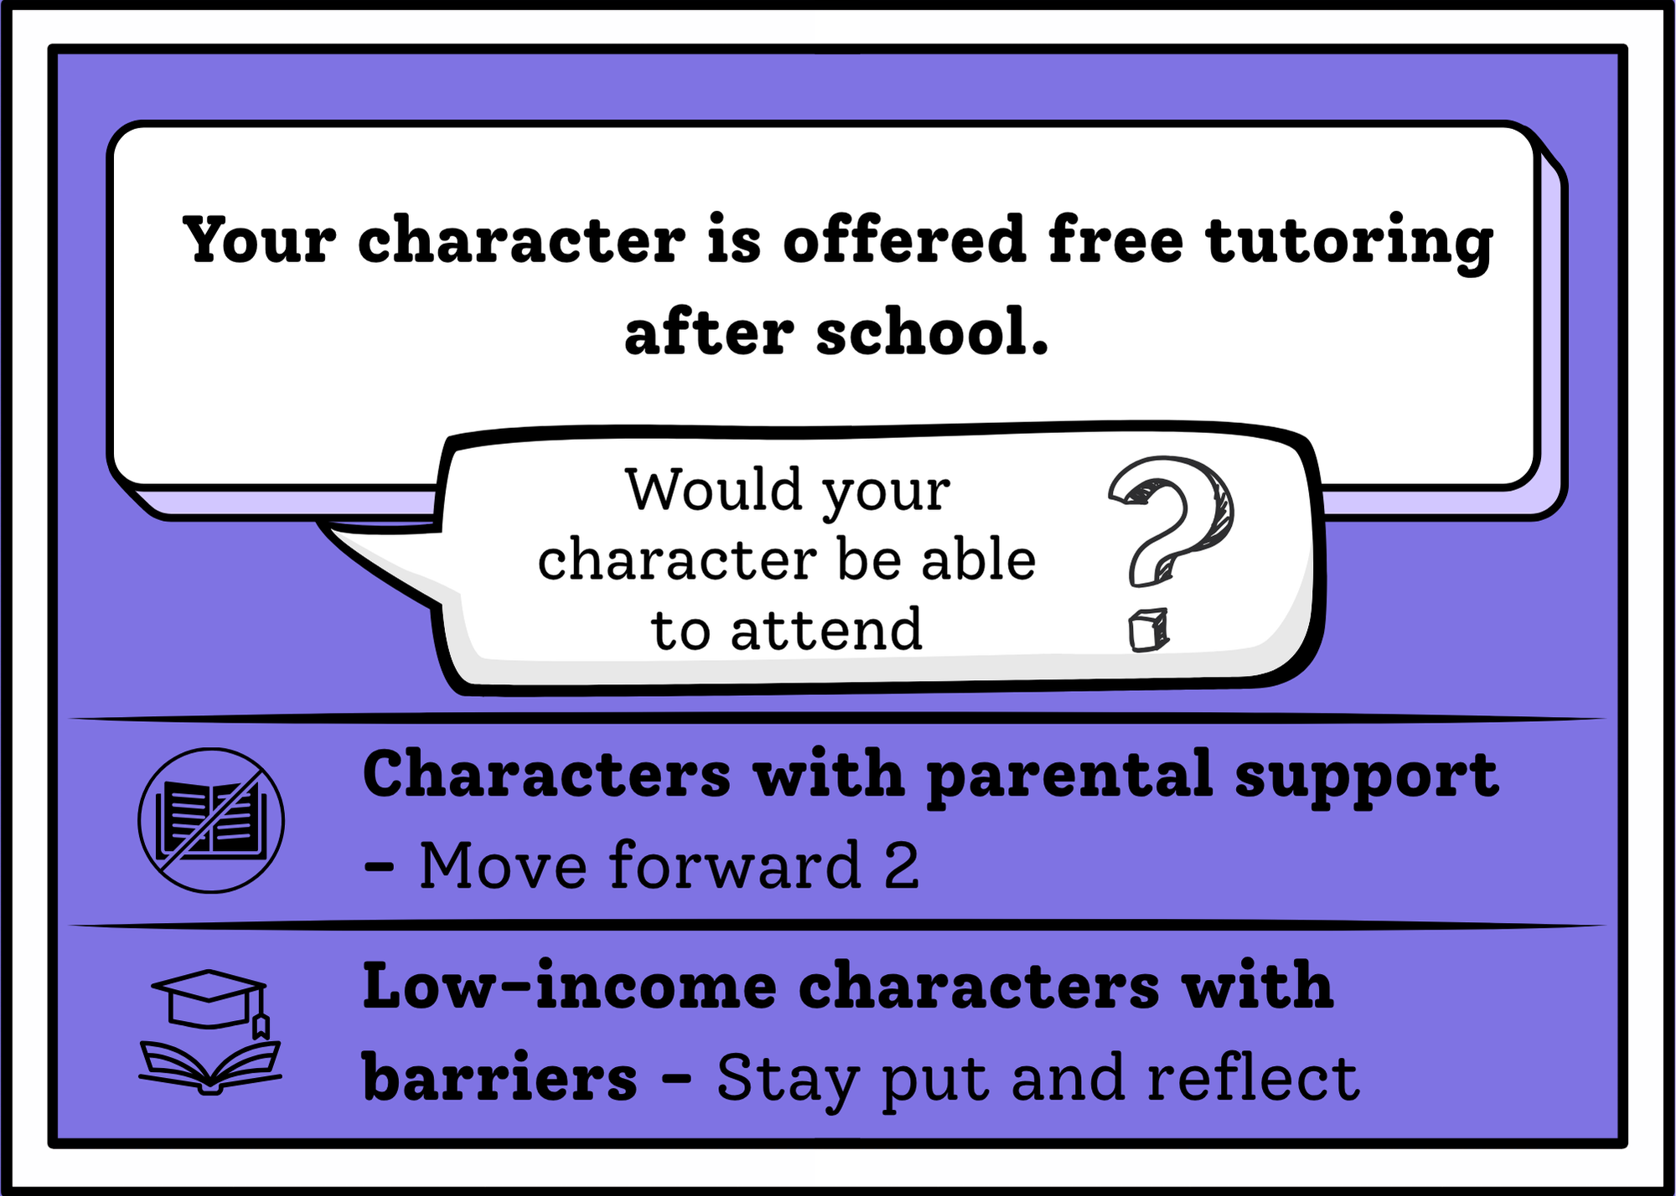
You Chose: card 8
Choose round

Slide 44

Round 4
Go!

Slide 45
Round 4: Choose your Card!
1 2 3 4
5 6 7 8

Slide 46
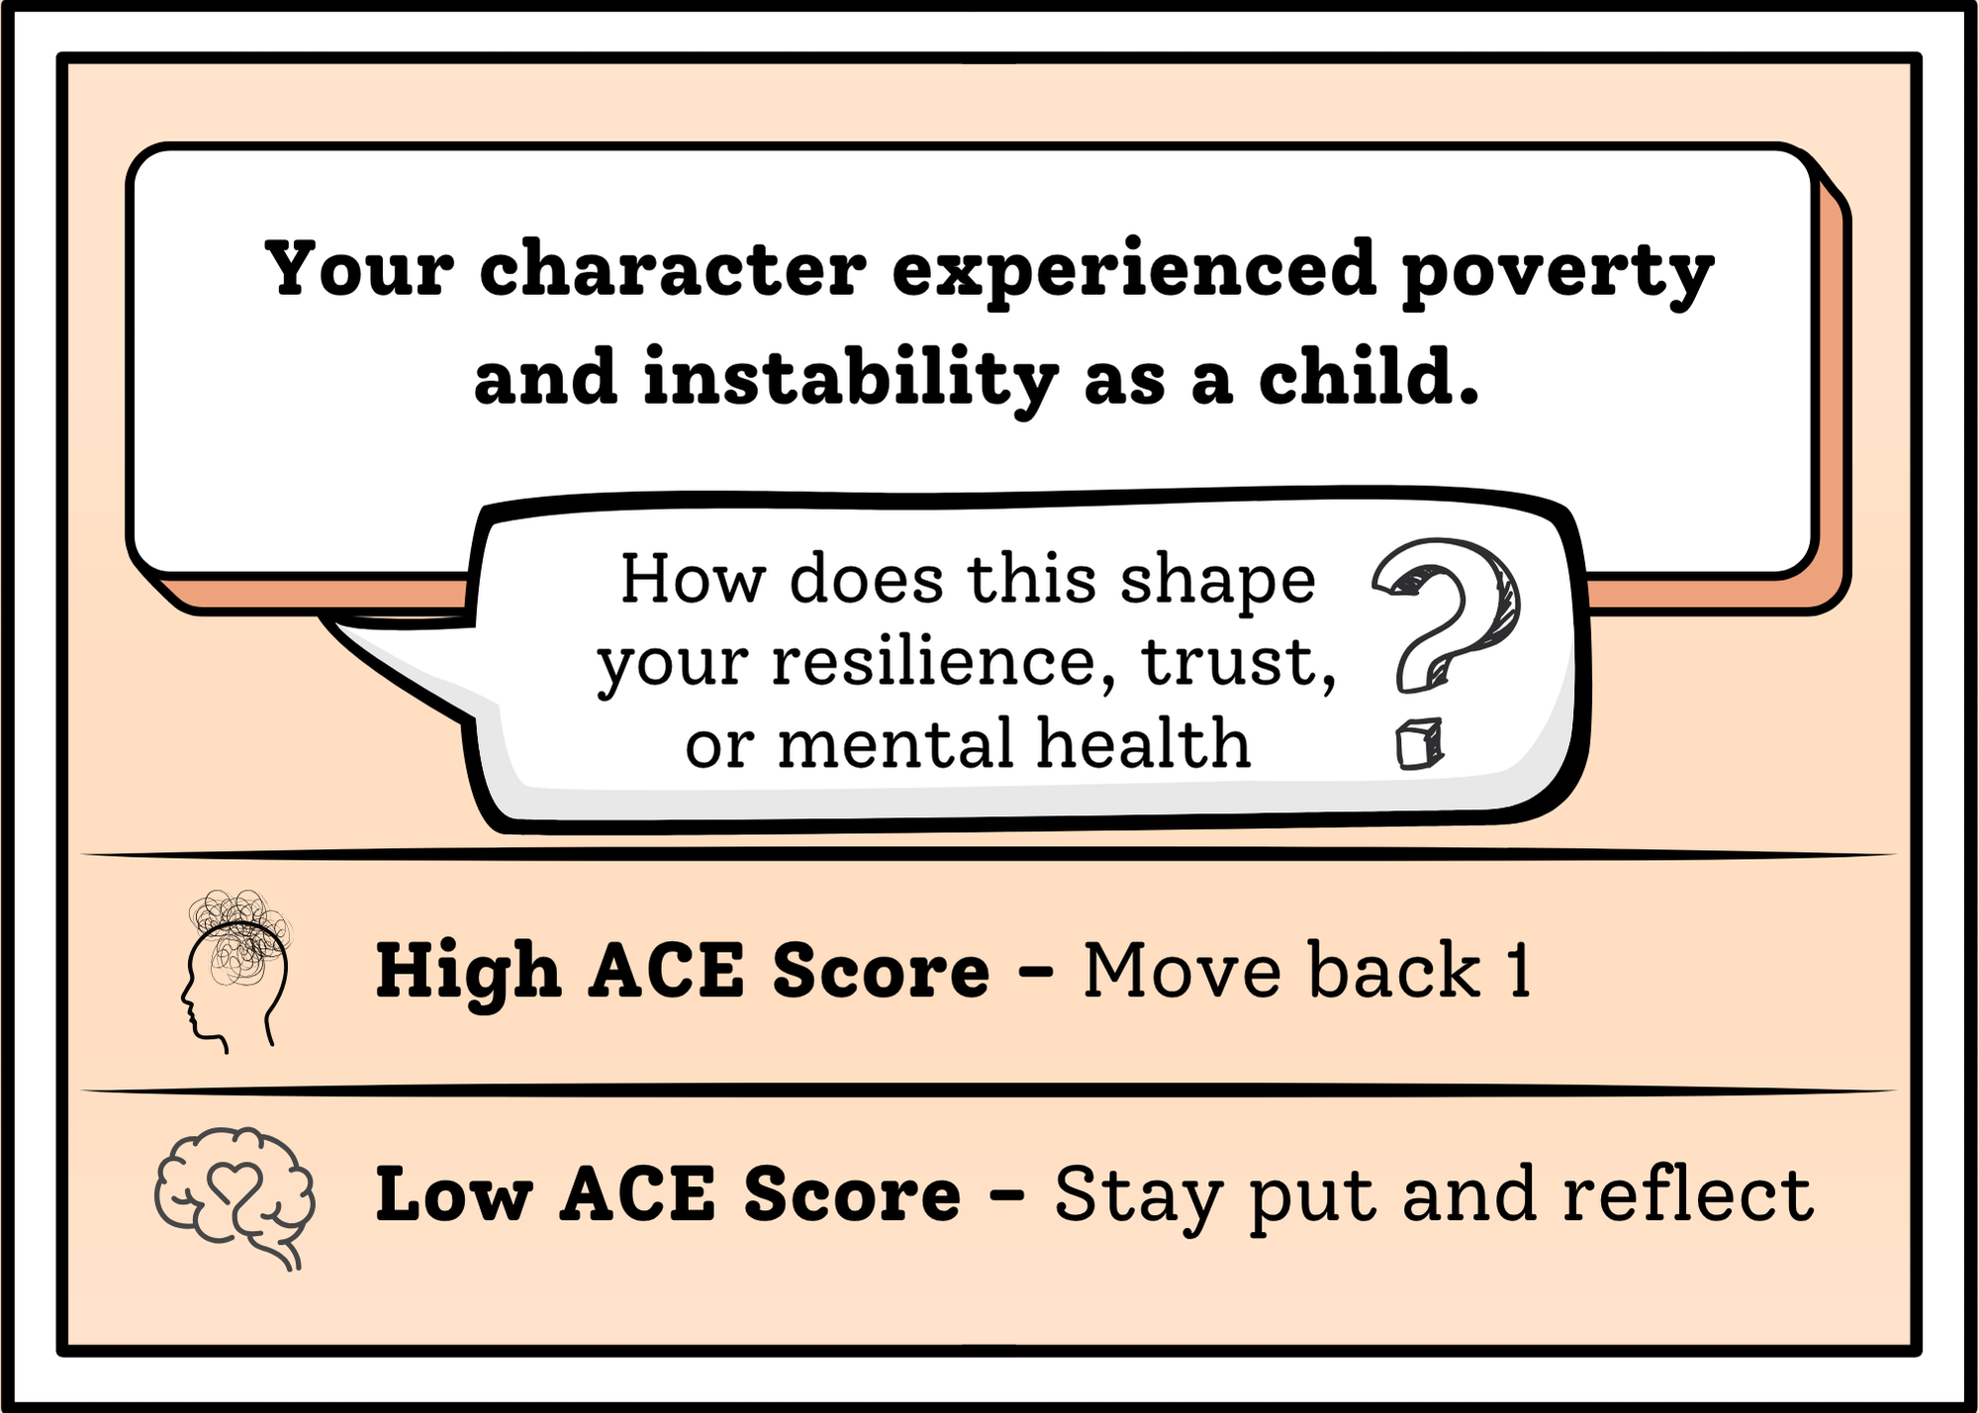
You Chose: card 1
Choose round

Slide 47
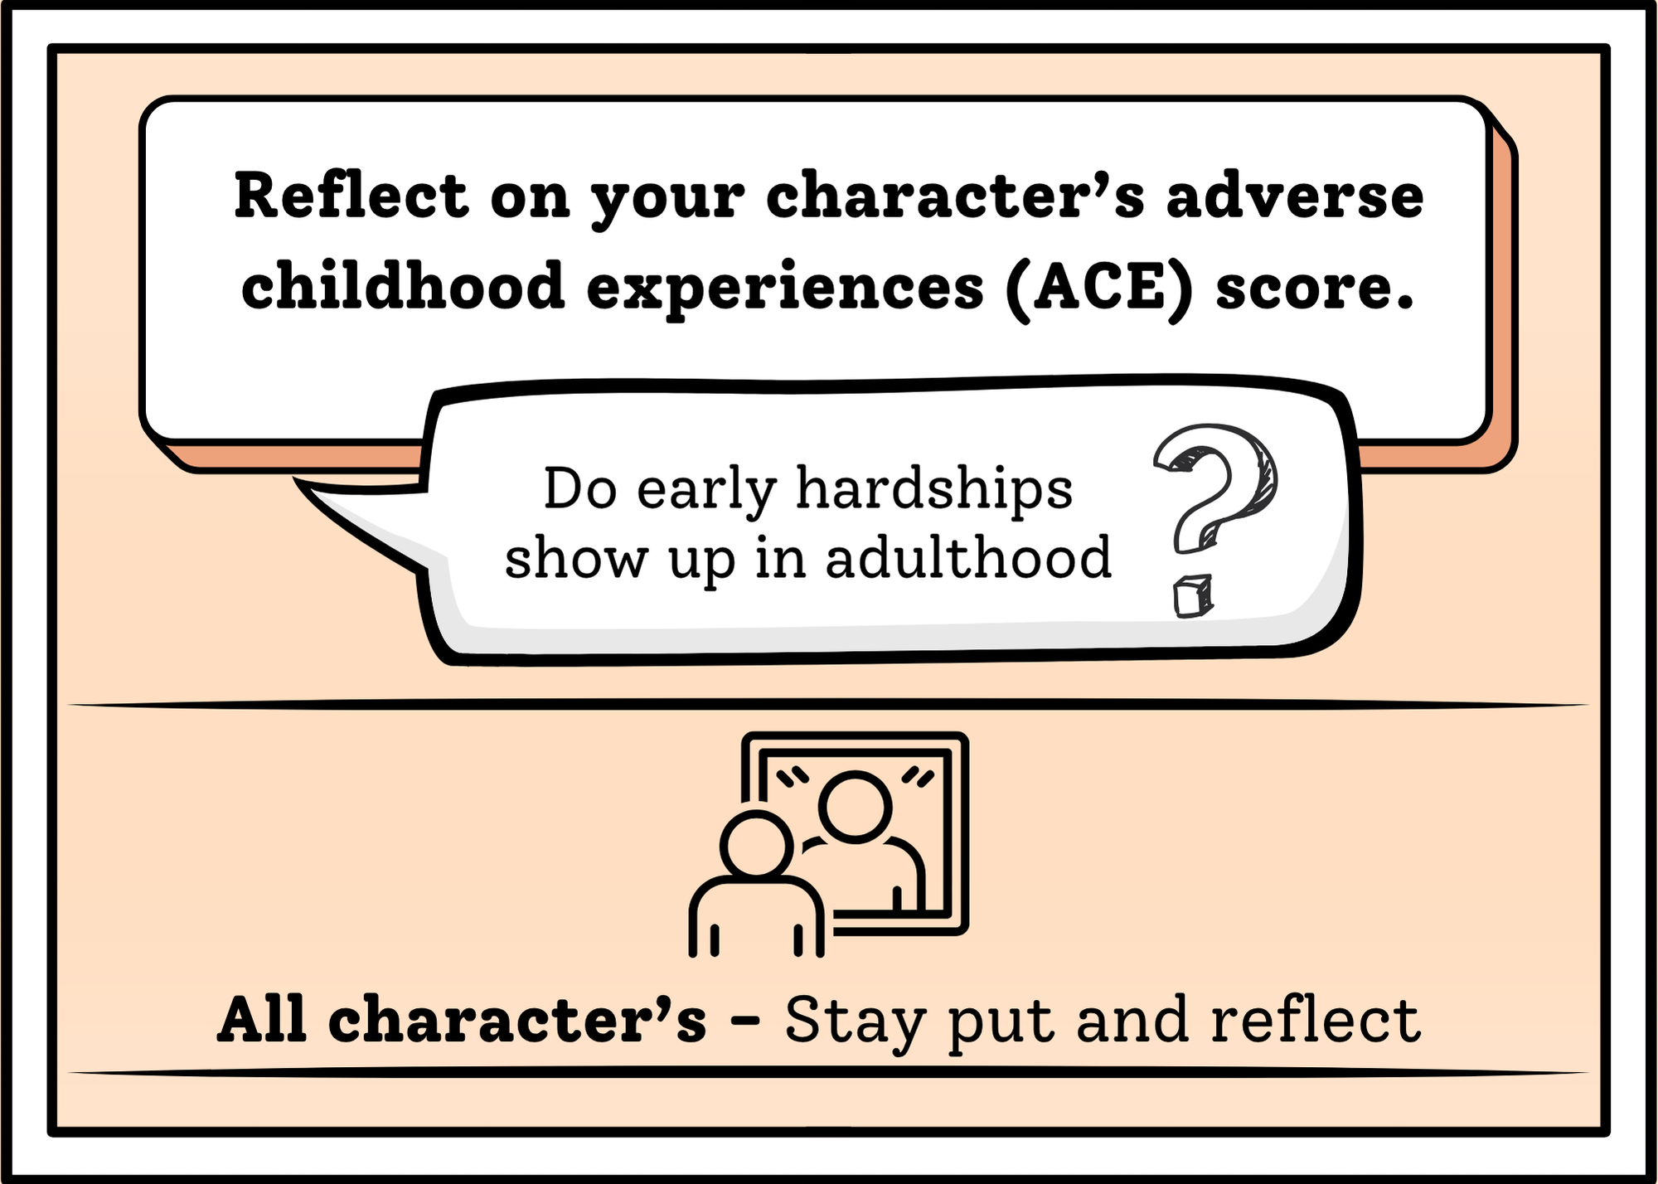
You Chose: card 2
Choose round

Slide 48
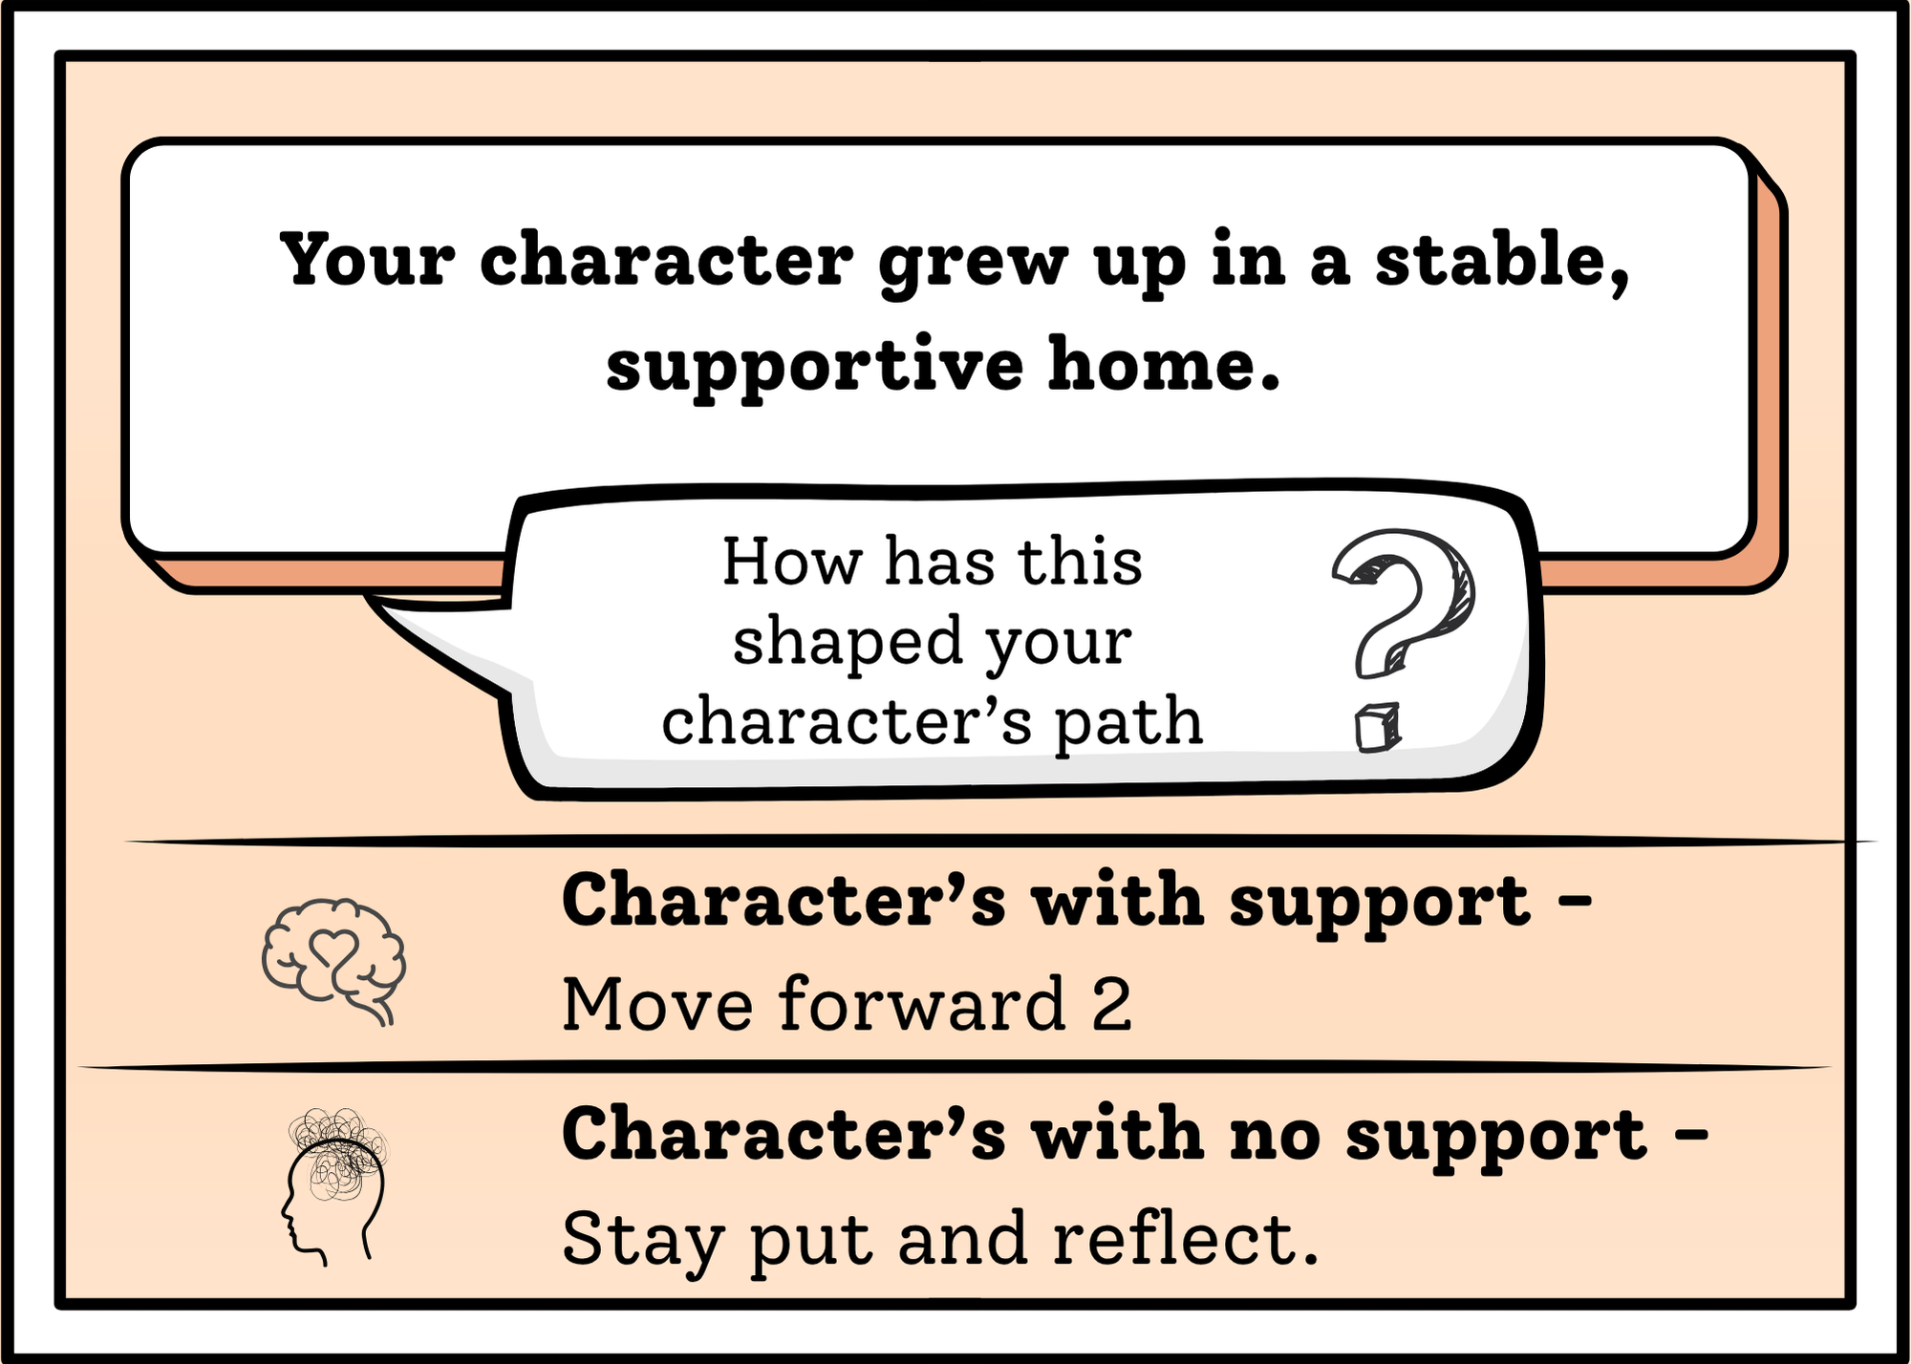
You Chose: card 3
Choose round

Slide 49
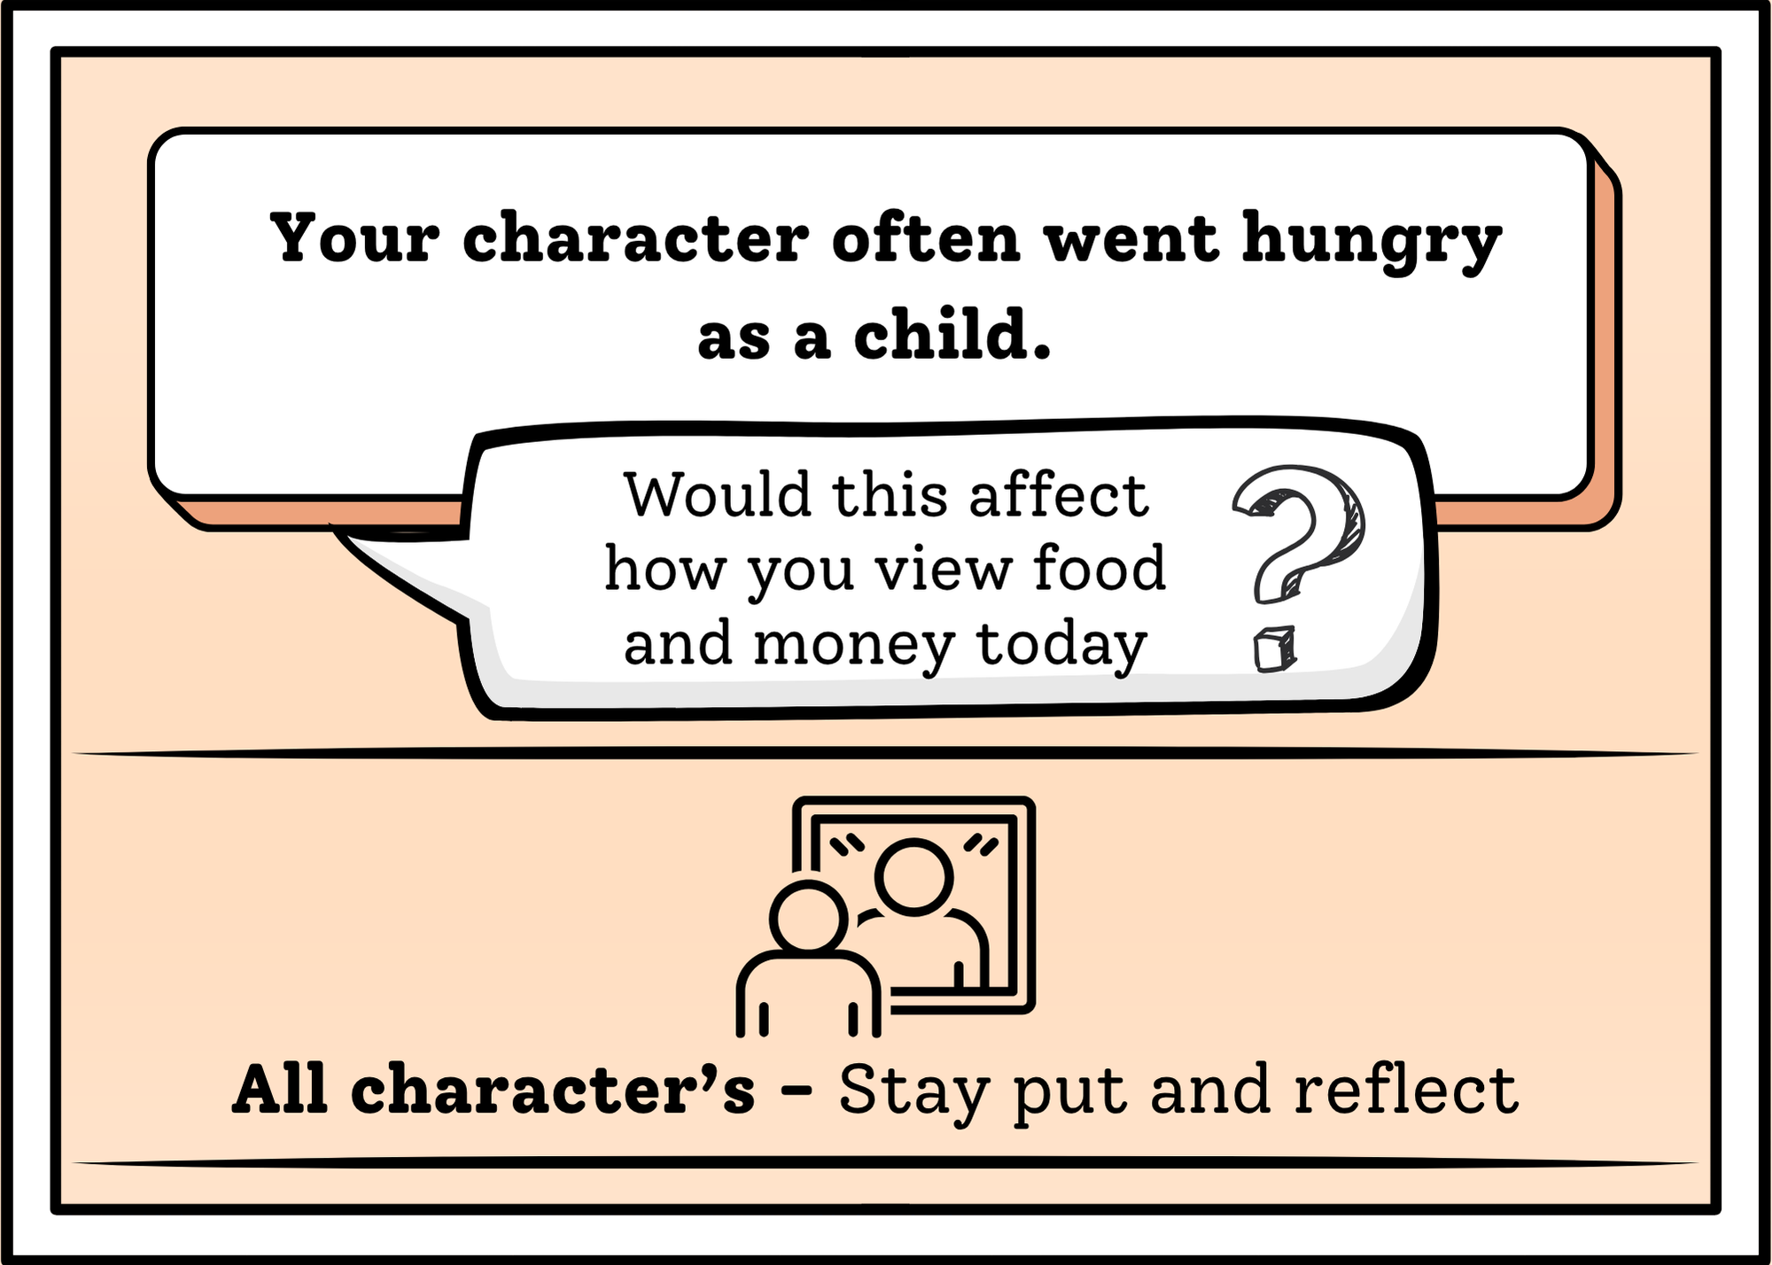
You Chose: card 4
Choose round

Slide 50
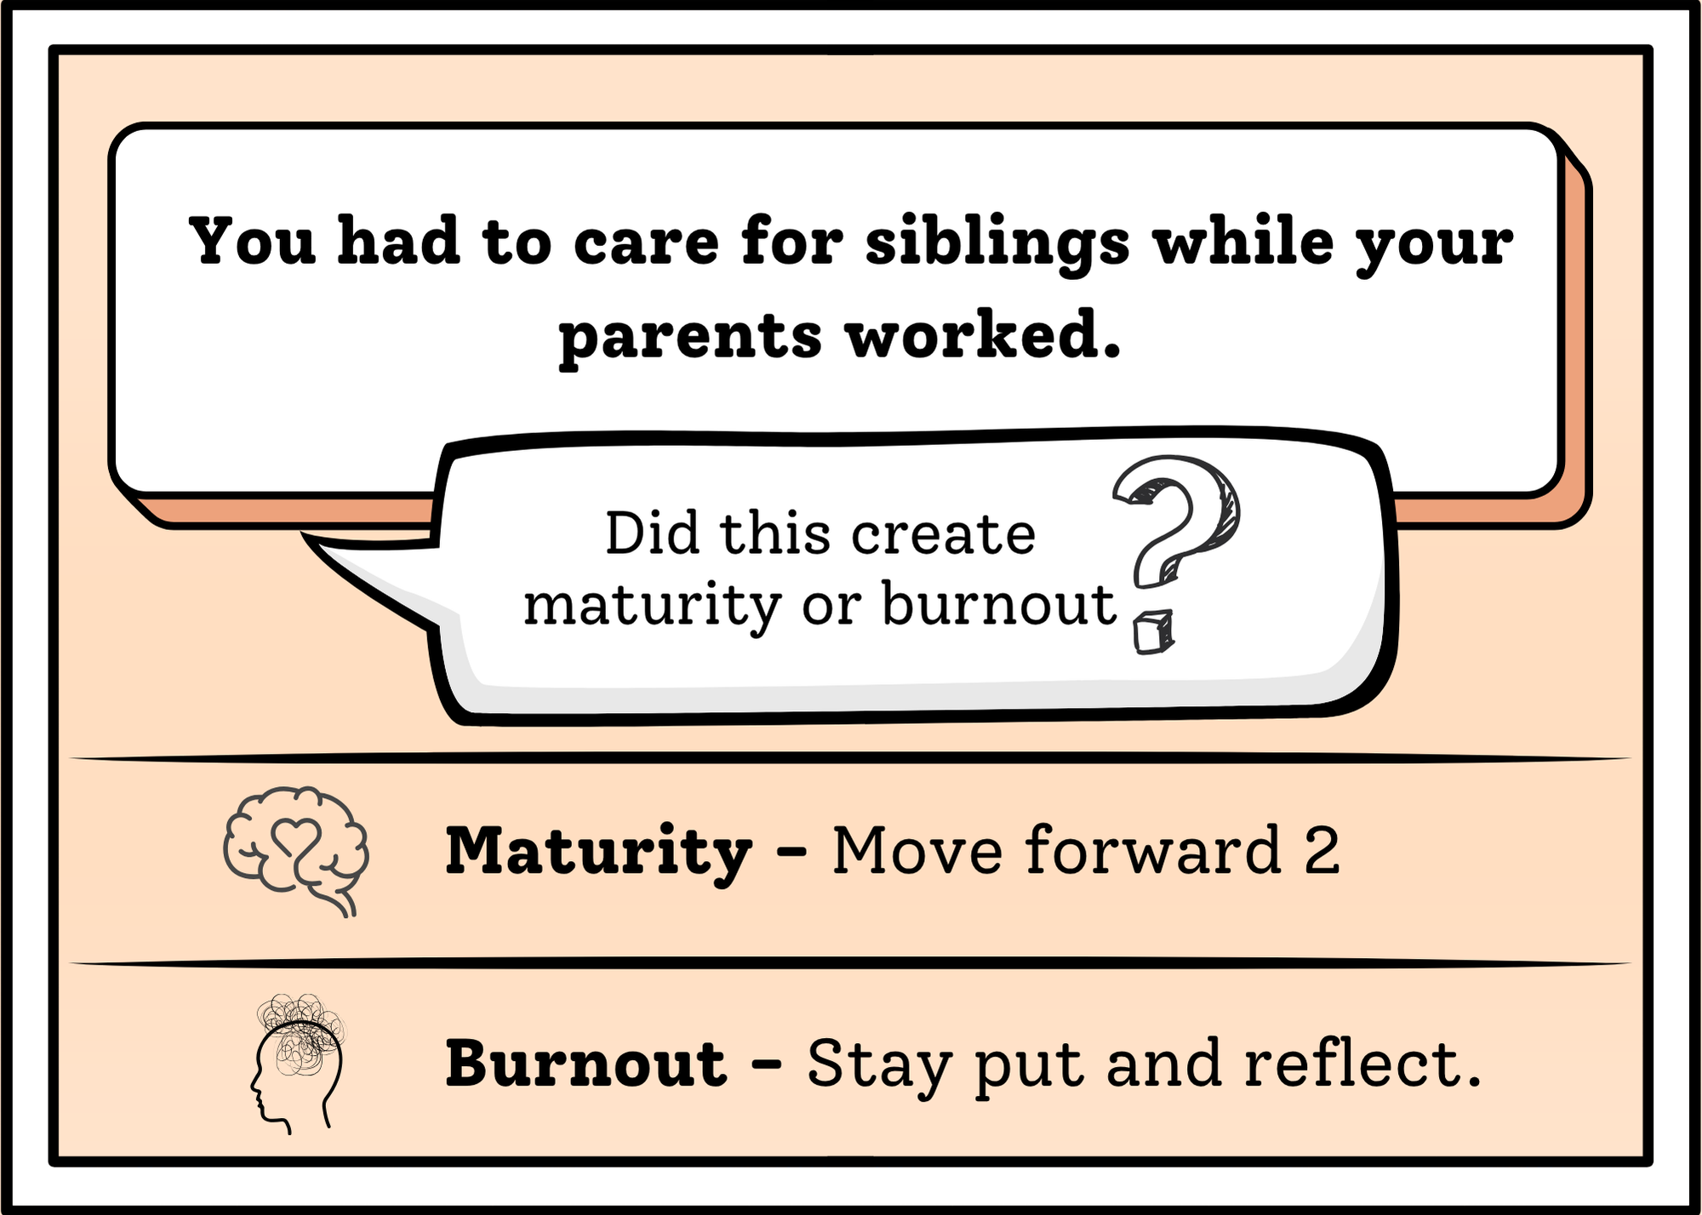
You Chose: card 5
Choose round

Slide 51
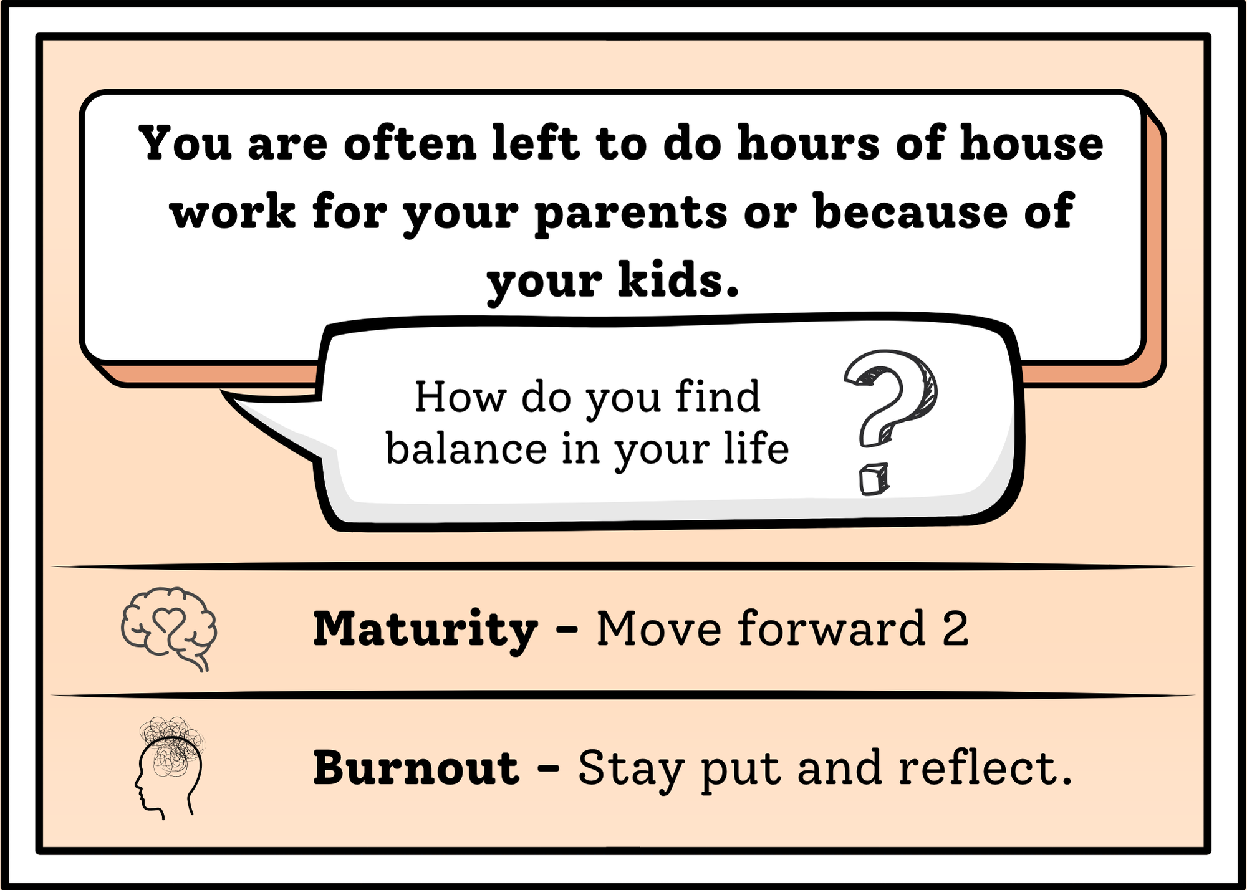
You Chose: card 6
Choose round

Slide 52
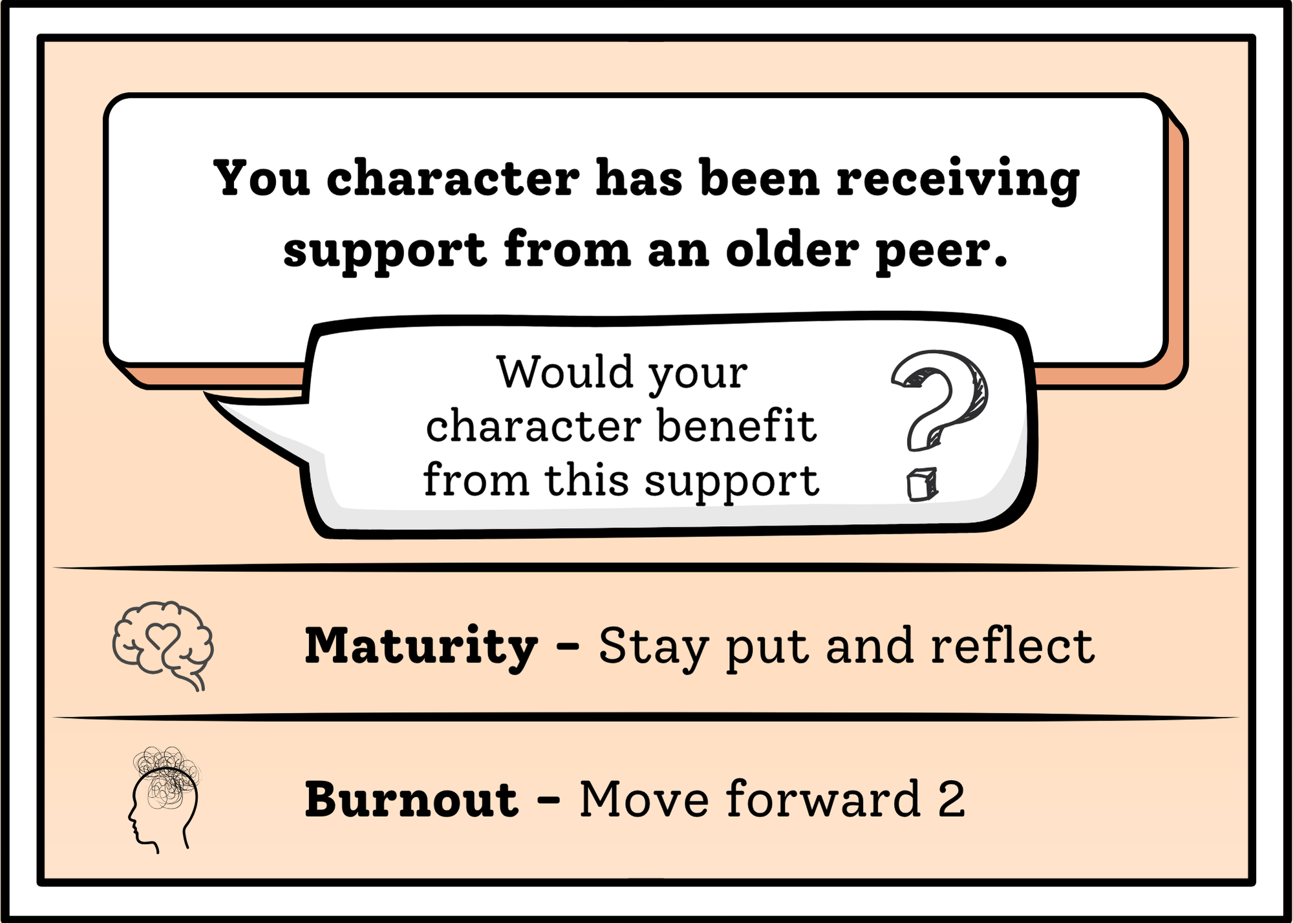
You Chose: card 7
Choose round

Slide 53
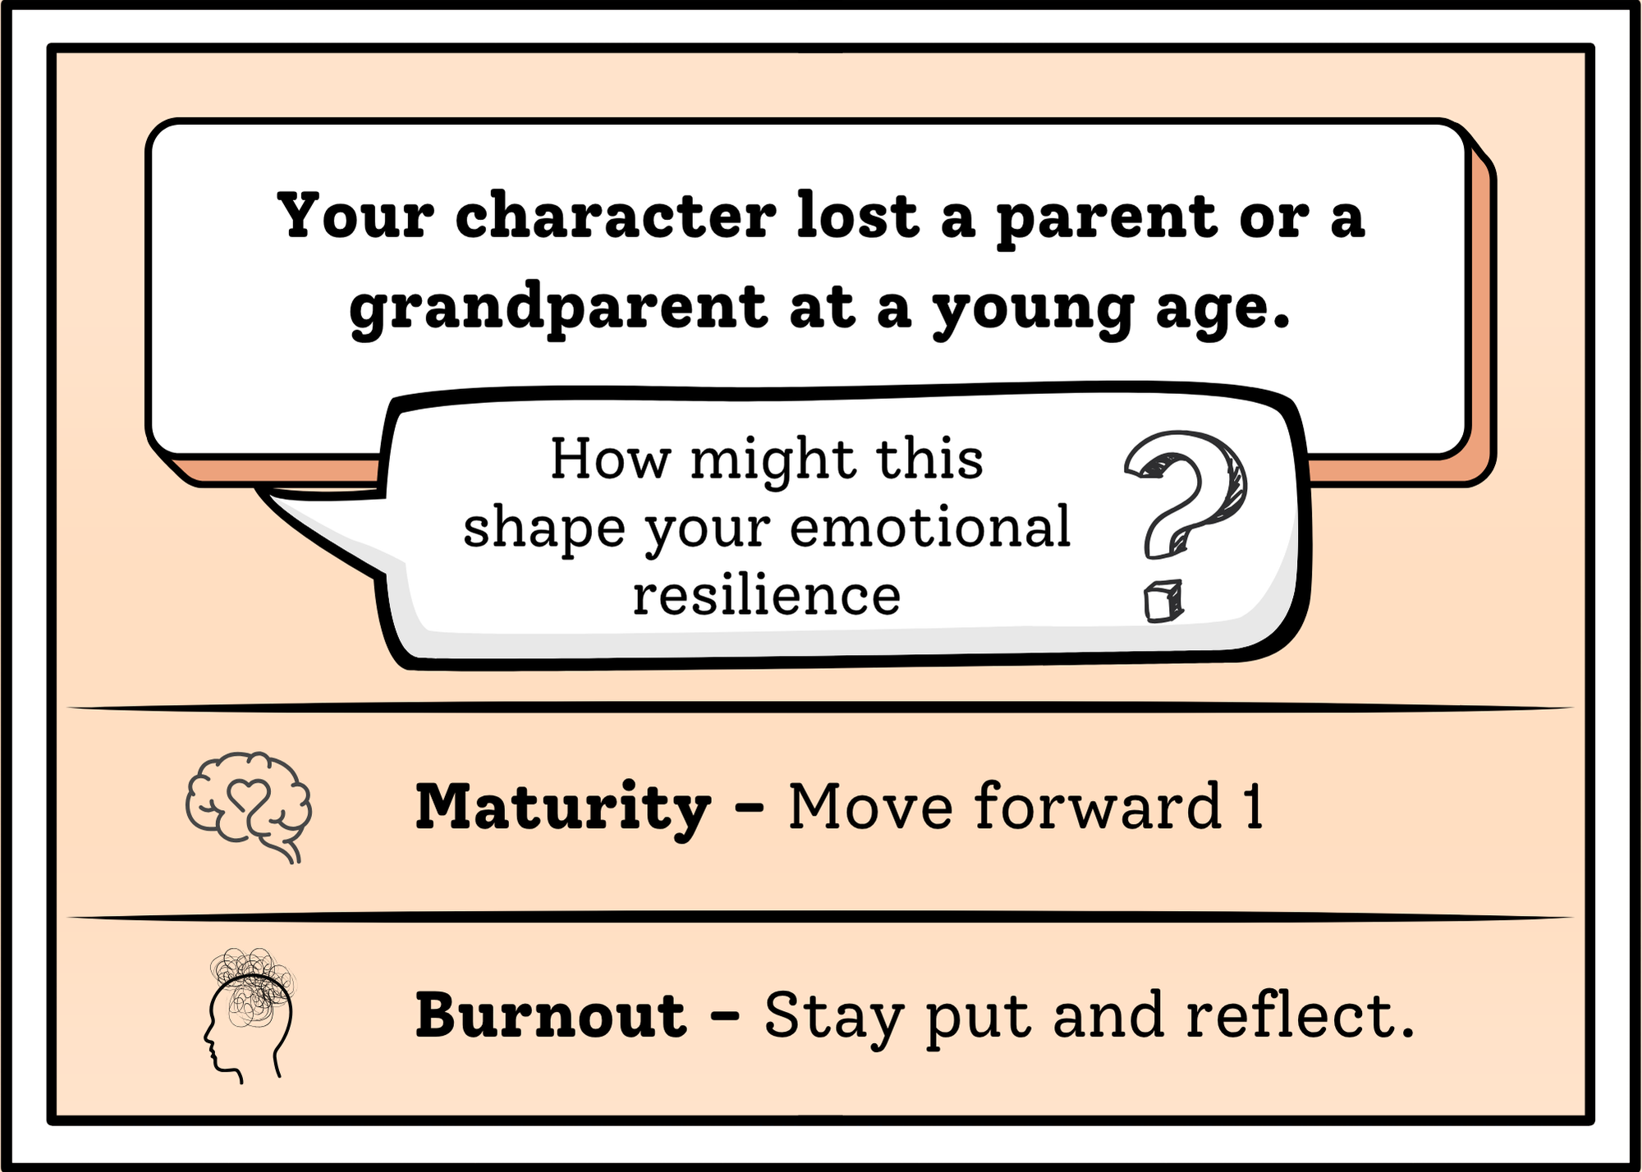
You Chose: card 8
Choose round

Slide 54

Round 5
Go!

Slide 55
round 5: Choose your Card!
1 2 3 4
5 6 7 8

Slide 56
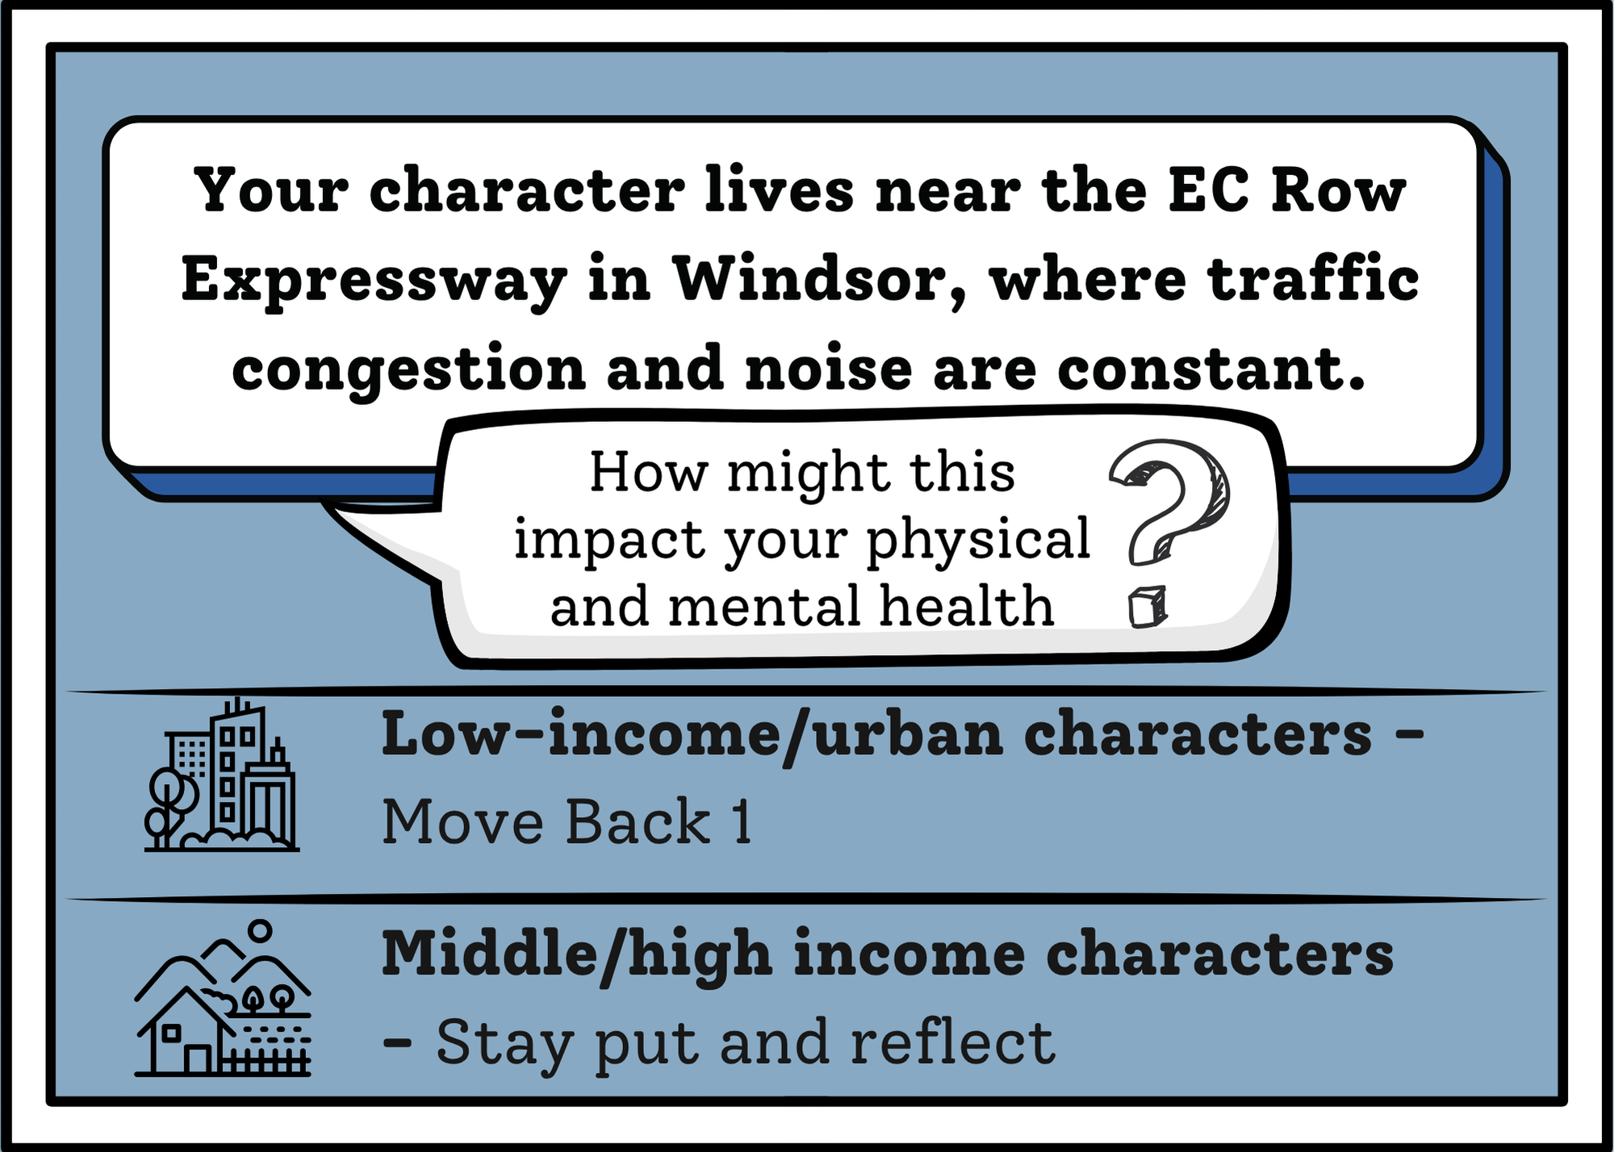
You Chose: card 1
Choose round

Slide 57
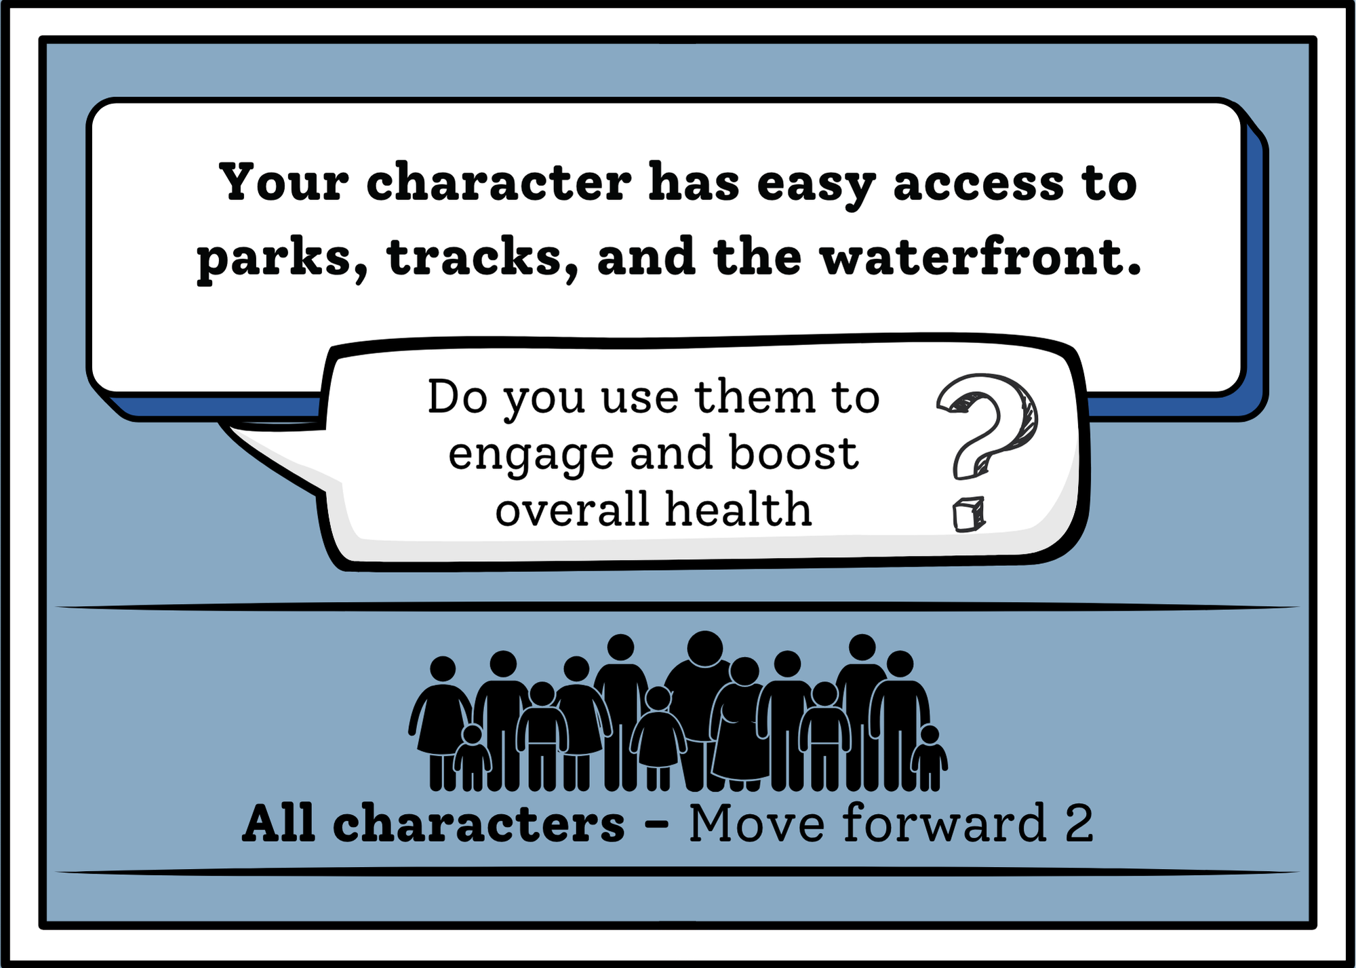
You Chose: card 2
Choose round

Slide 58
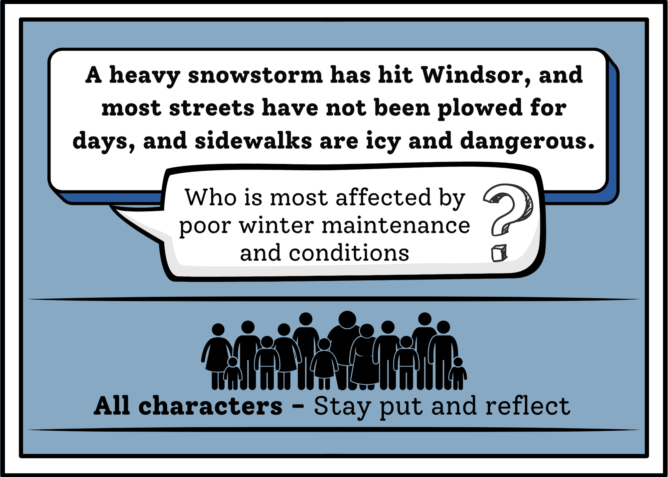
You Chose: card 3
Choose round

Slide 59
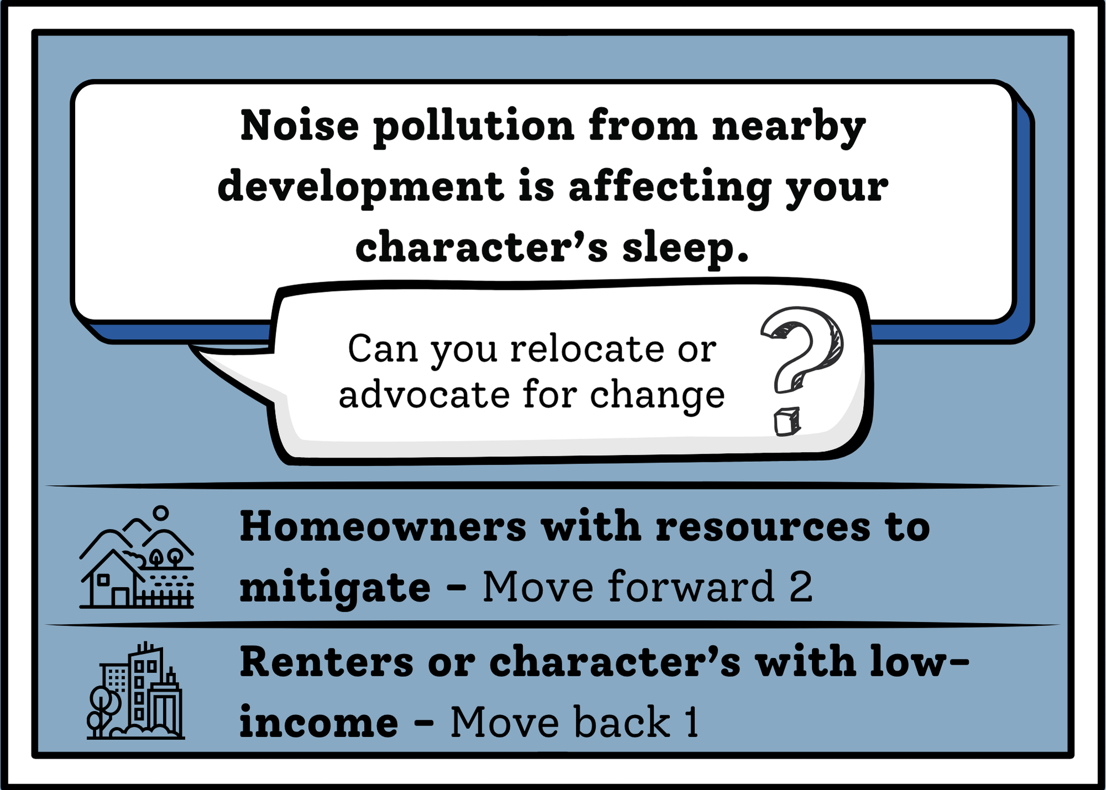
You Chose: card 4
Choose round

Slide 60
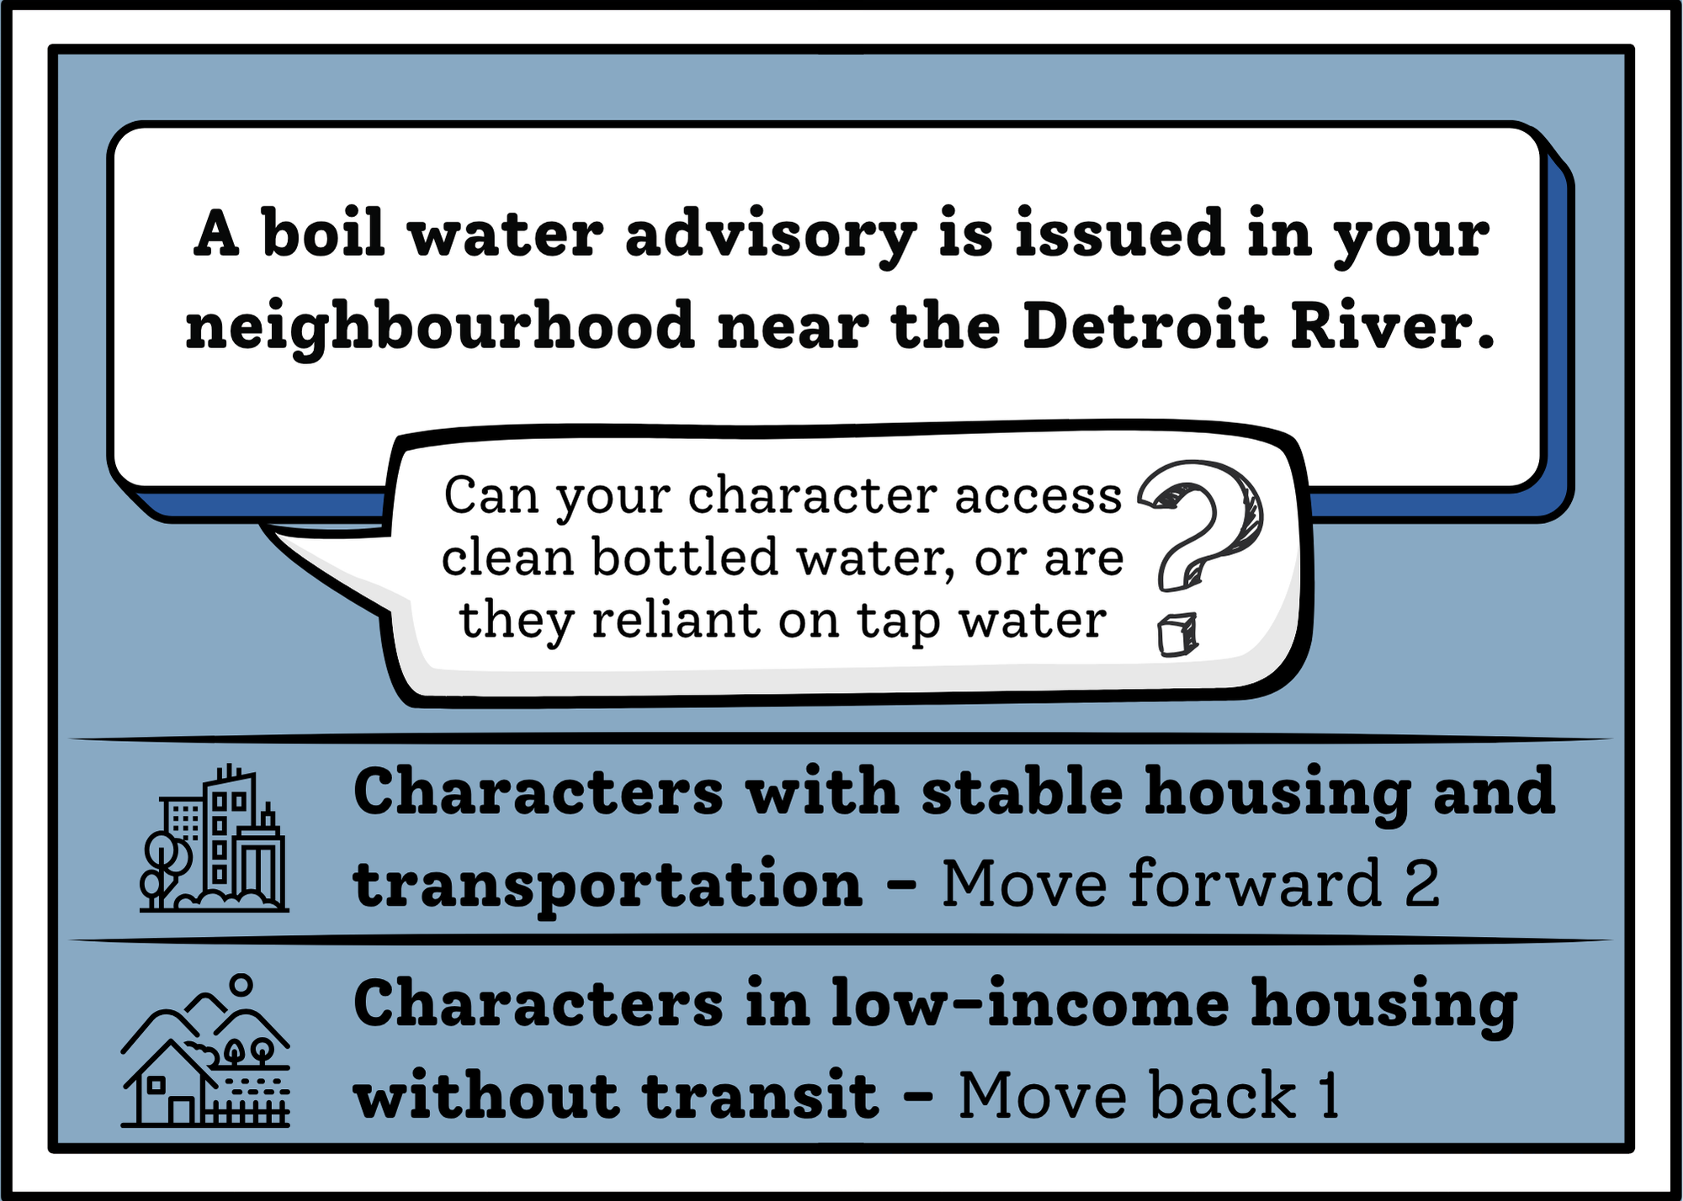
You Chose: card 5
Choose round

Slide 61
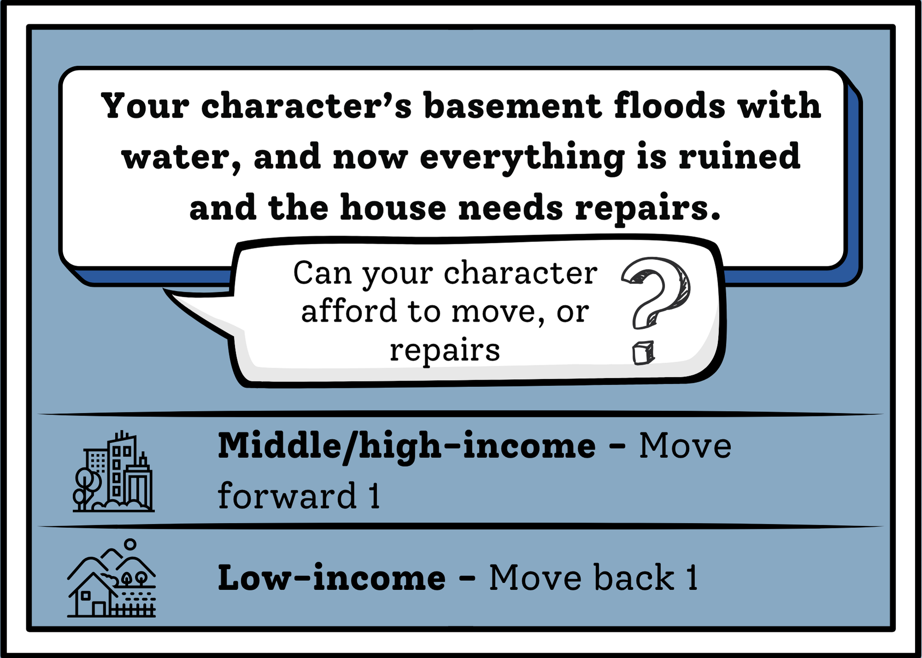
You Chose: card 6
Choose round

Slide 62

You Chose: card 7
Choose round

Slide 63

You Chose: card 8
Choose round

Slide 64

Round 6
Go!

Slide 65
Round 6: Choose your Card!
1 2 3 4
5 6 7 8

Slide 66

You Chose: card 1
Choose round

Slide 67

You Chose: card 2
Choose round

Slide 68

You Chose: card 3
Choose round

Slide 69

You Chose: card 4
Choose round

Slide 70

You Chose: card 5
Choose round

Slide 71

You Chose: card 6
Choose round

Slide 72

You Chose: card 7
Choose round

Slide 73

You Chose: card 8
Choose round

Slide 74

Round 7
Go!

Slide 75
Round 7: Choose your Card!
1 2 3 4
5 6 7 8

Slide 76

You Chose: card 1
Choose round

Slide 77

You Chose: card 2
Choose round

Slide 78

You Chose: card 3
Choose round

Slide 79

You Chose: card 4
Choose round

Slide 80

You Chose: card 5
Choose round

Slide 81

You Chose: card 6
Choose round

Slide 82

You Chose: card 7
Choose round

Slide 83

You Chose: card 8
Choose round

Slide 84

Round 8
Go!

Slide 85
Round 8: Choose your Card!
1 2 3 4
5 6 7 8

Slide 86

You Chose: card 1
Choose round

Slide 87

You Chose: card 2
Choose round

Slide 88

You Chose: card 3
Choose round

Slide 89

You Chose: card 4
Choose round

Slide 90

You Chose: card 5
Choose round

Slide 91

You Chose: card 6
Choose round

Slide 92

You Chose: card 7
Choose round

Slide 93

You Chose: card 8
Choose round

Slide 94

Round 9
Go!

Slide 95
Round 9: Choose your Card!
1 2 3 4
5 6 7 8

Slide 96

You Chose: card 1
Choose round

Slide 97

You Chose: card 2
Choose round

Slide 98

You Chose: card 3
Choose round

Slide 99

You Chose: card 4
Choose round

Slide 100

You Chose: card 5
Choose round

Slide 101

You Chose: card 6
Choose round

Slide 102

You Chose: card 7
Choose round

Slide 103

You Chose: card 8
Choose round

Slide 104

Round 10
Go!

Slide 105
Round 10: Choose your Card!
1 2 3 4
5 6 7 8

Slide 106

You Chose: card 1
Choose round

Slide 107

You Chose: card 2
Choose round

Slide 108

You Chose: card 3
Choose round

Slide 109

You Chose: card 4
Choose round

Slide 110

You Chose: card 5
Choose round

Slide 111

You Chose: card 6
Choose round

Slide 112

You Chose: card 7
Choose round

Slide 113

You Chose: card 8
Choose round

Slide 114

Round 11
Go!

Slide 115
Round 11: Choose your Card!
1 2 3 4
5 6 7 8

Slide 116

You Chose: card 1
Choose round

Slide 117

You Chose: card 2
Choose round

Slide 118

You Chose: card 3
Choose round

Slide 119

You Chose: card 4
Choose round

Slide 120

You Chose: card 5
Choose round

Slide 121

You Chose: card 6
Choose round

Slide 122

You Chose: card 7
Choose round

Slide 123

You Chose: card 8
Choose round

Slide 124

Round 12
Go!

Slide 125
Round 12: Choose your Card!
1 2 3 4
5 6 7 8

Slide 126

You Chose: card 1
Choose round

Slide 127

You Chose: card 2
Choose round

Slide 128

You Chose: card 3
Choose round

Slide 129

You Chose: card 4
Choose round

Slide 130

You Chose: card 5
Choose round

Slide 131

You Chose: card 6
Choose round

Slide 132

You Chose: card 7
Choose round

Slide 133

You Chose: card 8
Choose round

Slide 134

Thanks for playing!
Like what you see? Scan this QR code to give us feedback!
Without research, hope is just a word. Research allows us to continue to improve outcomes for patients and our community. Thank you for your support!

