Slide 1

Pursuit of
Knowledge
Systems of the Body
PLAY →
Notes:
Created by Krista Lucier.
HOW TO PLAY: Click through the buttons to learn about the systems of the body and to choose your cards. State your guess, then click “Answer”. If you get it right, click “Correct”, and if you get it incorrect, click “Incorrect”. Take pictures of your game pieces to keep track of your progress. Enjoy!

Slide 2
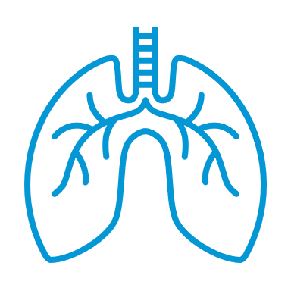
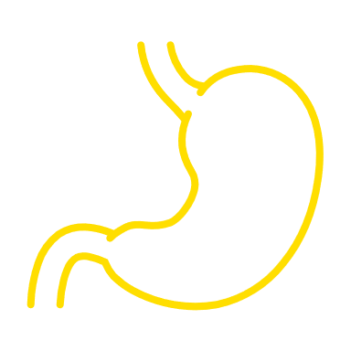
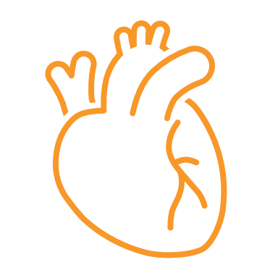
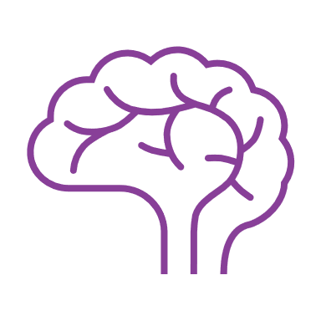
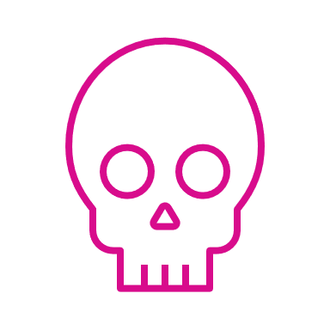
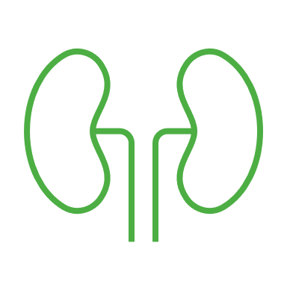
CATEGORIES
Respiratory
Digestive
Lungs – oxygen intake and gas exchange
Stomach, intestine – nutrient breakdown and absorption
Cardiovascular
Nervous
Heart – blood circulation and transport
Brain, spinal cord – signal control and communication
Musculoskeletal
Endocrine
Muscles, bones – stability, movement, and support
Glands – hormone production and regulation
START →

Slide 3
CHOOSE YOUR CATEGORY
Nervous
Musculoskeletal
Endocrine
Digestive
Cardiovascular
Respiratory
END GAME

Slide 4
Nervous System
1
2
3
4
5
6
7
8
9
10

Slide 5
1
The ____ lobe of the brain is responsible for processing sensory information, such as touch and spatial perception.
Parietal
Answer
Correct
Incorrect

Slide 6
2
The ____ is the part of the brain that is responsible for coordinating balance, posture, and precise muscle movements.
Cerebellum
Answer
Correct
Incorrect

Slide 7
3
The cells of the nervous system, called ____, transmit information through electrical signaling.
Neurons
Answer
Correct
Incorrect

Slide 8
4
The nervous system is divided into two main parts: (1) the ____ nervous system, which contains the brain and spinal cord, and (2) the peripheral nervous system, which contains the body’s large collection of nerves.
Central
Answer
Correct
Incorrect

Slide 9
5
The ____ is responsible for relaying messages between the brain and the rest of the body.
Spinal cord
Answer
Correct
Incorrect

Slide 10
6
The ____ is the part of the brain that connects the two hemispheres of the cerebrum.
Corpus callosum
Answer
Correct
Incorrect

Slide 11
7
The ____ is the part of the limbic system involved in memory.
Hippocampus
Answer
Correct
Incorrect

Slide 12
8
The ____ controls vital functions, such as heart rate, breathing, and reflexes.
Medulla oblongata
Answer
Correct
Incorrect

Slide 13
9
The protective covering of the nerve fibers is called ____, and is important for nerve signal transmission.
Myelin
Answer
Correct
Incorrect

Slide 14
10
Each nerve is made up of three components: the axon, the cell body, and the ____.
Dendrites
Answer
Correct
Incorrect

Slide 15
Correct!
Take this, you’ve earned it!
Back to Board

Slide 16

Incorrect…
Better luck next round!
Back to Board

Slide 17
Respiratory System
1
2
3
4
5
6
7
8
9
10

Slide 18
1
The tiny air sacs in the lungs where gas exchange takes place are called ____.
Alveoli
Answer
Correct
Incorrect

Slide 19
2
The ____ is the tube that carries air from the larynx to the lungs. It is commonly called the “windpipe”.
Trachea
Answer
Correct
Incorrect

Slide 20
3
The ____ is a muscle below the lungs that helps with breathing by contracting and relaxing.
Diaphragm
Answer
Correct
Incorrect

Slide 21
4
____ are air-filled cavities in the skull that connect to the nasal cavity.
Sinuses
Answer
Correct
Incorrect

Slide 22
5
The two main entry points for air into the respiratory system are the ____ and ____.
Mouth + nose
Answer
Correct
Incorrect

Slide 23
6
The ____ is also nicknamed the “voicebox”.
Larynx
Answer
Correct
Incorrect

Slide 24
7
The ____ is often simply referred to as the throat, which serves as a passageway for both air and food.
Pharynx
Answer
Correct
Incorrect

Slide 25
8
The two main airways branching from the trachea into the lungs are called the ____.
Bronchi
Answer
Correct
Incorrect

Slide 26
9
The small airways branching from the bronchi within the lungs are called the ____.
Bronchioles
Answer
Correct
Incorrect

Slide 27
10
The ____ serves as a lid, covering the opening of the trachea during swallowing to prevent food and liquids from entering the airway.
Epiglottis
Answer
Correct
Incorrect

Slide 28
Correct!
Take this, you’ve earned it!
Back to Board

Slide 29

Incorrect…
Better luck next round!
Back to Board

Slide 30
Digestive System
1
2
3
4
5
6
7
8
9
10

Slide 31
1
The ____ produces digestive enzymes and hormones, like insulin.
Pancreas
Answer
Correct
Incorrect

Slide 32
2
The ____ produces bile, which aids in fat digestion.
Liver
Answer
Correct
Incorrect

Slide 33
3
The ____ is an accessory organ, which stores and concentrates bile.
Gall bladder
Answer
Correct
Incorrect

Slide 34
4
The ____ is a muscular tube that pushes food to the stomach using a technique called peristalsis.
Esophagus
Answer
Correct
Incorrect

Slide 35
5
The ____ is the primary site of nutrient obsorption, further breaking down food with enzymes.
Small intestine
Answer
Correct
Incorrect

Slide 36
6
The ____ absorbs water and electrolytes, forming feces.
Large intestine
Answer
Correct
Incorrect

Slide 37
7
The ____ is a muscular organ that churns food and mixes it with digestive juices.
Stomach
Answer
Correct
Incorrect

Slide 38
8
____ is watery fluid produced in the mouth that aids in digestion.
Saliva
Answer
Correct
Incorrect

Slide 39
9
The three components of the small intestine are: the ____, jejunum, and ileum.
Duodenum
Answer
Correct
Incorrect

Slide 40
10
The role of the ____ is largely unknown, but it is connected to the large intestine and is often surgically removed.
Appendix
Answer
Correct
Incorrect

Slide 41
Correct!
Take this, you’ve earned it!
Back to Board

Slide 42

Incorrect…
Better luck next round!
Back to Board

Slide 43
Cardiovascular System
1
2
3
4
5
6
7
8
9
10

Slide 44
1
____ are a type of blood vessel that carry oxygenated blood away from the heart.
Arteries
Answer
Correct
Incorrect

Slide 45
2
____ are a type of blood vessel that carry deoxygenated blood back to the heart.
Veins
Answer
Correct
Incorrect

Slide 46
3
____ are tiny blood vessels involved in the exchange of oxygen, nutrients, and waste between the blood and the other tissues of the body.
Capillaries
Answer
Correct
Incorrect

Slide 47
4
The ____ is the main artery that carries blood away from your heart to the rest of your body
Aorta
Answer
Correct
Incorrect

Slide 48
5
The heart is made up of four chambers. The two at the top are called ____, which receive blood from the body.
Atria/left + right
atrium
Answer
Correct
Incorrect

Slide 49
6
The heart is made up of four chambers. The two at the bottom are called ____, which send blood towards the body.
Ventricles
Answer
Correct
Incorrect

Slide 50
7
The two main veins that return blood to the heart are the superior and inferior ____.
Vena cava
Answer
Correct
Incorrect

Slide 51
8
____ circulation occurs between the heart and lungs, where carbon dioxide is exchanged for oxygen.
Pulmonary
Answer
Correct
Incorrect

Slide 52
9
____ circulation occurs between the heart and the body, delivering oxygen and nutrients, and removing waste products.
Systemic
Answer
Correct
Incorrect

Slide 53
10
The cardiac cycle consists of two phases: ____, where blood is returned to the heart, and systole, where blood is returned to the body.
Diastole
Answer
Correct
Incorrect

Slide 54
Correct!
Take this, you’ve earned it!
Back to Board

Slide 55

Incorrect…
Better luck next round!
Back to Board

Slide 56
Musculoskeletal System
1
2
3
4
5
6
7
8
9
10

Slide 57
1
____ connect muscles to bones, transmitting the force of muscle contractions to the skeletal system.
Tendons
Answer
Correct
Incorrect

Slide 58
2
____ connect bones to other bones, providing stability to the joints.
Ligaments
Answer
Correct
Incorrect

Slide 59
3
____ is a specialized connective tissue that cushions and protects joint surfaces.
Cartilage
Answer
Correct
Incorrect

Slide 60
4
A ____ occurs when two or more bones meet, allowing for a range of motion.
Joint
Answer
Correct
Incorrect

Slide 61
5
____ muscle is found in the walls of internal organs like the stomach and intestines, and faciliate movements such as digestion and blood vessel contraction.
Smooth
Answer
Correct
Incorrect

Slide 62
6
____ muscles are attached to bones and are responsible for voluntary movements like walking and lifting.
Skeletal
Answer
Correct
Incorrect

Slide 63
7
The ____ is the largest bone in the human leg.
Femur
Answer
Correct
Incorrect

Slide 64
8
The ____ is the largest bone in the human arm. It is sometimes referred to as the “funny bone”.
Humerus
Answer
Correct
Incorrect

Slide 65
9
The three components of the spinal column from top to bottom are: the cervical spine, the ____ spine, and the lumbar spine, followed by the sacrum and coccyx at the very bottom.
Thoracic
Answer
Correct
Incorrect

Slide 66
10
Carpals, metacarpals, and ____ are the names for the small bones of the wrist and hand.
Phalanges
Answer
Correct
Incorrect

Slide 67
Correct!
Take this, you’ve earned it!
Back to Board

Slide 68

Incorrect…
Better luck next round!
Back to Board

Slide 69
Endocrine System
1
2
3
4
5
6
7
8
9
10

Slide 70
1
____ are chemical messengers that travel through the blood to target cells and tissues, influencing their activity.
Hormones
Answer
Correct
Incorrect

Slide 71
2
The ____ gland secretes hormones that regulate other endocrine glands. For this reason, it is often called the “master gland”.
Pituitary
Answer
Correct
Incorrect

Slide 72
3
The ____ gland is located in the neck, and produce hormones that control metabolism.
Thyroid
Answer
Correct
Incorrect

Slide 73
4
The ____ glands are located above the kidneys and produce stress hormones like cortisol and adrenaline.
Adrenal
Answer
Correct
Incorrect

Slide 74
5
The ____ produce estrogen and progesterone, which are crucial for female reproduction.
Ovaries
Answer
Correct
Incorrect

Slide 75
6
The ____ is part of the digestive system and produces insulin and glucagon to regulate blood glucose levels.
Pancreas
Answer
Correct
Incorrect

Slide 76
7
The ____ is located in the brain and links the nervous system to the endocrine system.
Hypothalamus
Answer
Correct
Incorrect

Slide 77
8
The ____ gland is located in the brain and produces melatonin, which regulates the sleep-wake cycle.
Pineal
Answer
Correct
Incorrect

Slide 78
9
The ____ produces testosterone, which is important for male reproductive function.
Testes
Answer
Correct
Incorrect

Slide 79
10
The ____ gland is located in the chest and produces hormones that affect the immune system.
Thymus
Answer
Correct
Incorrect

Slide 80
Correct!
Take this, you’ve earned it!
Back to Board

Slide 81

Incorrect…
Better luck next round!
Back to Board

Slide 82
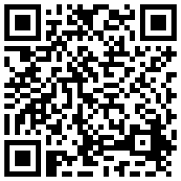
for
Like what you see? Scan this QR code to give us feedback!
Without research, hope is just a word. Research allows us to continue to improve outcomes for patients and our community. Thank you for your support!
Thanks
Playing!

