Slide 1
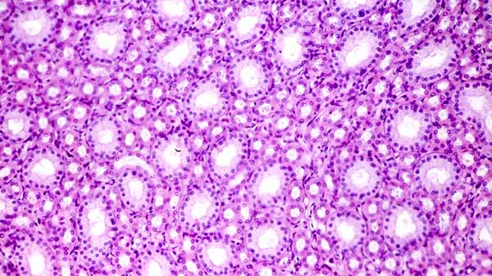
Learn to be a PATHOLOGIST
Notes:
Creators: Mitchell Elliott & Marisa Market
Adapted by: Krista Lucier.

Slide 2
What is a Pathologist?
A pathologist is a physician who studies the causes, nature, and effects of disease by looking at bodily fluids and tissues.
Some examples of things they do are:
Conduct blood investigations to identify blood disorders or cancers,
Analyze Pap smears and biopsies to check for unhealthy cells,
Perform autopsies to determine a patient's cause of death.
Their expertise is crucial in ensuring patients receive an accurate diagnosis! This is important in determining whether a tissue is normal or cancerous.

Slide 3
Determining Pathology
In this activity, you will have the opportunity to act as a pathologist! In each challenge, you will be given two tissue slides, and it will be your job to determine which one is normal, and which one is cancerous.
Here are some tips to help you succeed in this activity…

Slide 4
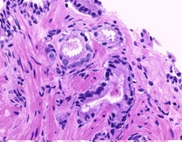
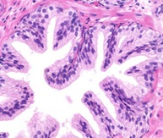
Tip #1: Distinct Structures
Healthy tissues have distinct structures to carry out the specific functions of that tissue (e.g., circular shapes in a healthy ovary are developing eggs).
If you notice these structures, you are likely looking at a healthy version of the tissue.

Slide 5
Tip #2: “Messy” Cells
Since cancer is a disease of uncontrolled cell growth, you may not see distinct, specialized structures.
You are more likely to see a "messy" tissue that doesn't seem to have much uniformity.

Slide 6
Tip #3: Many Nuclei
Due to the rapid overgrowth of cancer cells, it is common to see many nuclei in a cancerous tissue (i.e., stained as dark dots in the slide).
Each nuclei represents one cell. The more nuclei present, the more cells present.

Slide 7
Tip #4: White Areas
Any white areas in the tissue indicates that area is free of cell growth.
If you see white, think "these cells grew in an anticipated and controlled way".

Slide 8
Tip #5: Defined Borders
Clear, defined borders are typical of healthy tissues, not cancerous ones.
That was our final tip… so, let’s get pathologizing! →

Slide 9
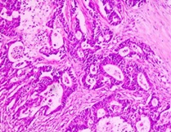
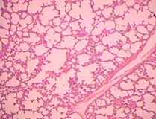
Which of the following is lung cancer?

Slide 10
Sorry – that’s incorrect!
Keep an eye out for patterns or specialized structures in the tissues – these won’t be present in cancerous cells.
← Try again
Move on →

Slide 11
Correct! Well done ☺
← Go back
Continue →

Slide 12
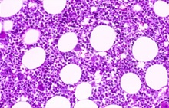
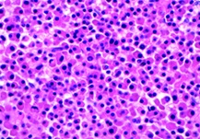
Which of the following is bone cancer?

Slide 13
Sorry – that’s incorrect!
Note: We wouldn't expect cancer to leave empty spaces. Instead, we would expect it to grow out of control, in all directions possible!
← Try again
Move on →

Slide 14
Correct! Well done ☺
← Go back
Continue →

Slide 15
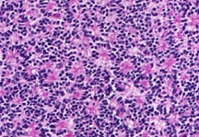
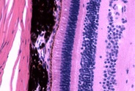
Which of the following is eye cancer?

Slide 16
Sorry – that’s incorrect!
Keep an eye out for "messy" looking tissues - that's a good place to start when determining which one is cancerous.
← Try again
Move on →

Slide 17
Correct! Well done ☺
← Go back
Continue →

Slide 18
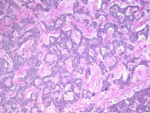
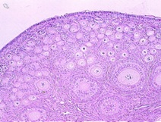
Which of the following is ovarian cancer?

Slide 19
Sorry – that’s incorrect!
Notice here there are clear, defined borders in the healthy tissue. We can also see circular shapes of various sizes within the ovary.
← Try again
Move on →

Slide 20
Correct! Well done ☺
← Go back
Continue →

Slide 21
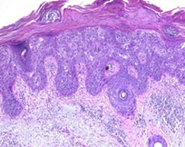
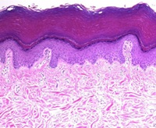
Which of the following is skin cancer?

Slide 22
Sorry – that’s incorrect!
Pay attention to the organization of the structures. Remember, cancer is an unorganized growth of cells that disrupts functionality of surrounding cells!
← Try again
Move on →

Slide 23
Correct! Well done ☺
← Go back
Continue →

Slide 24
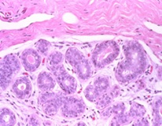
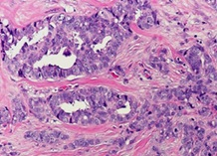
Which of the following is breast cancer?

Slide 25
Sorry – that’s incorrect!
In healthy tissue, you should observe specific structures to carry out specific functions/tasks. These structures aren’t as easily seen in cancerous tissue.
← Try again
Move on →

Slide 26
Correct! Well done ☺
← Go back
Continue →

Slide 27
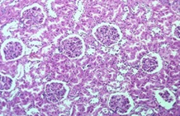
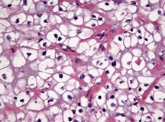
Which of the following is kidney cancer?

Slide 28
Sorry – that’s incorrect!
Remember, cancer will disrupt uniformity/structure that a tissue may have. If you notice repeated patterns or shapes, you are likely looking at the healthy sample.
← Try again
Finish →

Slide 29
Correct! Well done ☺
← Go back
Finish →

Slide 30
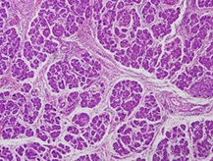
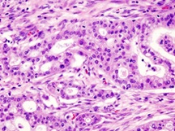
Which of the following is pancreatic cancer?

Slide 31
Sorry – that’s incorrect!
Remember, cancer will disrupt uniformity/structure that a tissue may have. If you notice repeated patterns or shapes, you are likely looking at the healthy sample.
← Try again
Move on →

Slide 32
Correct! Well done ☺
← Go back
Continue →

Slide 33
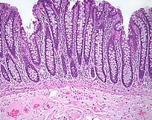
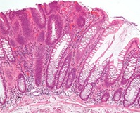
Which of the following is colon cancer?

Slide 34
Sorry – that’s incorrect!
Cancer tends to disrupt specialized structures with its overgrowing cells! Looking for patterns is a good place to start when trying to determine which tissue is healthy.
← Try again
Move on →

Slide 35
Correct! Well done ☺
← Go back
Continue →

Slide 36
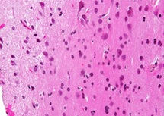
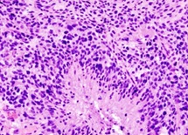
Which of the following is brain cancer?

Slide 37
Sorry – that’s incorrect!
Note: Dark dots represent the nuclei of cells present in that area. Since cancer is our cells growing out of control, we would expect more nuclei.
← Try again
Move on →

Slide 38
Correct! Well done ☺
← Go back
Continue →

Slide 39
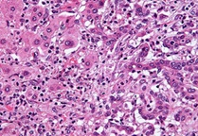
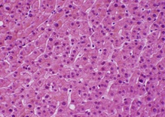
Which of the following is liver cancer?

Slide 40
Sorry – that’s incorrect!
Try to identify the tissue that looks "messy" versus the tissue that looks more organized and uniform. The messy tissue is likely to be cancerous.
← Try again
Move on →

Slide 41
Correct! Well done ☺
← Go back
Continue →

Slide 42
Thanks for practicing your pathology skills with us!
Like what you see? Scan the QR code below to give us feedback!
Without research, hope is just a word. Research allows us to continue to improve outcomes for patients and our community. Thank you for your support!
Notes:
Creators: Mitchell Elliott & Marisa Market
Adapted by: Krista Lucier.

