Slide 1


Cystic Fibrosis
Community Outreach
Activity
START →
Notes:
Created by Dr. Paula Van Wyk, Adapted by Krista Lucier
HOW TO PLAY: Click through the buttons to learn about cystic fibrosis, then take the enzyme quiz! Make your guess for how many enzymes are required, then click the image to reveal the answer. Have fun!

Slide 2
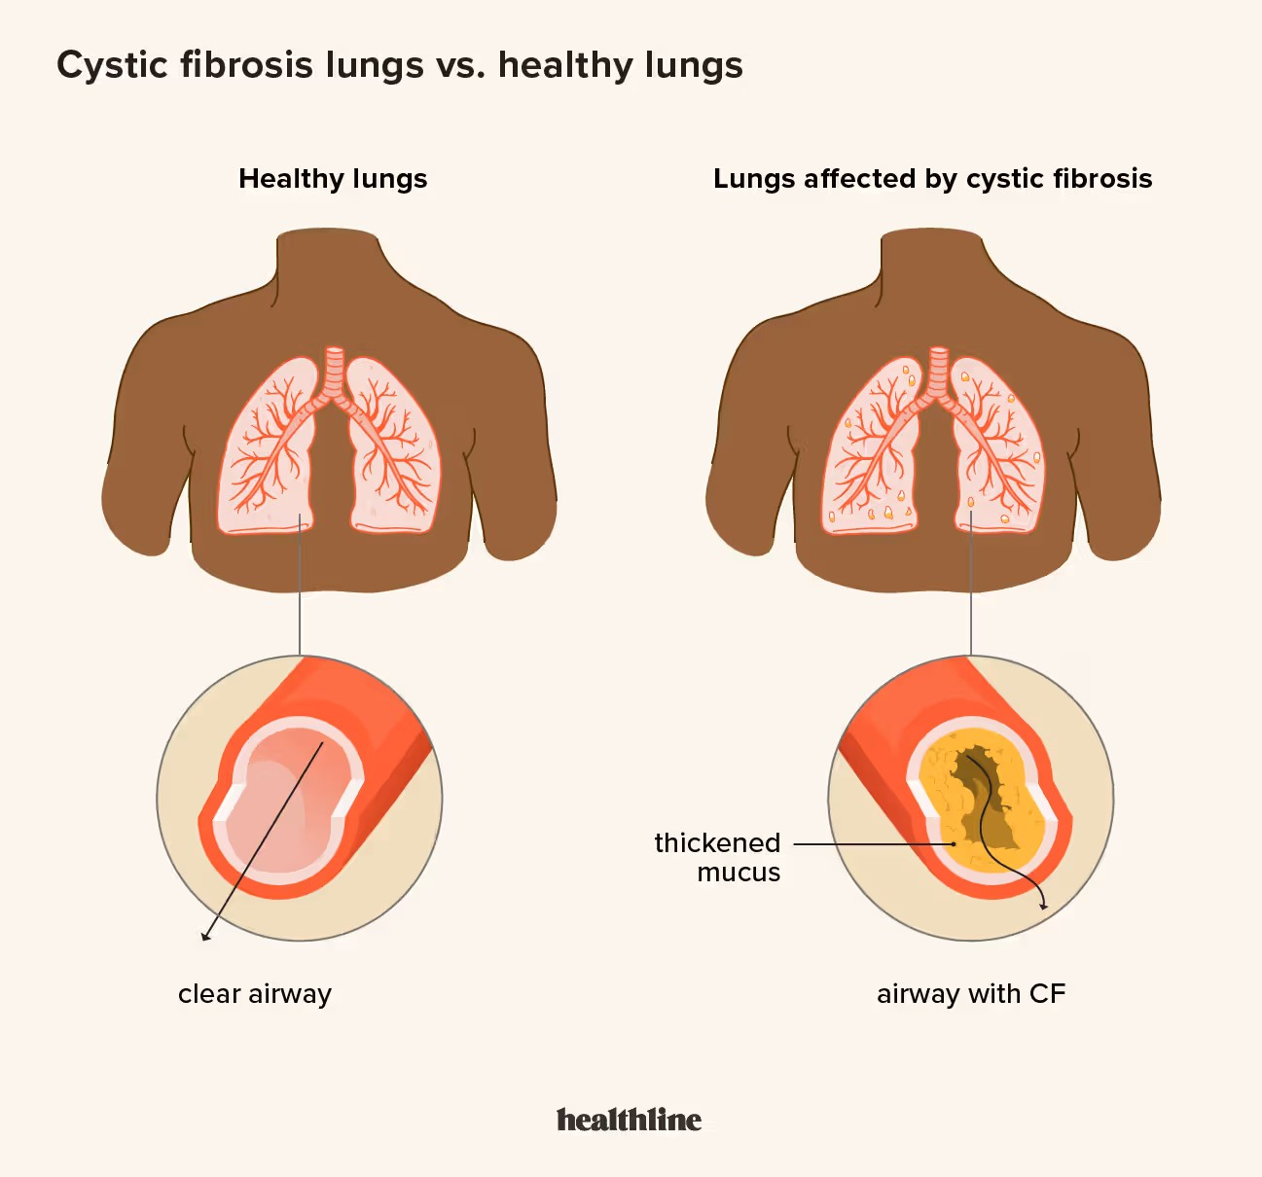
What is Cystic Fibrosis (CF)?
Cystic fibrosis (CF) is a genetic disorder that affects the lungs, pancreas, and other organs
In people with CF, gene mutations stop the movement of chloride (a component of salt) to the cell surface
Without the chloride to attract water to the cell surface, the mucus in various organs becomes thick and sticky, and the skin becomes very salty
NEXT →

Slide 3
CF and Enzymes
In the lungs…
In the pancreas…
The mucus clogs the airways and traps germs, leading to infections and inflammation, which can then lead to respiratory failure and other complications
In the pancreas, the buildup of mucus blocks the release of enzymes the body needs to absorb food and nutrients, resulting in malnutrition and poor growth
Because of this…
Most people with CF need to take enzymes when they eat
NEXT →

Slide 4

Enzymes
Digest carbohydrates, proteins, and fats
Gain and maintain a healthy weight
Absorb vitamins and minerals
Enzymes help you to…
In general, your body needs more enzymes to digest foods that are high in fat than foods that are high in carbohydrate. Enzymes are not needed for foods that contain only sugar.
NEXT →

Slide 5

How Many Enzymes?
Community Outreach
Activity
PLAY →

Slide 6
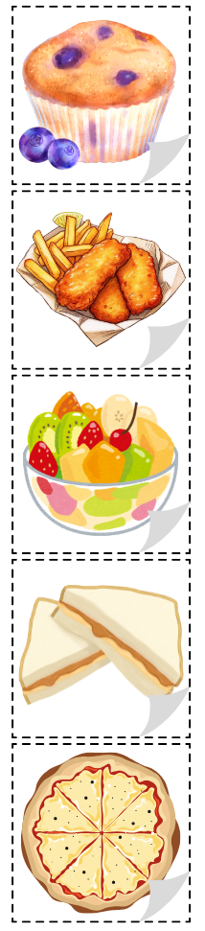
How Many Enzymes?
Note: The answers can depend on the person and the type of enzyme – the answers given here are the typical answers for someone who takes Creon.
In general, the equation is 1 Creon for 5-10 grams of fat.
1-3
1 blueberry muffin
2-4
4 chicken nuggets and fries
NEXT →

Slide 7
How Many Enzymes?
0
1 bowl of fruit salad
2-5
1 peanut butter sandwich
1-2
1 slice of cheese pizza
NEXT →

Slide 8
How Many Enzymes?
BONUS!
140
(click to find out why!)
The average person with Cystic Fibrosis can take an average of 20 enzymes per day depending on age and type of enzyme.
20 x 7 = 140!
How many enzymes constitute a typical week’s worth?
Note: Each day can be different and depends on what the person is eating – this is just an average estimate.
?
NEXT →

Slide 9
Local Events
Community Outreach
Activity
NEXT →

Slide 10


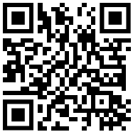
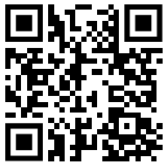



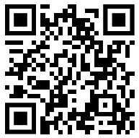
Local CF Events
Superheroes Unite
The Royal Ball
Jack’s Java
Walk to Make CF History
FINISH →

Slide 11
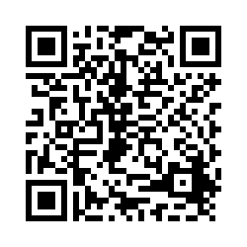
Thanks for Playing!
Like what you see? Scan this QR code to give us feedback!
Without research, hope is just a word. Research allows us to continue to improve outcomes for patients and our community. Thank you for your support!

