Slide 1

Notes:
Created by Jacob Bender
Adapted by Krista Lucier
Last Updated: 2025-07-09

Slide 2
We-spark health institute - Cancer TRIVIA
Cancer biology
Cancer prevention
Cancer treatment
Cancer statistics
Cancer research
Cancer pathology
$200
$200
$200
$200
$200
$200
$400
$400
$400
$400
$400
$400
$600
$600
$600
$600
$600
$600
$800
$800
$800
$800
$800
$800
$1000
$1000
$1000
$1000
$1000
$1000
Final jeopardy

Slide 3
The difference between a benign and malignant tumour
Cancer biology · $200
Answer: Benign is non-cancerous, malignant is cancerous

Slide 4
The term used to explain the spread of cancer to other sites or organs in the body
Cancer biology · $400
Answer: Metastasis

Slide 5
The general term for tumours that are composed of cells of epithelial origin
(Hint: breast, prostate, lung, colon, skin)
Cancer biology · $600
Answer: Carcinoma

Slide 6
The general term for tumours made up of cells of the connective tissue
(Hint: bone, cartilage, fat)
Cancer biology · $800
Answer: Sarcoma

Slide 7
The term used for tumours in the cells of the blood or bone marrow
Cancer biology · $1000
Answer: Leukemia

Slide 8
One preventative measure recommended to protect against skin cancer
Cancer prevention · $200
Answer: Lower sun exposure
OR sunscreen

Slide 9
The relationship between alcohol consumption and cancer
Cancer prevention · $400
Answer: Direct relationship (overconsumption is a risk factor)

Slide 10
One way to lower the risk of cancer, which also contributes to better heart health and overall well-being
Cancer prevention · $600
Answer: Regular exercise, no smoking, OR reduce stress

Slide 11
The cancer screening recommended for all men over the age of 50
Cancer prevention · $800
Answer: Prostate exam

Slide 12
The cancer screening recommended for all women over the age of 40
Cancer prevention · $1000
Answer: Mammogram

Slide 13
This type of treatment usually involves an incision of the skin and removal of the cancerous tissue. It offers the greatest chance for a cure if cancer has not spread.
Cancer treatment · $200
Answer: Surgery

Slide 14
This type of treatment uses high-energy particles or waves to destroy or damage cancerous cells. It is one of the most common forms of cancer treatment.
Cancer treatment · $400
Answer: Radiation therapy

Slide 15
This treatment uses drugs or medicines to treat cancer, which can also cause side effects. It is often paired with another form of treatment.
Cancer treatment · $600
Answer: Chemotherapy
Notes:
Chemotherapy

Slide 16
This type of treatment uses the body’s immune system to fight off cancerous cells.
Cancer treatment · $800
Answer: Immunotherapy

Slide 17
If a patient has prostate cancer which has not spread, this treatment would be the most effective at eliminating the identified cancerous cells.
Cancer treatment · $1000
Answer: Surgical removal of the prostate

Slide 18
The leading cause of death among Canadians
Cancer Statistics · $200
Answer: Cancer
Notes:
Still correct as of 2025-07-09

Slide 19
The cancer that causes the greatest number of deaths per year in Canada
(Hint: same for males and females)
Cancer Statistics · $400
Answer: Lung cancer
Notes:
Still correct as of 2025-07-09

Slide 20
The most commonly diagnosed cancer in Canadian men
Cancer Statistics · $600
Answer: Prostate cancer
Notes:
Still correct as of 2025-07-09

Slide 21
The second most commonly diagnosed cancer in Canadian women
Cancer Statistics · $800
Answer: Breast cancer
Notes:
Still correct as of 2025-07-09

Slide 22
The reason cancer research is so important
Cancer Statistics · $1000
Answer: To find a cure
(and save over 80,000 Canadian lives each year!)
Notes:
Still correct as of 2025-07-09

Slide 23
The name of a model organism that is used in cancer research that might “bug” you
Cancer research · $200
Answer: Fruit fly

Slide 24
The type of fish used as a model organism in cancer research
Cancer research · $400
Answer: Zebrafish

Slide 25
The most common and significant model organism used in cancer research
Cancer research · $600
Answer: Mouse

Slide 26
All model organisms used in cancer research have their ________ sequenced
Cancer research · $800
Answer: Genomes/DNA

Slide 27
The type of research that connects basic cancer research to clinical cancer research
Cancer research · $1000
Answer: Translational research

Slide 28
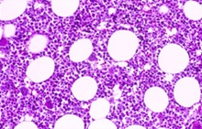
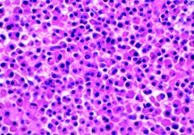
What type of cancer is shown on the right?
Cancer pathology · $200
Answer: Bone cancer

Slide 29
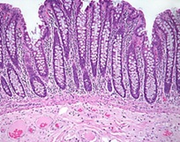
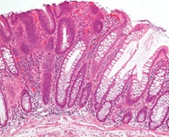
What type of cancer is shown on the right?
Cancer pathology · $400
Answer: Colon cancer

Slide 30
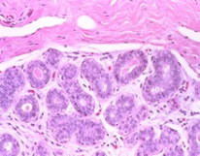
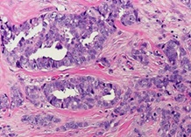
What type of cancer is shown on the right?
Cancer pathology · $600
Answer: Breast cancer

Slide 31
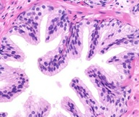
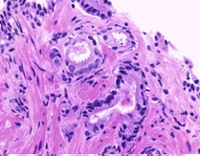
What type of cancer is shown on the right?
Cancer pathology · $800
Answer: Prostate cancer

Slide 32
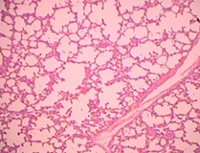
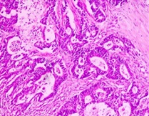
What type of cancer is shown on the right?
Cancer pathology · $1000
Answer: Lung cancer

Slide 33
The most well-known cancer drug
(Hint: it is derived from a tree)
Final jeopardy
Answer: Taxol

Slide 34


Like what you see? Scan this QR code to give us feedback!
Without research, hope is just a word. Research allows us to continue to improve outcomes for patients and our community. Thank you for your support!
Thanks for playing!
Notes:
Created by Jacob Bender, Adapted by Krista Lucier

